Slide 1
Kansas Water Plan Implementation
Kansas Water Authority
August 2024

Slide 2
Shifting from Vision to Implementation
Hundreds of Kansans provide input for the Kansas Water Plan
2022 Kansas Water Plan Released Creating a Vision for Kansas
Governor & Bipartisan Legislators support funding the Water Plan
2024 Summer Local Consult input on implementation (part 1)
2024 Fall Local Consult: to discuss implementation (part 2)
Notes:
Vijay transitions to Julie.

Slide 3
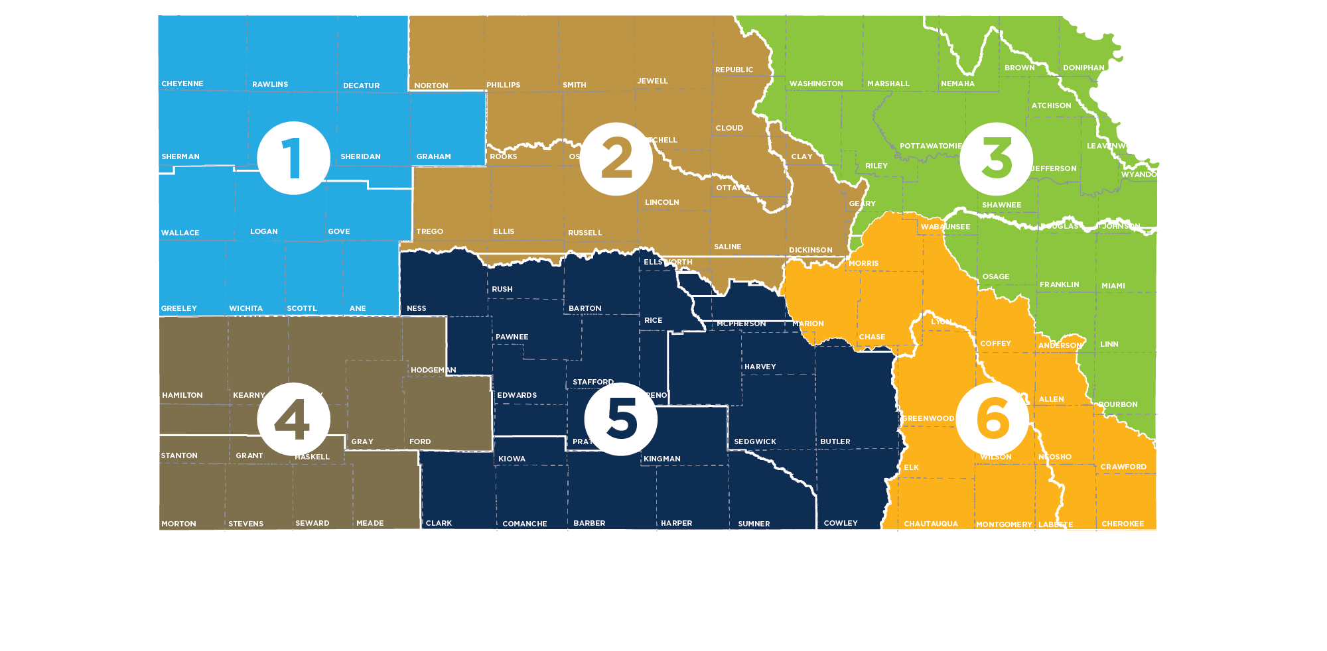
600+ People Participated Across 6 Regional Meetings
55+
80+
150+
Northwest
90+
135+
90+
Notes:
Julie

Slide 4
Summer Local Consult Participants Profile
Notes:
About 13% of our participants were from the ag industry but we wanted to increase the amount of input we’re getting from all of you which is why we’ve arranged this webinar today.

Slide 5
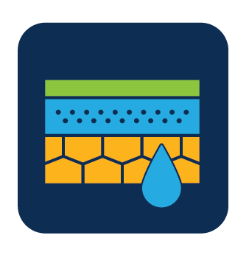
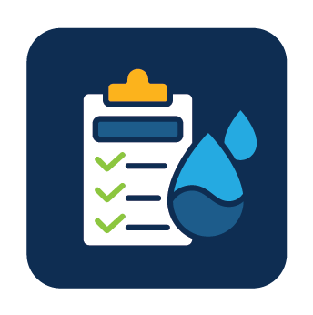
Kansas Water Plan Vision: 5 Guiding Principles
4. Reduce Our Vulnerability to Extreme Events
5. Increased Awareness of Kansas Water Resources
Embedded within these 3.
Conserve and Extend the High Plains Aquifer
Secure, Protect and Restore Our Kansas Reservoirs
Improve the State’s Water Quality
We are organizing around the big 3
Notes:
Vijay

Slide 6
Input Sought in These 3 Areas at the Meetings
1
2
3
Regional Goals
Where is there alignment within your region and across the state?
Investment Prioritization
Why do you value investments in one Guiding Principle over another if forced to choose?
Performance
How are we managing water in the state? Where could we improve our programs?
Finding Summary: Strong agreement on the goals
Will share highlights of these today
Notes:
Julie

Slide 7
Investment Scenario Menu & Feedback
Make major water usages (irrigation, feedlots, municipal systems) more efficient through technology upgrades/reuse systems | Sediment reduction increasing storage capacity at reservoirs | Infrastructure grants to communities to improve water and sewer systems to save water and meet health compliance standards
Enhanced monitoring of water conditions lets us track usage better and make effective decisions | Protecting watersheds prevents sediment from reaching the reservoirs | Protecting watersheds from pollution and stormwater runoff
 |  | Addressing nitrates in drinking water and groundwater
 |  | Regional interconnection projects connect communities to multiple water sources
Local Consult Participants Rejected: Limiting water usage by the State purchasing (large-scale) water rights.
Aquifer
Reservoir
Water Quality
Notes:
Reservoir & sediment reduction—always important to emphasize with agriculture that this is as much about making sure inputs stay on the fields where they have the best return on investment.
This also tends to include funding for agricultural practices & technology that help farmers improve yields by updating their equipment & tech.

Slide 8
Investment Scenario with Strongest Support
Aquifer
Tie
Reservoir
Water Quality
Notes:
Julie

Slide 9
Takeaways related to the Big 3 Guiding Principles
Aquifer: Strong support for about the need to reach sustainability of High Plains Aquifer by using multiple tools like irrigation technologies, cropping practices, water reuse
Reservoir: Strong support for keeping our reservoir water supplies viable for generations through using in-lake and upstream techniques to reduce sedimentation
Water Quality: Strong support for improving water quality across Kansas by improving our water infrastructure
Notes:
Julie

Slide 10
Consensus Overarching Takeaways from Kansans
We have serious water challenges and the time to act is now.
We have a vision, now is time for implementation.
We are all connected by our water issues, what happens in the western portion of the state impacts the east and vice versa.
Clean, secure, accessible water is an economic necessity.
Local input to inform decisions is critical.
Notes:
Julie

Slide 11
Kansans' suggestions for how we can improve…
Streamline state agency water programs to make them easier to use and more efficient
Implement a more proactive approach to water infrastructure projects
Increase awareness of the immediate need to conserve water in portions of the state
Addressing shortages of staff and building additional expertise at state agencies
Need a sustainable investment strategy that will last several generations
Notes:
Julie

Slide 12
Ag Industry Webinar Takeaways
Additional Stakeholder Outreach following Summer Local Consult

Slide 13
200+ Participants in the Ag Webinar

Slide 14
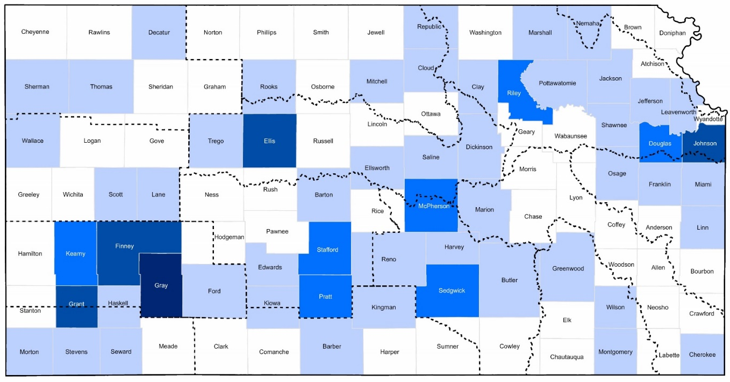
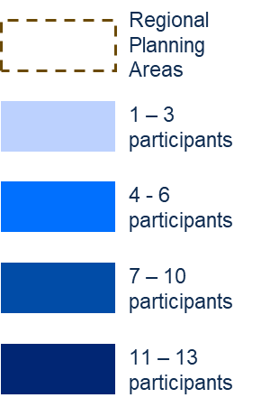
Geographical Location of Participants

Slide 15
Majority of grain producers want their children or grandchildren to take over their operation

Slide 16
Purpose of the webinar
Local consult meetings held during harvest in portions of the state making it difficult for producers to participate.
Webinar offered a way to get additional input directly from ag industry
Implementation team also used this as opportunity to advance the discussion from round 1 and offer some new material and targeted questions for this audience

Slide 17
An uncertain, safe water supply impacts all
Our Health
Our Economy
Our Future
Increases risks of diseases (ex. hepatitis, lead poisoning)
Reduces recreation/exercise opportunities (closed pools/lakes)
All industries need water for workforce and/or for the business to operate
Access to irrigation boosts western Kansas land values by $3.8 billion
If a community has less than 50 years of useable water…
People may leave (“My forever home needs to be somewhere my kids and grandkids will be able to thrive”)
Businesses may leave or be unwilling to invest
Notes:
Water is our most basic need and any uncertainty in our water supply impacts all aspects of our life.
From our health – not having access to clean drinking water increases the risk of contracting diseases and getting sick.
The two biggest drivers of the Kansas economy are agriculture and manufacturing — and both depend on water. Dried-up aquifers and silt-filled reservoirs will impact all Kansans.
And our future depends on it. People and business do not want to make commitments or investments to places that are a risk of running out of water. For example, if it’s important to you that your children or grandchildren may be able to live near you – you want to make sure you’re in place that also has good long-term economic prospects as well as the ability to meet basic needs like having a water supply.
Similarly – businesses often scout a community before choosing whether they wish to locate there or remain there going forward.
Part of their decision is to forecast what the future holds for that community – things like projected population growth, access to transportation infrastructure, market trends, cost of utilities – AND water supply can be a factor too. Especially for industries that are more water reliant than others – they want some certainty that there will be ample water supply before choosing to locate in a community. Some industries have a standard requirement – such as that they need to know there is at least enough useable water for the next 40 years prior to committing to a location. This type of analysis is conducted by many corporate buyers of ag products when determining whether to stay in Kansas. Thus, having adequate water supply is not only important for serving a community's citizens - it’s also critical for long-term economic growth opportunities.

Slide 18
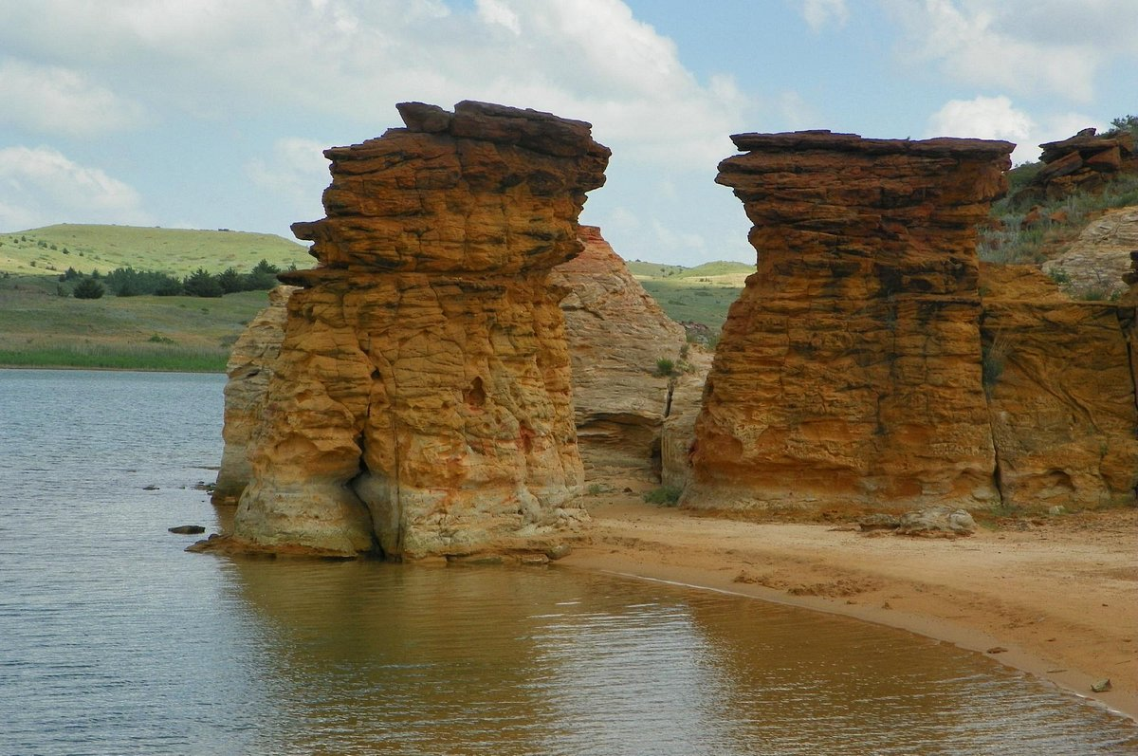
How we create more certainty…
Apply the same long-range inclusive, nimble, and well-financed approach to our water issues that the state has to transportation.
Craft a long-term framework around the 5 guiding principles
Recommendations should include:
Policy changes
Ways to improve state capacity and water management
Braiding federal, state and local funding
Measurable goals and timelines
Input from state and local stakeholders
Notes:
Vijay

Slide 19
The goal of this effort is to provide more certainty
More certainty in our water supply can mean…
No Kansas community is in a water crisis
All Kansans have access to safe, clean drinking water
Communities are retaining businesses and competitively recruiting new ones
Today’s grandkids will be able to live in the same community (if they choose to) and enjoy the same/better economic prosperity as their grandparents
Water users are less worried about abrupt changes in state regulatory actions
Notes:
By creating more certainty, we can make sure no communities are facing a water crisis. All Kansans have access to safe, clean drinking water.
It’s hard to recruit and retain businesses in your community if the long-term water supply forecast is dire. We want our communities to remain economic competitive and creating more certainty in our water supply is a way to do that.

Slide 20
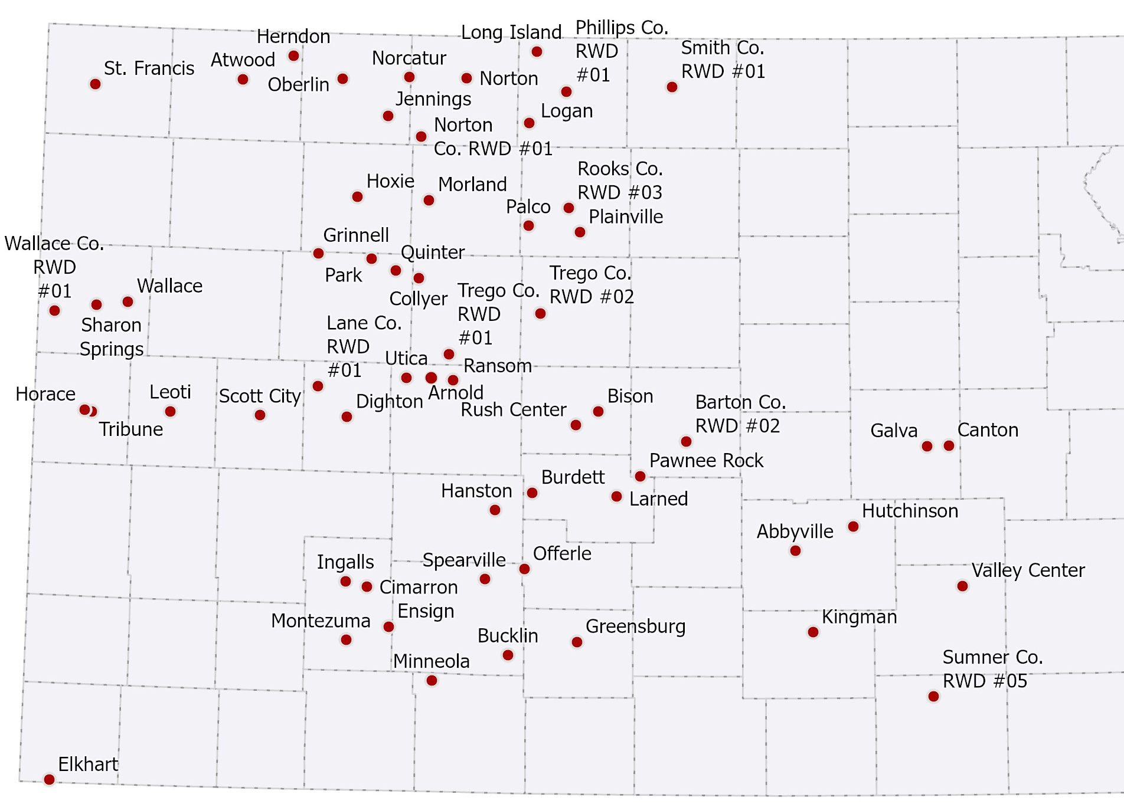
Communities at risk of losing their economic base and water supply in 25 years or less
Aquifer Challenge
2024 Estimates
Work in Progress
Impacts 90,000 Kansans
Notes:
Conserving the Aquifer is a top priority because we have 59 Kansas communities at risk of running out of useable water in 25 years or less. These are those communities, which are home to about 90,000 Kansans.
I want to be clear. These are projections and projections are not always right.
The Kansas Geographical Survey monitors water level change in all communities served by the High Plains Aquifer. KGS tracked the changes in water levels from 2012-2014 versus what the water level change was 2022-2024 and used that data to create a trendline going forward. Based on the decline over the past decade, these cites, and rural water districts have water wells with less than 25 years of estimated useable life remaining.
Communities can change these projections –such as by being more efficient with water use– in your home it might be things like more efficient washers or toilets. For farms that irrigate, it can mean upgrading your center irrigation pivots – where we we’ve seen some farms use 15% less water without a loss in profitability.
Other ways of saving water is things like using treated municipal wastewater for landscaping or irrigation.
Some communities may be able to secure additional water sources as well.
And there is always an opportunity that we receive more rainfall than anticipated which helps slow the decline of the aquifer.
There were some small areas of the High Plains Aquifer region where the water table increased from where it was in 2012-2014.

Slide 21
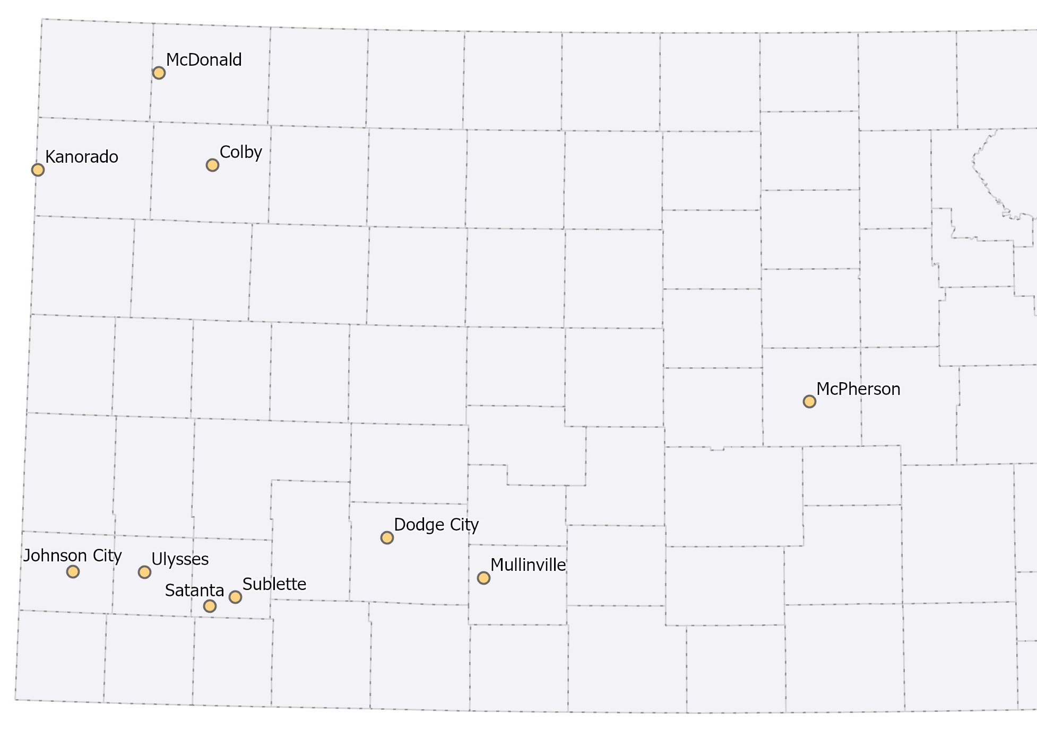
Aquifer Challenge
2024 Estimates
Work in Progress
Communities at risk of losing their economic base and water supply in 50 years or less
Impacts 58,000 Kansans
Notes:
Based on the decline over the past decade, these cites and rural water districts have water wells with less than 50 years of estimated useable life remaining.
These communities are home to about 58,000 Kansans.
All together we have about 150,000 Kansans served by water wells with 50 years or less of useable life.

Slide 22
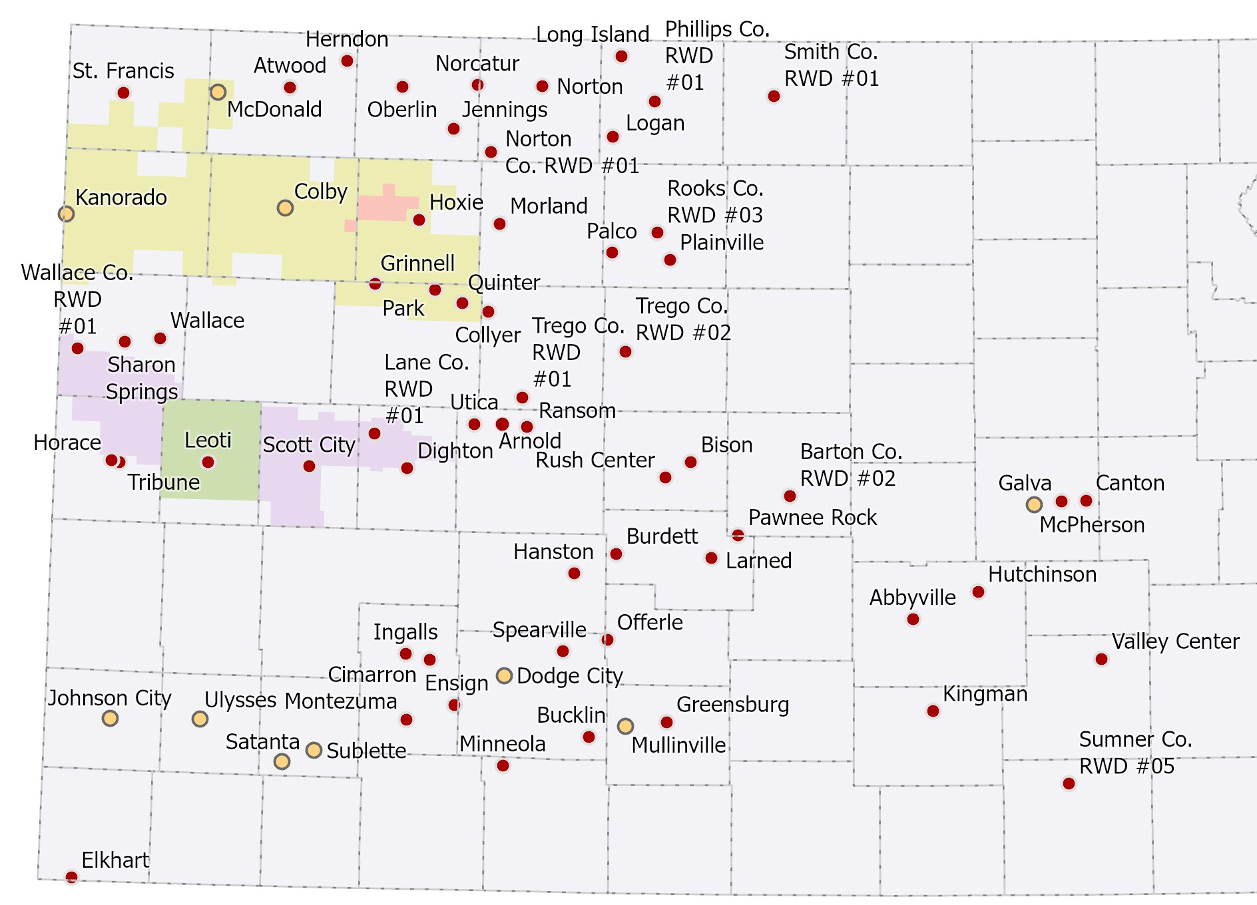
Communities taking collective action through LEMAs
Work in Progress
GMD4
Sheridan 6
GMD1 Four County
Wichita County
Notes:
LEMAs
There are already communities starting to take collective action through Local Enhanced Management Areas, or LEMAs.
Ag producers working together have shown that it is not only possible to continue to make profit while conserving water, in some areas even in this low-precipitation environment, the aquifer has demonstrated recharge. Sheridan 6 LEMA set 20% reduction in use goal for 2013-2017. Actual estimated savings for 2013-17 was 35%
We know there is more work to do, but these areas are tackling their water issues head on while building a “culture of conservation” across the region, showing that it’s possible to save water while meeting production goals and reducing input costs.
Building on these locally-led efforts to establish water security while maintaining economic viability across Western Kansas will be critical to ensure that no community is at risk of losing water within a generation.

Slide 23
Useable life
25 yrs
What level of certainty in your water supply would provide your business/industry the security you need to stay in your community?
26-50 yrs
51-75 yrs
76-100 yrs
101+ yrs
Notes:
Emphasize that whether individual producers are thinking about it this way or not, corporate buyers of ag products are & they will decide whether to stay in Kansas based on their analysis.

Slide 24
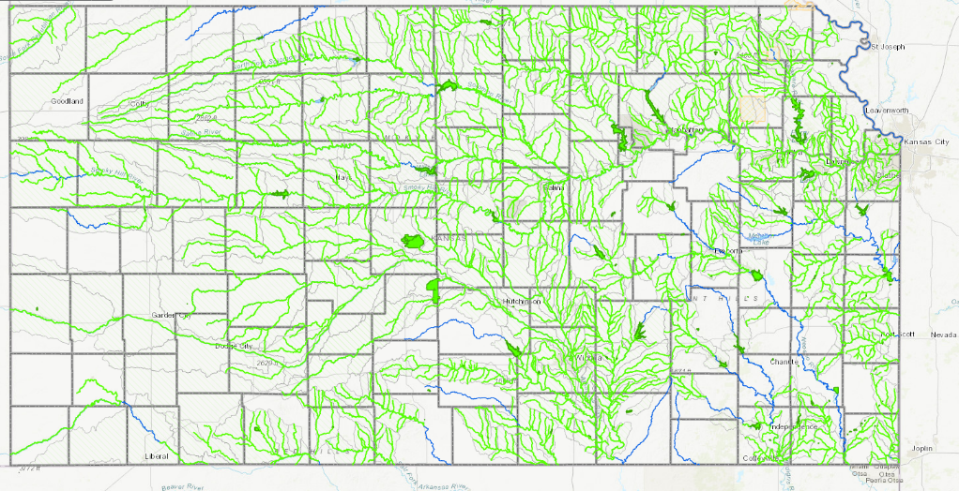
Water Quality Challenge: Green are impaired streams
Notes:
Vijay

Slide 26
Open Ended Question
Irrigation is by far the top water use in the state, which may make conversations about conservation feel like they are singling irrigators out. What suggestions do you have for how we can have productive conversations without it feeling like we are singling anyone out?

Slide 27
Responses varied considerably…
“Most irrigators have or are conserving now we need to acknowledge this and ask the other users to reduce instead of expand”
“Irrigators aren’t the PROBLEM they are the SOLUTION! Don’t demonize them! Keep it positive! We all want the same thing!”
“Suck it up buttercup. As the largest user (80%+) the conversation should be focused on Irrigation. Avoidance of the problem/discussion is what led us down the course we are not trying to rechart.”

Slide 28
Also sought input on policy/programing
We cannot afford to waste tax dollars. One challenge is recruiting landowners to participate in best management practice programs. As an example, enrolling landowners willing to install sediment-reducing buffer strips to reduce the rate of sedimentation in our reservoirs. What should we do?
Eliminate the program all together
Establish a threshold that at least X% of the landowners must opt-in for the state to provide funding
Geographically focus funding only near certain high-risk reservoirs
Mandate everyone participates
Continue to invest in the program as is
Other

Slide 30
Environmental Conference Takeaways
Additional Stakeholder Outreach following Summer Local Consult

Slide 31
Which region of the state do you live in?
160+ participants from across Kansas

Slide 32
Participants noted staffing challenges
Based on your experience working with agency staff, how big of an issue would you say staffing challenges are (short-staffed, lack of expertise/training).
Notes:
This is an opportunity to advocate for strengthening the work force to support increase funding.

Slide 33
Which of the following contaminants do you see as the biggest threat facing water quality in Kansas?

Slide 34
How concerned are you about the reliability of your water supply?

Slide 35
How would you rate the state's ability currently to be proactive addressing water infrastructure needs?
Weighted Score: 4.86 | (N = 153)

Slide 36
How would you rate the average Kansan’s awareness of the immediate need to reduce water usage in certain portions of the state?
Weighted Score: 2.29 | (N = 154)

Slide 37
87 Days
Until December 31, counting today.
Let’s work together to make them all count for Kansas!
Notes:
I also want to acknowledge this is a tight timeline. We only have 87 working days from now until the end of the year.

Slide 38
Fall Local Consult Preview

Slide 39
Input Sought in These 3 Areas
1
2
3
Water Plan Investment Criteria
(Bracketology Exercise)
Establishing Reasonable Minimum Investment Levels & State Policies to achieve the Minimums
Preferred Revenue Sources to Achieve the Minimums
Notes:
Julie

Slide 40
Why we need input in these areas
Shared Criteria | Reasonable Minimums | Revenue Sources
Needs will always exceed revenues. When choosing between investments areas, need to know what Kansans value most & why. | Sets the floor of what must be achieve in 10 years to be considered a success and what policies are needed and minimum funding levels are needed. | Understanding of what sources have the most support to increase revenues.

Slide 41
We need your help in advance of LC for this portion
Shared Criteria | Reasonable Minimums | Revenue Sources
Needs will always exceed revenues. When choosing between investments areas, need to know what Kansans value most & why. | Sets the floor of what must be achieve in 10 years to be considered a success and what policies are needed and minimum funding levels are needed. | Understanding of what sources have the most support to increase revenues.

Slide 42
Guiding Principles & Proposed Objectives
Guiding Principles Long-term/ongoing goals we’re trying to achieve | Measurable Objectives What we need to do in the next 10 years to be on-track to meeting the Guiding Principles
Conserve and Extend the High Plains Aquifer | Provide irrigation system audits and technology upgrades for 50-75% of irrigation systems in Kansas, saving 15% or more in water use while maintaining profitability. Provide grants for at least 30 communities to purchase water rights to secure water sources in areas with 50 years or less of useable life.
Secure, Protect and Restore Our Kansas Reservoirs | Establish 100% in-reservoir sediment managed in Tuttle Creek by 2030, John Redmond and Kanopolis by 2031, and Council Grove, Elk City, and Perry by 2032. Secure water supply for up to 350,000 people through regional interconnection projects for rural water districts, water assurance or access districts, and small to mid-sized cities to avoid water crises during times of drought and ensure capacity for economic development.
Improve the State’s Water Quality | Ensure that 99% of all drinking water systems in Kansas meet federal standards. Ensure that 95% of all wastewater discharges meet federal standards. 35% of all orphan contaminated sites will be closed and remediated.

Slide 43
Conserve and Extend the High Plains Aquifer
Secure, Protect and Restore Our Kansas Reservoirs
Improve the State’s Water Quality
Examples of metrics unique to each principle to track progress toward objectives
# of communities <50 years of useable water life
% of sediment managed in reservoirs
% of drinking water systems meeting federal standards
All 3 principles can evaluate the cost-effectiveness of the strategies they’re doing to make progress in the metrics above and by having shared criteria across all 3 principles (and within bundled programs), the State will be able to manage its complete portfolio of water investments more efficiently.

Slide 44
What do we mean by shared criteria?
Example Criterion & Why It Could Be Helpful | Example(s) of how it could be measured/applied:
Number of Guiding Principles Impacted: In Summer Local Consult, participants asked for more “stackable programs”, which include investments that serve more than one guiding principle. This would be a good way to emphasize getting more bang for your buck. | Points based on the number of how many guiding principles the strategy significantly impacts.
Stakeholder Input: In Summer Local Consult, participants emphasized that local input needed to play a role in decision-making. It’s helpful to have the people most impacted by decision have a role in shaping it. | Points for strategies identified as regional priorities at Local Consult.
Economic Impact: In Summer Local Consult, participants identified clean, secure, assessable water is an economic necessity. It’s important to account for positive or negative economic impact an investment or policy change may have on a region or the state. | Forecasting changes in income, GDP or employment to create an economic score
Cost Effectiveness: In Summer Local Consult, participants wanted the state to have a sustainable long-term investment strategy and measuring how cost-effective strategies can be helpful to maximize the value of investments and so that in lean years, the state can continue to invest in the most beneficial strategies. | Perceived benefit of the strategy divided by the total cost

Slide 45
Why establishing shared criteria can be helpful
Multiple programs/strategies can be implemented to achieve these goals and outcomes. Shared criteria is a way to evaluate and compare programs/strategies that do different things .
Having shared criteria across all principles; helps ensure some consistency in implementation across all 3 agencies.
This does not mean that all programs/strategies would be evaluated the exact same.

Slide 46
Example of how this could work…
Shared criteria established through Local Consult:
Agencies tailor the weights of the criteria to fit specific programs/strategies
Some criteria will not be included for every program and additional criteria will be considered too
Cost- Effectiveness
Economic Impact
*
*
Stakeholder Input
*
Program A
Program B
*
*
# Guiding Principles
*
Program C
Program D
*Criterion unique to that program
Goal: All programs/strategies use at least X of the shared criteria

Slide 47
Shared Criteria Benefits for Kansans
Makes it clear how and where local input informs decision-making by increasing transparency and accountability
Provides additional metrics for reporting and evaluating progress at Local Consult every 2 years based on the factors Kansans most care about.
Allows the overall water program to be more dynamic by providing more data/reasoning to demonstrate why it may be important to increase funding in one area and reduce/eliminate it in another

Slide 48
For Local Consult Breakouts…
The focus would be to understand what criteria is the most important to Kansans and why.
It’s not to decide how to measure each criterion.
We can provide examples of how criteria could be measured for context, but more internal analysis and discussion will be needed to determine the exact metrics and weighting.

Slide 49
What we need from you…
Review the handout of potential criteria distributed with survey.
Rank your top 10 criteria via a survey distributed tomorrow.
Don’t stress about your responses; we will do prioritization exercise at the Sept. 11th webinar as a group.
Your input from the webinar will inform the Local Consult prioritization exercise

Slide 50
Questions?

Slide 51
Fall Local Consult

Slide 52
Thank you

