Slide 2
Kansas Water Plan Implementation Workshops
Kansas Water Authority
June 2024

Slide 3
Stakeholder Input Update
We have met with over 250 stakeholders, from 23 organizations.
Such as, Farm Bureau, Sierra Club, KLA, KS Bankers, Conservation Districts, Kansas Chamber, KS Corn & Sorghum producers
General themes:
Planning is done, it is time to implement.
The large number of programs are difficult to navigate.
There is support for action, but no clear consensus around specific actions.

Slide 4
RSVP Totals for Local Consult Meetings
LOCATION | RSVPs
June 17; 5 - 8 PM; Colby | 27
June 18; 9 AM - Noon; Dodge City | 66
June 20; 2 - 5 PM; Chanute | 37
June 25; 9 AM - Noon; Wichita | 81
June 26; 9 AM - Noon; Salina | 54
June 27; 9 AM - Noon; Lawrence | 72
TOTAL | 337

Slide 5
Local Consult Presentation Overview

Slide 6
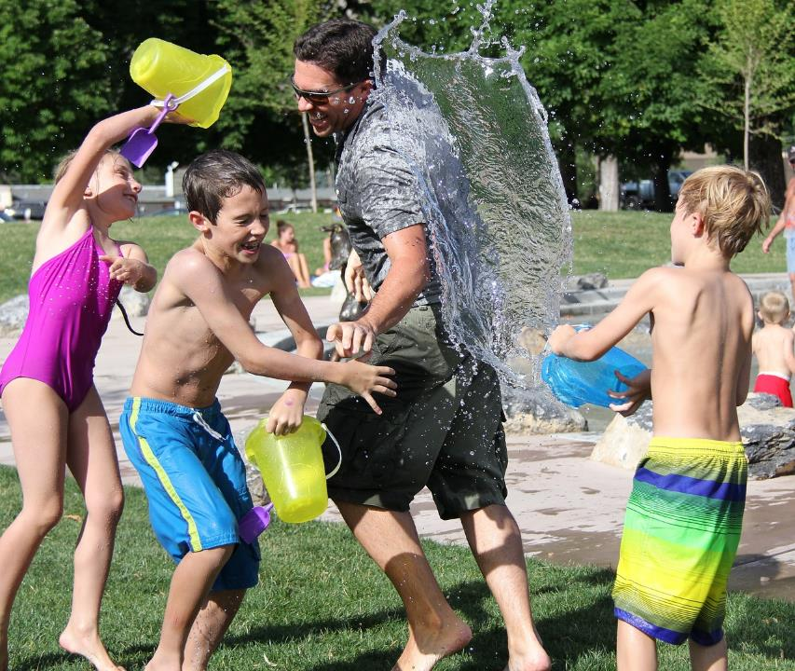
“Water is for everyone.”
A shared resource AND a shared responsibility
6
Notes:
We are here today because an issue that impacts all of us. Water.
It’s a shared resource and in turn a shared responsibility for how we manage it.

Slide 7
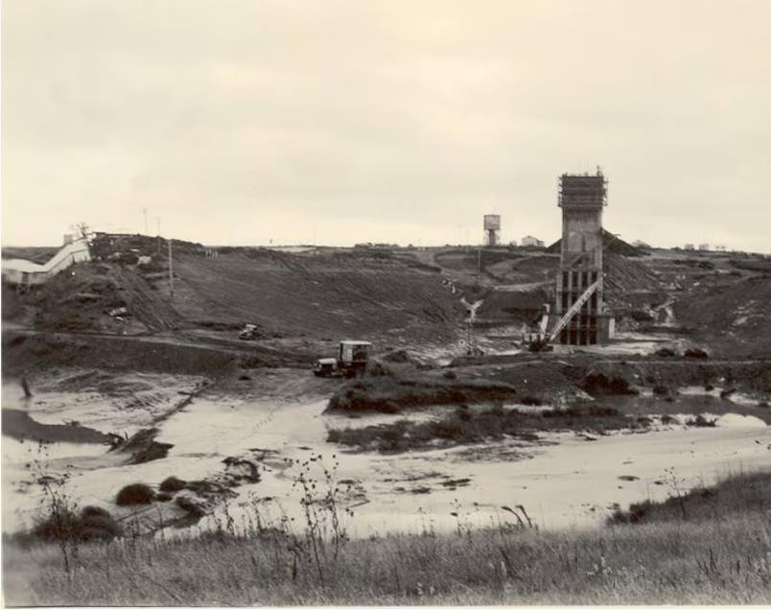
“We know that ‘where there is no vision the people perish,’ and we also know the difference between a vision and a daydream is sweat.”
- Kansas Governor Frank Carlson, 1947 Inaugural Address
Construction of Kanopolis Lake Reservoir
Notes:
So much of why we have the water resources we do today in Kansas can be traced to previous generations whose hard work or sweat made sure we’d have the water we need to live and for our economy to thrive.
Special shout is deserved to Kansans in the 1940s. This is when the major Kansan Water Law including the 1945 Water Appropriation Act was passed – the major water policy document of Kansas to this day.
It’s also when our state began building reservoirs including Kanopolis Lake shown here. And some of us may still be reliant on water pipes built in the 1940s.
We owe a great deal to those previous generations for the investments they made for us. And as we look to tackle the next generation of water challenges, we would be wise to listen to the man nicknamed Kansas Favorite Son, Frank Carlson, who served as a legislator and Governor while much of these accomplishments were occurring.
His words are so poignant for where we are today. Having a vision is important, but if you’re not willing to do the work to implement it – it’s just a daydream.
Today is where this work begins.

Slide 8
Where we are today
Hundreds of Kansans provide input for the Kansas Water Plan
2022 Kansas Water Plan Released Creating a Vision for Kansas
Governor & Bipartisan Legislators support funding the Water Plan
Today: Implement the Water Plan & Establish Ongoing, Dynamic process
Notes:
The good news is we have a vision.
This is the result of hundreds of Kansans – many of which might who have been here today to provide input on the Kansas Water Plan.
This water plan has set a vision for us and now we turn our focus to implementing it.
Governor Kelly and the Kansas Water Authority have encouraged us to adopt a similar process to how our state manages transportation, which is why I have been brought into help.
We create 20 year long range transportation plans that set a vision for Kansas, but we implement them in 10 year, dynamic programs – which give Kansans ongoing opportunities to help us prioritize our investments.
Today, is the start of a conversation for how we could create a similar approach for Water.

Slide 9
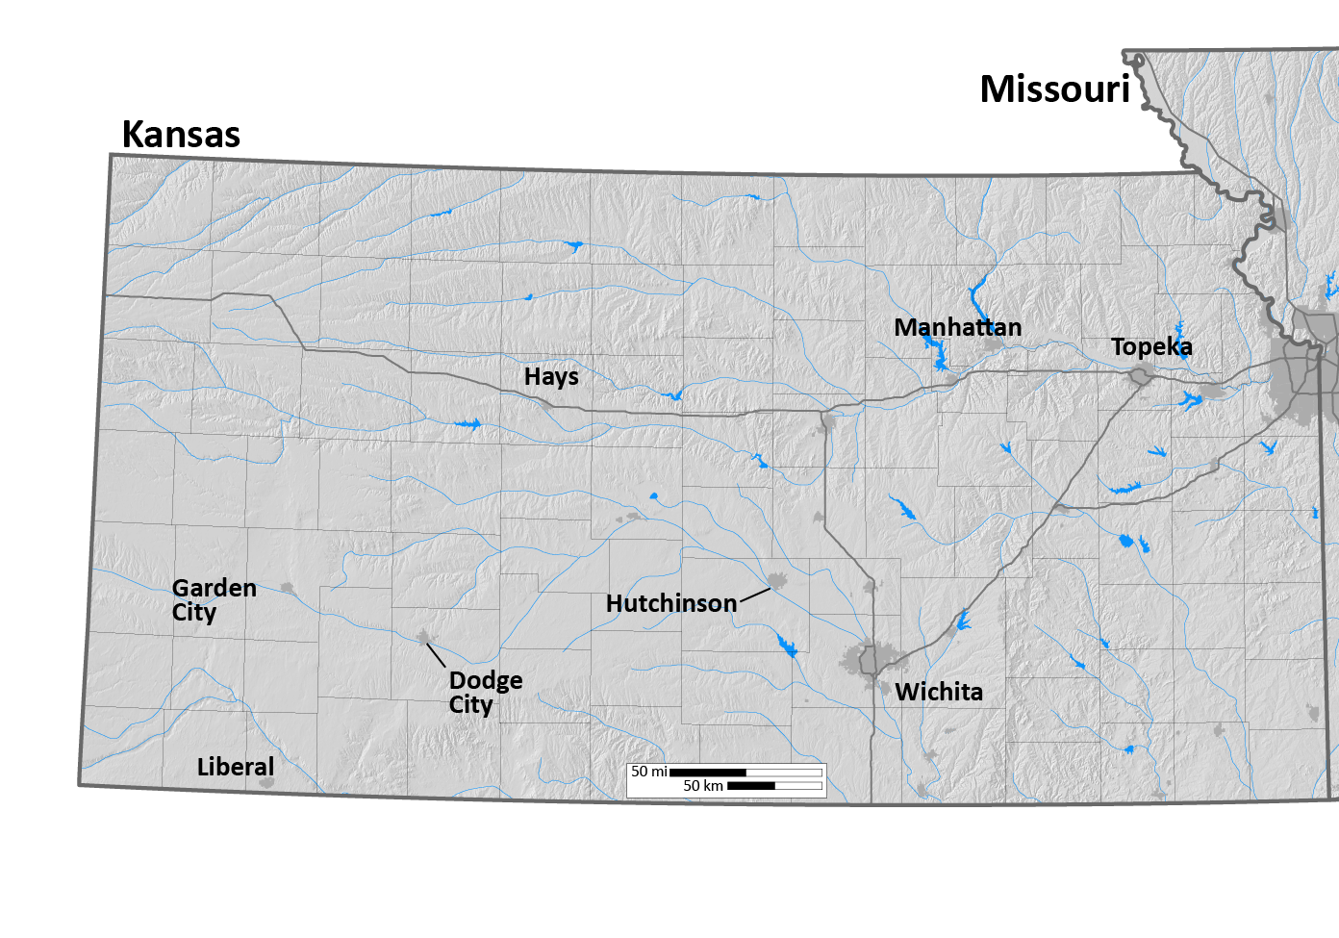
9
Water Sources for Our State
Tuttle Creek
High Plains Aquifer
Milford
Perry
Wilson Lake
Cedar Bluff
Clinton
Pomona Lake
Kanopolis
Melvern
John Redmond
El Dorado
Cheney
Notes:
For those of you who may not be as familiar with water in our state – a quick primer on where we get our water.
It’s helpful to know there are two major sources of water – groundwater found in aquifer and surface water. The portion in tan here are reliant on the high plains aquifer.
The portion in gray is reliant on surface water including reservoirs.
This is important for understanding why the Water Plan is organized around 5 guiding principles.
Different sources of water – we’re still one state.

Slide 10
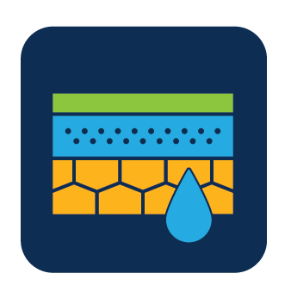
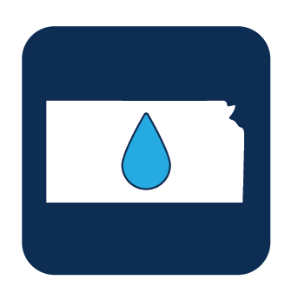
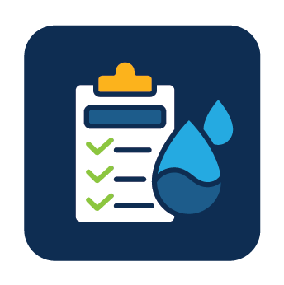
Kansas Water Plan Vision: 5 Guiding Principles
4. Reduce Our Vulnerability to Extreme Events
5. Increased Awareness of Kansas Water Resources
Embedded within these 3.
Conserve and Extend the High Plains Aquifer
Secure, Protect and Restore Our Kansas Reservoirs
Improve the State’ s Water Quality
We are organizing around the big 3
Notes:
The Vision for Kansas Water is outlined in 5 Guiding Principles and as an organizing framework we’re focused on the big 3 as the other two are embedded in the top 3.

Slide 11
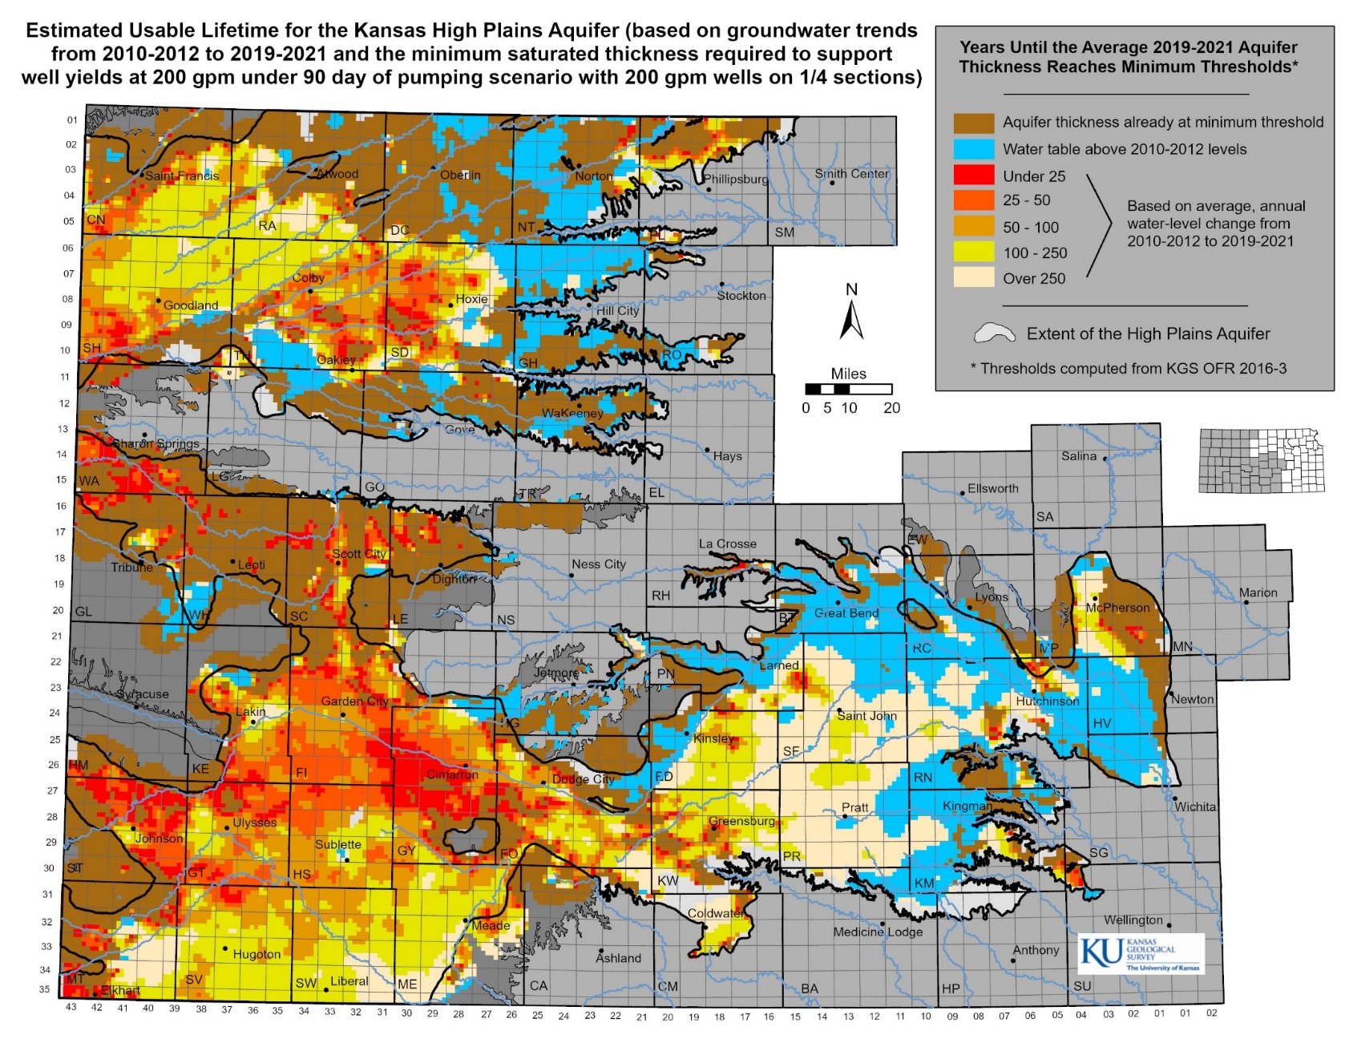
Estimated usable life varies across aquifer
Without decreasing usage, some of the region’s farms and towns could vanish within a generation or two.
Counties reliant on the aquifer account for $57 billion in economic output annually for Kansas

Slide 12
Newest Reservoir
Oldest Reservoir
Hillsdale Lake
Tuttle Creek Lake
Kanopolis Lake
66% of Kansans rely on Reservoirs, and they are losing capacity due to sedimentation
42
Years
62
Years
76
Years
-Projected sedimentation lifespan-
1
Year
50
Years
100
Years

Slide 13
Water Quality Challenge: Reacting to water contaminants is more costly than protecting waters from contamination
Kansas Lakes & Reservoirs Conditions prior to Treatment
Notes:
Impaired water indicates the water is polluted and the level of pollution may vary. For example, there may be streams that are safe to fish in but not swim in.
This graph charts the impairment of Lakes and Reservoirs as it relates to Domestic Drinking Water. As you can see, there is a significant amount that will require treatment to being safe to drink. The more we can prevent our water from becoming contaminated, the more we can protect public health and reduce treatment costs.

Slide 14
About a 100 communities vulnerable to similar event
Notes:
We also know water infrastructure is a concern for many, which overlaps both. That can have overlap in if pipes are leaking – we are wasting precious water – and if we’re reliant on lead pipes that can be a water quality issue.
Protecting and preserving our state’s water supply is essential to continued economic growth and the success of our communities. As with any investment, we need to make sure our approach is strategic and proactive, in order to prevent situations like what happened last year in Caney.
For those who don’t know, Caney is a town in southeast Kansas with a population of fewer than 2,000 people. Last year, the town nearly ran out of water. In the middle of summer during the hottest year on record, they had to close the town pool. Restaurants couldn’t give tap water to customers. Schools were forced to bring in portable bathrooms for students, and the district eventually closed schools on Fridays to conserve water.
Obviously, the extreme drought conditions in recent years have exacerbated our water problems. But in Caney, another causal factor was ancient, leaking pipes.
And that it was reliant on a small lake – or sole source of water. When we can connect multiple water systems, it allows water to be distributed from multiple sources making us more resilient. Caney was not on a regionalized water system.
We know there are many other Kansas communities also vulnerable to these same problems..

Slide 15
Seeking Your Input Today in 3 Key Areas
1
2
3
Regional Goals
Where is there alignment within your region and across the state?
Investment Prioritization
Why do you value investments in one Guiding Principle over another if forced to choose?
Performance
How are we managing water in the state? Where could we improve our programs?

Slide 16
Breakout Session: Regional Goals Alignment Input Session

Slide 17
Regional Advisory Committees
Upper Republican |  | Priorities
Upper Smoky Hill |  | Priorities
Upper Arkansas |  | Priorities
Cimarron |  | Priorities
Solomon-Republican |  | Priorities
Smoky-Hill Saline |  | Priorities
Great Bend Prairie |  | Priorities
Red Hills |  | Priorities
Equus-Walnut |  | Priorities
Missouri |  | Priorities
Kansas |  | Priorities
Marias des Cygnes |  | Priorities
Verdigris |  | Priorities
Neosho |  | Priorities
Kansas Water Plan
5 Guiding Principles
Notes:
Start to put together statewide view for investments

Slide 18
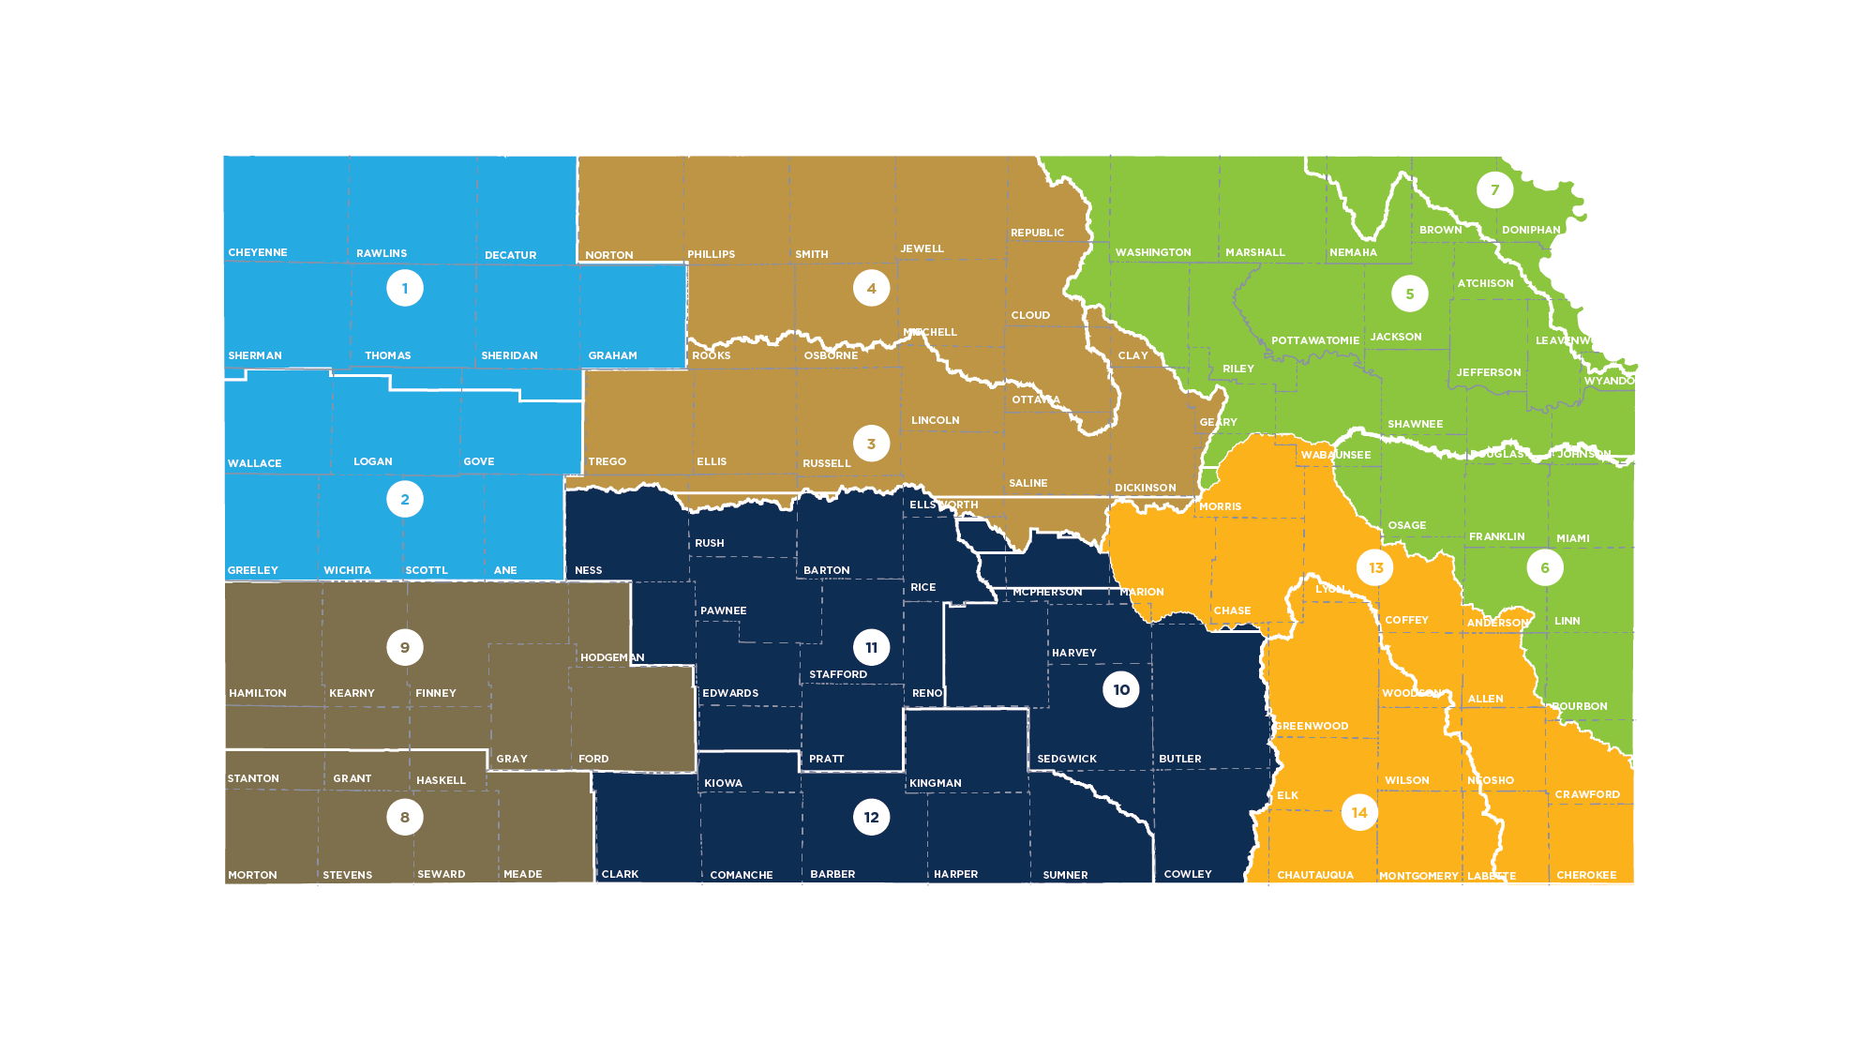
Today we’re asking you to broaden out
From 14 RACs to
6 Regions

Slide 19
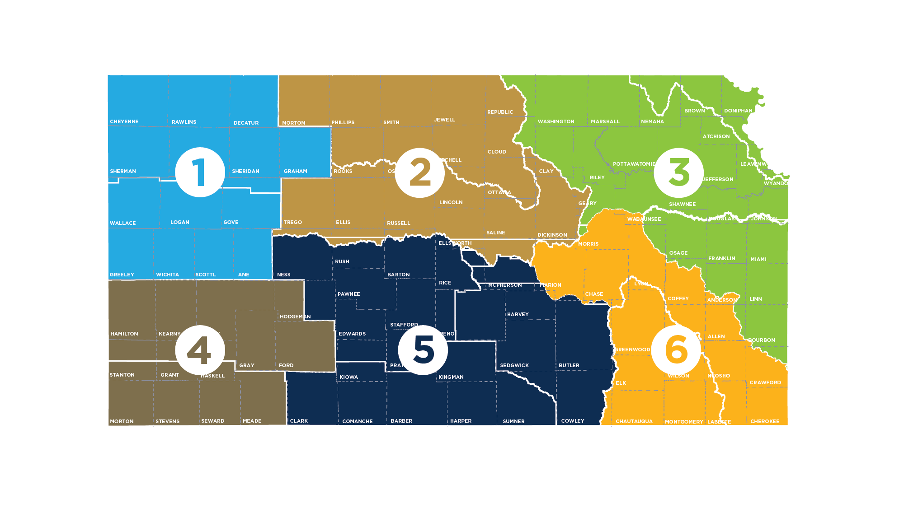
Today we’re asking you to broaden out
From 14 RACs to
6 Regions

Slide 20
Kansas Water Authority Simplified Draft Goals
High Plains Aquifer
Halt the decline of the Ogallala
Restore and maintain natural streamflow
Maximize the economic output of all water users
Reservoir
Adequate storage for all climate conditions
Promote and incentivize regionalization
Promote land management practices to reduce sedimentation
Water Quality
All water sources are free of all forms of pollution and contaminants

Slide 21
Discussion framework
Your region’s priorities. Compare /contrast RAC goals in your region – why are they similar and different?
Your region’s priorities compared to Water Authority priorities. Do you see expanding your regional priorities to include those Water Authority goals?
Statewide view. RAC/regional goals often vary by water source and use. Compare and contrast your region with other regions. Do any of the other regions’ goals surprise you? Looking at the Water Authority goals that might not be relevant for your region, what questions do you have about statewide goals?

Slide 22
Regional Goals Handout
Compare to Statewide Goals
Goals for each RAC in the region listed for comparing similarities
Rate RAC similarities

Slide 23
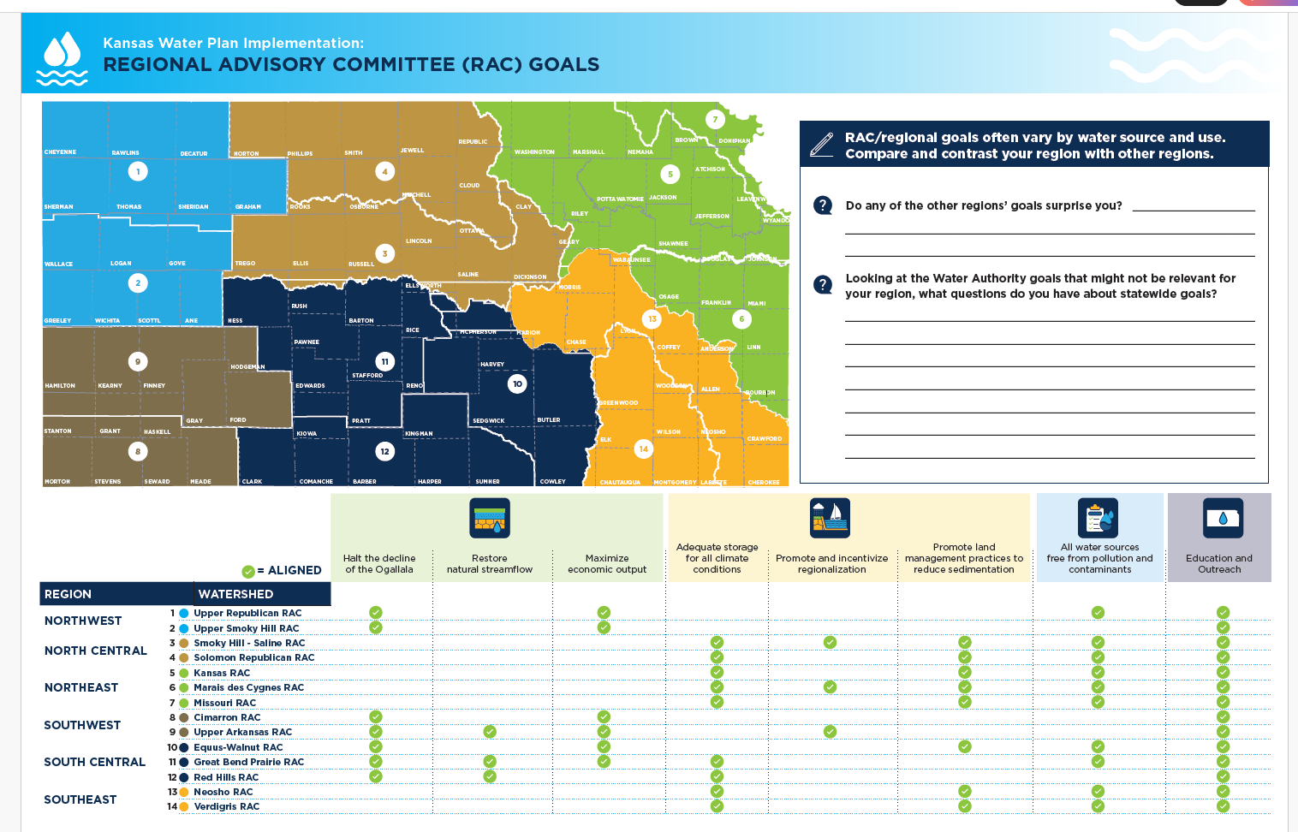
Regional Goals Handout – Page 2
Shows how RAC goals compare across regions

Slide 24
Three Key State Goals: Plentiful water, clean water, and economic prosperity

Slide 25
Investment Scenario Input Session

Slide 26
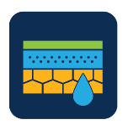
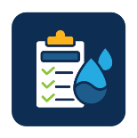
Average Annual State Investment by Guiding Principle
Increase Awareness
Conserve High Plains Aquifer
Reduce Vulnerability
Secure & Protect Reservoirs
Improve Water Quality
Notes:
Here is how state funds have been prioritized around the principles currently. We want to hear your feedback.

Slide 27
Investment Scenario Prioritization Exercise
Stand Pat
Move the Needle
Game Changer
Each participant gets one chip for each investment level; each participant will put his/her chip in the respective bucket and guided through a facilitated discussion to explore why he/she invested in the ways that they did.

Slide 28
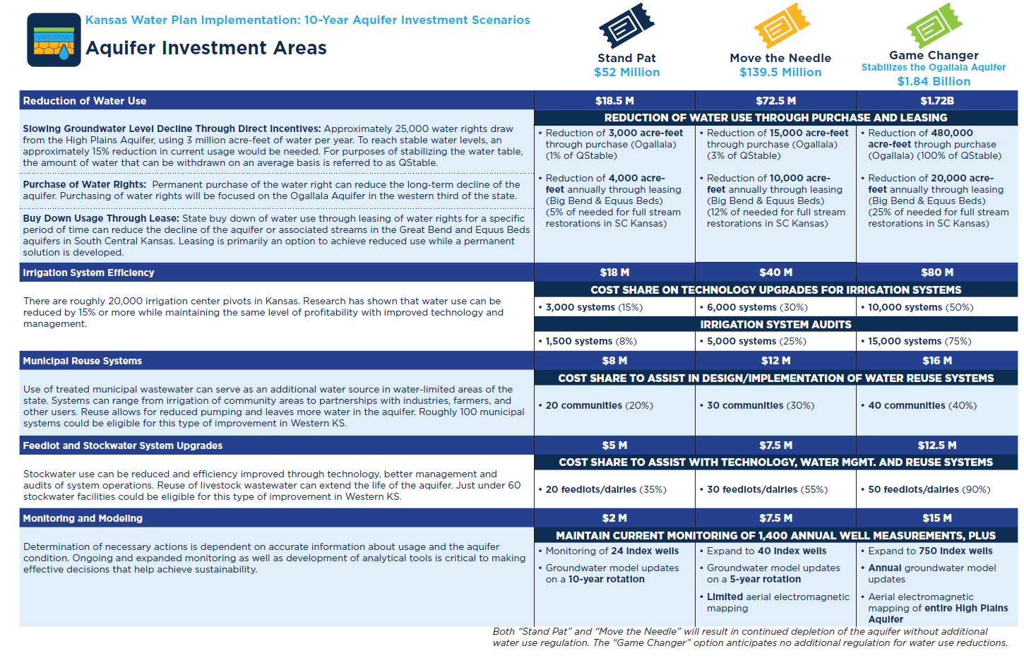
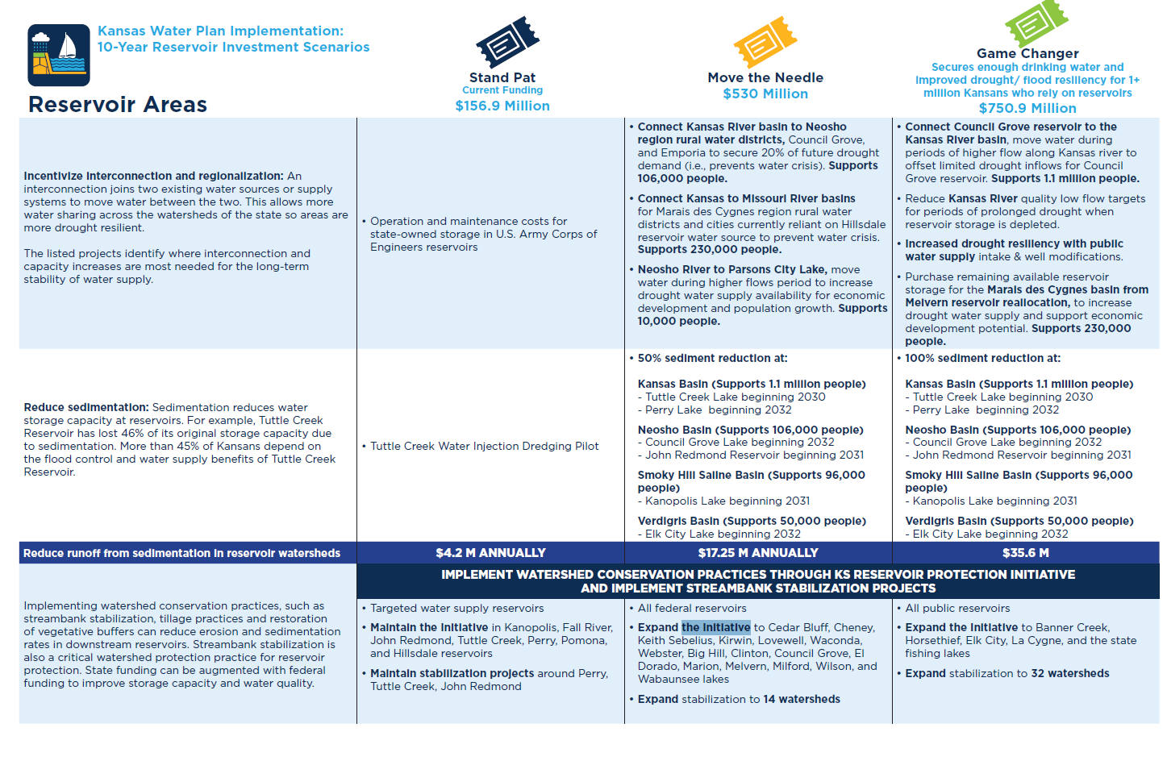
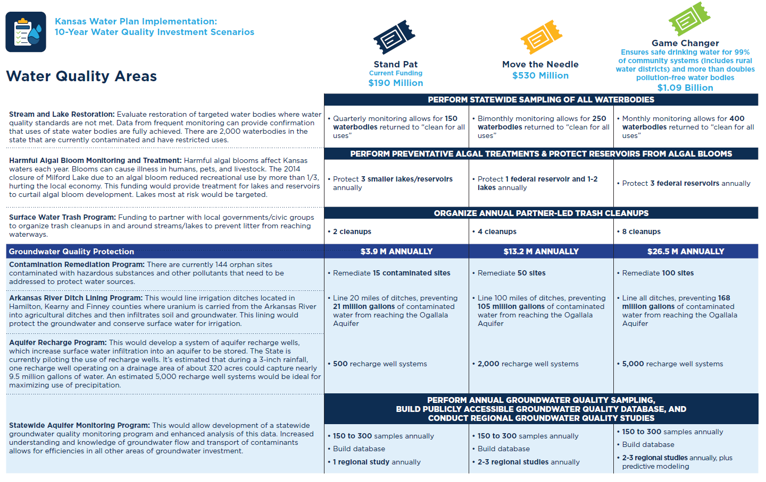
Handouts for Each Guiding Principle:
Aquifer
Reservoir
Water Quality
Notes:
To help you make your deci

Slide 29
Each Principle has 3 investment level scenarios

Slide 30
Each Principle has 3 investment level scenarios

Slide 31
Each Principle has 3 investment level scenarios

Slide 32
For Today
Why
How
You made the investment choices you did
Pressing challenges? Best buy?
You chose to invest your tickets.
Notes:
The purpose of this exercise is to understand why you would make the investment choices you made. And it’s often by forcing people to make a decision that you can yield the greatest understanding of why they made the choice they did.
I don’t want anyone to fear that we’re tallying up the chips and making critical decisions based on how the chips landed today.
The discussion is the outcome that will help us.
Did you make your selections because you feel those are the most pressing challenges for us to address as state, did you feel that one scenario was simply the best buy for the progress you could make for the price point or did you have other reasons? We want to know why.

Slide 33
Aquifer Scenario Highlights
Overall approach: Reduce/halt the decline of the aquifer through improved efficiency and purchasing water rights.
Stand Pat and Move the Needle Scenarios result in the continued decline of aquifer
These scenarios are still reliant on irrigation producers and communities opting in to cost share programs
Game changer – $1.84B Stabilize Ogallala Aquifer
Notes:
Disclaimer.
We’ve tried hard to simplify the information in your scenarios. But we fully admit, these are not perfect documents. Some things may be confusing and where we tried having too many words – we may have actually put too few for your to fully grasp what is occurring.
We’re asking you to do your best. And to help give you a little more context, I wanted to give you the cliff notes version of each of the Investment areas.
As mentioned earlier, the decline of the High Plains Aquifer can have dire consequences for the communities that rely on it and for our overall state’s economy.
The overall approach for the aquifer scenario was to identify ways to reduce the decline or halt the decline.
Only a Game Changer investment actually stabilizes the Aquifer.
The others result in continued decline though at slower rate.
Additionally, this approach relies on voluntary actions rather than regulations which would force people to reduce their water usage.

Slide 34
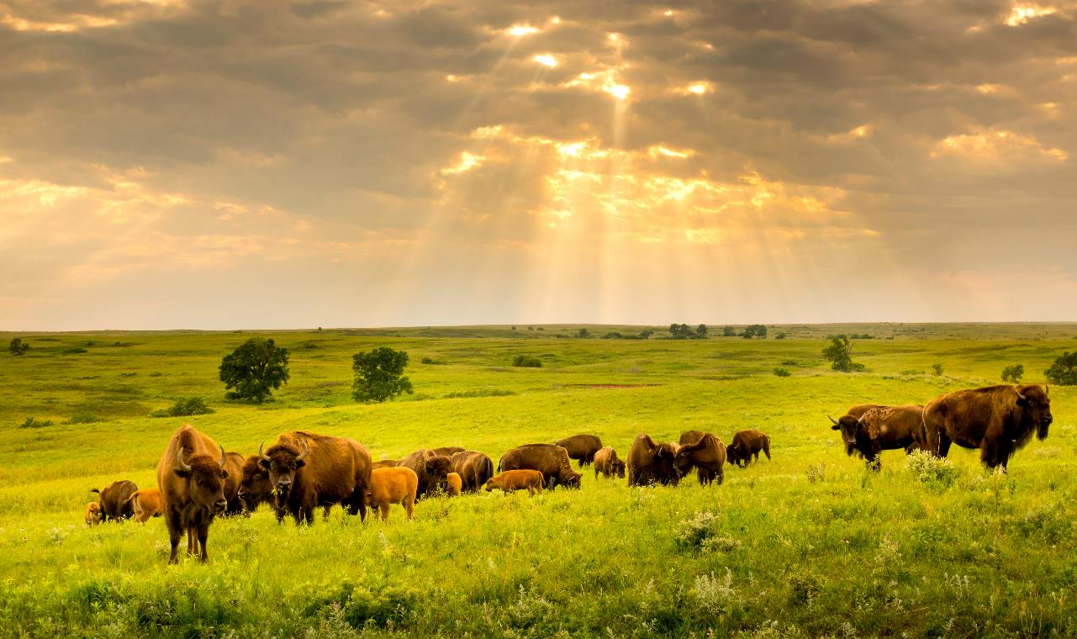
It’s complicated
Everyone needs water today, tomorrow and forever
Levers: infrastructure, incentives, regulation
Your tax dollars
Kansas way of life and livelihoods
Notes:
These are Buffalo in the Flint Hills of Kansas.
I always thought Buffalo are like cattle. But they aren’t, and in one key way they can teach us something about leadership.
What cows do is very natural. Cows sense the storm coming from the west and so they start to try to run toward the east. The only problem with that is that if you know anything about cows you know they aren’t very fast.
So the storm catches up with the cows rather quickly. And without knowing any better the cows continue to try to outrun the storm. But instead of outrunning the storm they actually run right along with the storm. Maximizing the amount of pain and time and frustration they experience from that storm
But Buffalo are native to the plains. They understand storms better than their bovine brethren.
In fact, Buffalo are unique in the animal kingdom in their approach to bad weather. When a storm hits, they not only face the storm, they move directly into the teeth of it, moving forward as best they can despite the wind, snow, and biting cold.
Why? Because as plains animals, they learned that the best way to weather a storm is not to retreat. The fastest way out of a storm is to head directly into the face of it… and go through.
How do you weather challenges? Buffalo take them head on and shorten their duration.
Be a Buffalo.

Slide 35
Reservoir Scenario Highlights
Overall approach: By increasing reservoir capacity, we can store more water in wet years, to sustain us in dry years. And by connecting more water systems, communities are less vulnerable to running out of water
Move the Needle:
Connects multiple water systems to increase resiliency during droughts
Reduces sedimentation at 5 reservoirs by 50%
Game changer:
Connects multiple water systems to increase resiliency during droughts
Purchases additional reservoir storage for increased resiliency
Reduces sedimentation at 6 reservoirs by 100%
Notes:
As mentioned, two-thirds of Kansans are dependent upon reservoirs for their water.
Our reservoirs are losing storage capacity because of increased sedimentation. That is problematic not only for being able to store enough to meet water demands but also to have some in reserve for dry years. Remember, increasing our capacity doesn’t increase our supply automatically. If there is no water to store, it doesn’t matter how much room we have for it. Thus, the longer we go without begin able to store water – the more potential wet years we miss out on banking water for dry years.
These scenarios increase our capacity.
Additionally, we are also connecting water systems along this water basin. One of the reason Caney was in such a dire situation is it relied on a small lake for its water – and when the lake began to dry up there was no other source of water.
Through the Move the Needle/Game Changer scenarios more water systems in the state are able to be connected. (This is not possible by standing pat.)

Slide 36
Water Quality Scenario Highlights
Overall approach: By increasing investment, we move to more cost-effective, proactive actions, rather than reactive.
Move the Needle more than doubles investment in most water quality programs, serving all parts of Kansas
Game changer – safe drinking water for 99% of community systems (includes rural water districts) and more than doubles pollution free water bodies
Notes:
When you have to treat water after it’s been contaminated, it costs you more money to treat – than if you were able to prevent it from becoming contaminated to begin with over the long-term.
With current funding levels, we have been required as a state to be more reactionary and address the latest problems.
Increasing investments in water quality allow you to become more proactive and actually have long-term benefits for cost savings.
For each of the scenarios, when you increase funding you increase more progress.
More communities will get improve water and sewer infrastructure.
More contaminated sites will be cleaned up.
More reservoirs will be able to receive timely treatments to prevent algal blooms.

Slide 37
New Challenges Demand Nimble Approaches
“You know, the people are back, but that stuff is still out there and it’s still disgusting,” Brad Roether said. “Honestly, I care more about the good of the lake than my businesses. They’ve got to figure something out.”
Notes:
Algal Blooms have become a major problem since 2011. Some weeks it’s been common to see 20 to 30 public waters listed on the KDHE’s harmful algal blooms advisory list
And the reasons for the increase is unclear. Science doesn’t have all the answers yet.
Milford and Marion were the reservoirs initially hit hardest, with blooms bad enough to sometimes close much of the lakes to human contact. Milford Lake shutdown not only posed a risk to people and animals, the lack of boating and fishing resulted in millions lost to the local economy.
This is a quote from man who owns several businesses in the Milford area.
I do appreciate the sense that there is a larger issue at play than just the individual cost he’s paying.
In 2019, the Kansas Legislature granted KDHE $450,000 annually, over a four-year period, to research ways to deal with algal blooms. In 2020, a sizable bloom on Milford was treated with peroxide. The treatment worked, but not long enough.
It knocked (the cyanobacteria) back for about three hours, then it was back. That treatment was $128,000. “That’s about $43,000 an hour for short-term relief.
Because of this lesson, KDHE know how learned that doing smaller treatments earlier in the process yields better results, which is presented in your scenarios. This is a great example of how investments can lead to better results through some trial and error and can be a lesson we carry with us as we set forth a process that allows for ongoing evaluations of how our strategies are working for the Water Program as whole – not just in water quality.

Slide 38
Programs Evaluation Input Session

Slide 39
Program Effectiveness by Principle
Do you have experience with any of these programs? If so, which ones?
Rate on scale of 1 – 5 with 1 being not very effective and 5 being very effective. What have you observed or experienced to provide that rating?
When you think about effective state programs, what are some of the key attributes to make them effective (easy to understand, flexible to use, incentive program)?
Are there programs you’d like to see changed?
Are there new water programs you think the state should offer? If so, what would that program include or focus on?
Aquifer
Quality
Reservoir
KS Water Office
KS Water Office
KDA : Conservation
KS Water Office
KS Water Authority
State Water Plan Dev.
Regional Advisory Committees
Drought Monitoring and Response
Assessment and Evaluation
HB 2302 Grant Programs
High Plains Aquifer Partnerships
Conservation Assistance for Water Users
Regional Advisory Committees
Drought Monitoring and Response
Assessment and Evaluation
HB 2302 Grant Programs
Arbuckle Study
Chloride Plume Remediation
Water Quality Partnerships
Stream Gaging
Conservation Assistance for Water Users
Reservoir and Water Quality Research
Conservation Districts
Water Resources Cost Share
Nonpoint Source Pollution Assistance
Buffer Incentive Program
Water Supply Restoration
Riparian and Wetland Protection Program
Soil Health Initiative
Conservation Reserve Enhancement Program
Streambank stabilization Program
Crop & Livestock Research
Reservoir Protection Initiative
Drought Monitoring
Reservoir Operations
HB 2302 Grant Programs
Reservoir and Water Quality Research
Stream Gaging
Water Injection Dredging
Water Quality Partnerships
KDA: Division of Water Resources
KDA : Conservation
KDHE
Soil Health Initiative
Watershed Dam Construction/Rehabilitation
Nonpoint Source Pollution Assistance
Riparian and Wetland Protection Program
Soil Health Initiative
Streambank stabilization Program
Water Resources Cost Share Program
Water Rights Permits
Local Enhancement Management Area
Multi-Year Flex Accounts
Interstate Water Issues
Water Use Database
Subbasin Water Resources Management
KS Department of Commerce
Total Maximum Daily Load Initiatives
Public Water Supply Loans and Program
Harmful Algae Bloom Monitoring
Water Quality Standards
Contamination Remediation
Drinking Water Protection Program
Storage Tank Regulation
Superfund Oversight
Cleanup Program
Groundwater Quality Monitoring Program
Orphan Sites Program
Small Town Infrastructure
Stream Trash Removal
Watershed Management
Livestock Waste Management
Clean Water Act Certification
Drinking Water Testing
Watershed Restoration and Protection Strategies (WRAPS)
Hazardous Waste Management
Solid Waste Management
Community Development Block Grants
Water & Wastewater Infrastructure
KDA : Conservation
Streambank Stabilization
Buffer Incentive Program
Conservation Districts
Conservation Reserve Enhancement Program
Irrigation Technology Initiative
Water Resources Cost Share Program
Kansas Corporation Commission
KDA: Division of Water Resources
Watershed Districts
Dam Permitting
Floodplain Zoning
Dam Safety
Water Rights Permits
Local Enhancement Management Area
Multi-Year Flex Accounts
Interstate Compacts
Protection of Usable Water during well operation & plugging
Oil & Gas Advisory Committee
Well Spill Database
KDWP
Aquatic Invasive Species
Notes:
11 State Agencies are involved in Water Policy and programs
These are all the programs that I have related to the water plan and SWPF $ - There are others funded by federal funds, other state funds, ect. We are still assembling the full look

Slide 40
“If we build ahead carefully and right, the unexcelled product of the Kansas home and family – our sons and daughters- will remain with us to help with the tasks for which they should be reared. Let us not lose them. Rather, let them have the vision of the Kansas of tomorrow, and face with us this new frontier. Rather, let the youth of America see here the future can be ours.” – Frank Carlson
Notes:
I will leave you with one more thought – that goes back to where we began at the opening..
This was Governor’s Carlson final charge to Kansans. It was to build carefully and right to create a future that – future Kansans would want to be part of.
It was to face the challenges of a new frontier head on – so future Kansans would be gifted the same opportunities they were offered.
They met this challenge. Will we?
We are facing our new frontier. 21st Century Water Challenges – can not be solved with 20th Century Infrastructure and thinking alone. We have work to do – and we need your help.
Thank you for showing up today and I hope you’ll embrace the opportunity before you today to create a future Kansas that our kids and grandkids want to be part of.

Slide 41
Breakout Group Assignments & Locations
Group assignment found on Regional handout here
Red | Meeting Room 1
Blue | Meeting Room 2
Green | Meeting Room 3
Purple | Meeting Room 4

Slide 42
Facilitator Summary for Each Group
Red Group
Blue Group
Green Group
Purple Group

Slide 43
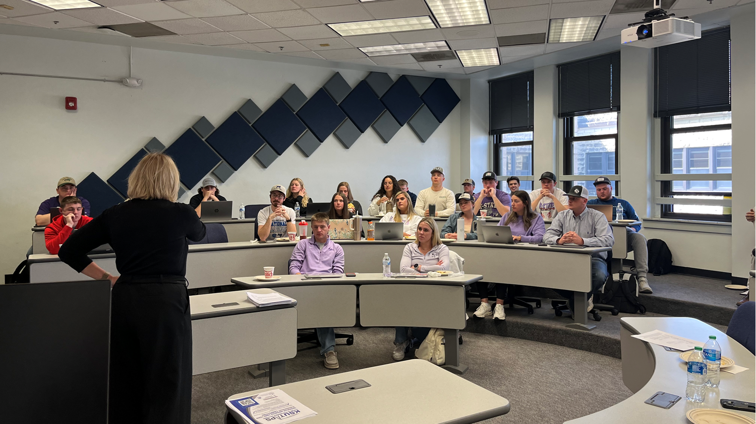
Building a Future for Today and Tomorrow’s Kansans
Notes:
Thank you all for being here.
I began the conversation playing tribute to some wise words from a Kansans of a previous generations and acknowledging what those previous generations of Kansans were able to provide for us in terms of our water infrastructure.
I want to leave you with some wise words from young Kansans of today – or Gen Z.
We conducted a focus group with some K-State ag econ students to see how their views compared to a previous survey of producers on the aquifer – who were much older.
In general, we noticed that the students were much more concerned and focused on the future. They saw a greater need to make sure water would be available for future generations.
As one student said it best, our kids have not been born yet, but we have to look out for them.
Today’s conversations have laid the groundwork for how we can ensure that future Kansans will have the same resources that we’ve had to prosper. Thank you all for caring about the future of our state and giving us your time.
As Mr. Carlson said, you’ve help prove that the future can be ours. Because we care about it enough to do the work.

Slide 44
Kansas Water Plan Implementation Workshops
Kansas Water Authority
June 2024

Slide 45
Stakeholder Input Update
We have met with over 250 stakeholders, from 23 organizations.
Such as, Farm Bureau, Sierra Club, KLA, KS Bankers, Conservation Districts, Kansas Chamber, KS Corn & Sorghum producers
General themes:
Planning is done, it is time to implement.
The large number of programs are difficult to navigate.
There is support for action, but no clear consensus around specific actions.

Slide 46
RSVP Totals for Local Consult Meetings
LOCATION | RSVPs
June 17; 5 - 8 PM; Colby | 27
June 18; 9 AM - Noon; Dodge City | 66
June 20; 2 - 5 PM; Chanute | 37
June 25; 9 AM - Noon; Wichita | 81
June 26; 9 AM - Noon; Salina | 54
June 27; 9 AM - Noon; Lawrence | 72
TOTAL | 337

Slide 47
Local Consult Presentation Overview

Slide 48
“Water is for everyone.”
A shared resource AND a shared responsibility
48
Notes:
We are here today because an issue that impacts all of us. Water.
It’s a shared resource and in turn a shared responsibility for how we manage it.

Slide 49
“We know that ‘where there is no vision the people perish,’ and we also know the difference between a vision and a daydream is sweat.”
- Kansas Governor Frank Carlson, 1947 Inaugural Address
Construction of Kanopolis Lake Reservoir
Notes:
So much of why we have the water resources we do today in Kansas can be traced to previous generations whose hard work or sweat made sure we’d have the water we need to live and for our economy to thrive.
Special shout is deserved to Kansans in the 1940s. This is when the major Kansan Water Law including the 1945 Water Appropriation Act was passed – the major water policy document of Kansas to this day.
It’s also when our state began building reservoirs including Kanopolis Lake shown here. And some of us may still be reliant on water pipes built in the 1940s.
We owe a great deal to those previous generations for the investments they made for us. And as we look to tackle the next generation of water challenges, we would be wise to listen to the man nicknamed Kansas Favorite Son, Frank Carlson, who served as a legislator and Governor while much of these accomplishments were occurring.
His words are so poignant for where we are today. Having a vision is important, but if you’re not willing to do the work to implement it – it’s just a daydream.
Today is where this work begins.

Slide 50
Where we are today
Hundreds of Kansans provide input for the Kansas Water Plan
2022 Kansas Water Plan Released Creating a Vision for Kansas
Governor & Bipartisan Legislators support funding the Water Plan
Today: Implement the Water Plan & Establish Ongoing, Dynamic process
Notes:
The good news is we have a vision.
This is the result of hundreds of Kansans – many of which might who have been here today to provide input on the Kansas Water Plan.
This water plan has set a vision for us and now we turn our focus to implementing it.
Governor Kelly and the Kansas Water Authority have encouraged us to adopt a similar process to how our state manages transportation, which is why I have been brought into help.
We create 20 year long range transportation plans that set a vision for Kansas, but we implement them in 10 year, dynamic programs – which give Kansans ongoing opportunities to help us prioritize our investments.
Today, is the start of a conversation for how we could create a similar approach for Water.

Slide 51
51
Water Sources for Our State
Tuttle Creek
High Plains Aquifer
Milford
Perry
Wilson Lake
Cedar Bluff
Clinton
Pomona Lake
Kanopolis
Melvern
John Redmond
El Dorado
Cheney
Notes:
For those of you who may not be as familiar with water in our state – a quick primer on where we get our water.
It’s helpful to know there are two major sources of water – groundwater found in aquifer and surface water. The portion in tan here are reliant on the high plains aquifer.
The portion in gray is reliant on surface water including reservoirs.
This is important for understanding why the Water Plan is organized around 5 guiding principles.
Different sources of water – we’re still one state.

Slide 52
Kansas Water Plan Vision: 5 Guiding Principles
4. Reduce Our Vulnerability to Extreme Events
5. Increased Awareness of Kansas Water Resources
Embedded within these 3.
Conserve and Extend the High Plains Aquifer
Secure, Protect and Restore Our Kansas Reservoirs
Improve the State’ s Water Quality
We are organizing around the big 3
Notes:
The Vision for Kansas Water is outlined in 5 Guiding Principles and as an organizing framework we’re focused on the big 3 as the other two are embedded in the top 3.

Slide 53
Estimated usable life varies across aquifer
Without decreasing usage, some of the region’s farms and towns could vanish within a generation or two.
Counties reliant on the aquifer account for $57 billion in economic output annually for Kansas

Slide 54
Newest Reservoir
Oldest Reservoir
Hillsdale Lake
Tuttle Creek Lake
Kanopolis Lake
66% of Kansans rely on Reservoirs, and they are losing capacity due to sedimentation
42
Years
62
Years
76
Years
-Projected sedimentation lifespan-
1
Year
50
Years
100
Years

Slide 55
Water Quality Challenge: Reacting to water contaminants is more costly than protecting waters from contamination
Kansas Lakes & Reservoirs Conditions prior to Treatment
Notes:
Impaired water indicates the water is polluted and the level of pollution may vary. For example, there may be streams that are safe to fish in but not swim in.
This graph charts the impairment of Lakes and Reservoirs as it relates to Domestic Drinking Water. As you can see, there is a significant amount that will require treatment to being safe to drink. The more we can prevent our water from becoming contaminated, the more we can protect public health and reduce treatment costs.

Slide 56
About a 100 communities vulnerable to similar event
Notes:
We also know water infrastructure is a concern for many, which overlaps both. That can have overlap in if pipes are leaking – we are wasting precious water – and if we’re reliant on lead pipes that can be a water quality issue.
Protecting and preserving our state’s water supply is essential to continued economic growth and the success of our communities. As with any investment, we need to make sure our approach is strategic and proactive, in order to prevent situations like what happened last year in Caney.
For those who don’t know, Caney is a town in southeast Kansas with a population of fewer than 2,000 people. Last year, the town nearly ran out of water. In the middle of summer during the hottest year on record, they had to close the town pool. Restaurants couldn’t give tap water to customers. Schools were forced to bring in portable bathrooms for students, and the district eventually closed schools on Fridays to conserve water.
Obviously, the extreme drought conditions in recent years have exacerbated our water problems. But in Caney, another causal factor was ancient, leaking pipes.
And that it was reliant on a small lake – or sole source of water. When we can connect multiple water systems, it allows water to be distributed from multiple sources making us more resilient. Caney was not on a regionalized water system.
We know there are many other Kansas communities also vulnerable to these same problems..

Slide 57
Seeking Your Input Today in 3 Key Areas
1
2
3
Regional Goals
Where is there alignment within your region and across the state?
Investment Prioritization
Why do you value investments in one Guiding Principle over another if forced to choose?
Performance
How are we managing water in the state? Where could we improve our programs?

Slide 58
Breakout Session: Regional Goals Alignment Input Session

Slide 59
Regional Advisory Committees
Upper Republican |  | Priorities
Upper Smoky Hill |  | Priorities
Upper Arkansas |  | Priorities
Cimarron |  | Priorities
Solomon-Republican |  | Priorities
Smoky-Hill Saline |  | Priorities
Great Bend Prairie |  | Priorities
Red Hills |  | Priorities
Equus-Walnut |  | Priorities
Missouri |  | Priorities
Kansas |  | Priorities
Marias des Cygnes |  | Priorities
Verdigris |  | Priorities
Neosho |  | Priorities
Kansas Water Plan
5 Guiding Principles
Notes:
Start to put together statewide view for investments

Slide 60
Today we’re asking you to broaden out
From 14 RACs to
6 Regions

Slide 61
Today we’re asking you to broaden out
From 14 RACs to
6 Regions

Slide 62
Kansas Water Authority Simplified Draft Goals
High Plains Aquifer
Halt the decline of the Ogallala
Restore and maintain natural streamflow
Maximize the economic output of all water users
Reservoir
Adequate storage for all climate conditions
Promote and incentivize regionalization
Promote land management practices to reduce sedimentation
Water Quality
All water sources are free of all forms of pollution and contaminants

Slide 63
Discussion framework
Your region’s priorities. Compare /contrast RAC goals in your region – why are they similar and different?
Your region’s priorities compared to Water Authority priorities. Do you see expanding your regional priorities to include those Water Authority goals?
Statewide view. RAC/regional goals often vary by water source and use. Compare and contrast your region with other regions. Do any of the other regions’ goals surprise you? Looking at the Water Authority goals that might not be relevant for your region, what questions do you have about statewide goals?

Slide 64
Regional Goals Handout
Compare to Statewide Goals
Goals for each RAC in the region listed for comparing similarities
Rate RAC similarities

Slide 65
Regional Goals Handout – Page 2
Shows how RAC goals compare across regions

Slide 66
Three Key State Goals: Plentiful water, clean water, and economic prosperity

Slide 67
Investment Scenario Input Session

Slide 68
Average Annual State Investment by Guiding Principle
Increase Awareness
Conserve High Plains Aquifer
Reduce Vulnerability
Secure & Protect Reservoirs
Improve Water Quality
Notes:
Here is how state funds have been prioritized around the principles currently. We want to hear your feedback.

Slide 69
Investment Scenario Prioritization Exercise
Stand Pat
Move the Needle
Game Changer
Each participant gets one chip for each investment level; each participant will put his/her chip in the respective bucket and guided through a facilitated discussion to explore why he/she invested in the ways that they did.

Slide 70
Handouts for Each Guiding Principle:
Aquifer
Reservoir
Water Quality
Notes:
To help you make your deci

Slide 71
Each Principle has 3 investment level scenarios

Slide 72
Each Principle has 3 investment level scenarios

Slide 73
Each Principle has 3 investment level scenarios

Slide 74
For Today
Why
How
You made the investment choices you did
Pressing challenges? Best buy?
You chose to invest your tickets.
Notes:
The purpose of this exercise is to understand why you would make the investment choices you made. And it’s often by forcing people to make a decision that you can yield the greatest understanding of why they made the choice they did.
I don’t want anyone to fear that we’re tallying up the chips and making critical decisions based on how the chips landed today.
The discussion is the outcome that will help us.
Did you make your selections because you feel those are the most pressing challenges for us to address as state, did you feel that one scenario was simply the best buy for the progress you could make for the price point or did you have other reasons? We want to know why.

Slide 75
Aquifer Scenario Highlights
Overall approach: Reduce/halt the decline of the aquifer through improved efficiency and purchasing water rights.
Stand Pat and Move the Needle Scenarios result in the continued decline of aquifer
These scenarios are still reliant on irrigation producers and communities opting in to cost share programs
Game changer – $1.84B Stabilize Ogallala Aquifer
Notes:
Disclaimer.
We’ve tried hard to simplify the information in your scenarios. But we fully admit, these are not perfect documents. Some things may be confusing and where we tried having too many words – we may have actually put too few for your to fully grasp what is occurring.
We’re asking you to do your best. And to help give you a little more context, I wanted to give you the cliff notes version of each of the Investment areas.
As mentioned earlier, the decline of the High Plains Aquifer can have dire consequences for the communities that rely on it and for our overall state’s economy.
The overall approach for the aquifer scenario was to identify ways to reduce the decline or halt the decline.
Only a Game Changer investment actually stabilizes the Aquifer.
The others result in continued decline though at slower rate.
Additionally, this approach relies on voluntary actions rather than regulations which would force people to reduce their water usage.

Slide 76
It’s complicated
Everyone needs water today, tomorrow and forever
Levers: infrastructure, incentives, regulation
Your tax dollars
Kansas way of life and livelihoods
Notes:
These are Buffalo in the Flint Hills of Kansas.
I always thought Buffalo are like cattle. But they aren’t, and in one key way they can teach us something about leadership.
What cows do is very natural. Cows sense the storm coming from the west and so they start to try to run toward the east. The only problem with that is that if you know anything about cows you know they aren’t very fast.
So the storm catches up with the cows rather quickly. And without knowing any better the cows continue to try to outrun the storm. But instead of outrunning the storm they actually run right along with the storm. Maximizing the amount of pain and time and frustration they experience from that storm
But Buffalo are native to the plains. They understand storms better than their bovine brethren.
In fact, Buffalo are unique in the animal kingdom in their approach to bad weather. When a storm hits, they not only face the storm, they move directly into the teeth of it, moving forward as best they can despite the wind, snow, and biting cold.
Why? Because as plains animals, they learned that the best way to weather a storm is not to retreat. The fastest way out of a storm is to head directly into the face of it… and go through.
How do you weather challenges? Buffalo take them head on and shorten their duration.
Be a Buffalo.

Slide 77
Reservoir Scenario Highlights
Overall approach: By increasing reservoir capacity, we can store more water in wet years, to sustain us in dry years. And by connecting more water systems, communities are less vulnerable to running out of water
Move the Needle:
Connects multiple water systems to increase resiliency during droughts
Reduces sedimentation at 5 reservoirs by 50%
Game changer:
Connects multiple water systems to increase resiliency during droughts
Purchases additional reservoir storage for increased resiliency
Reduces sedimentation at 6 reservoirs by 100%
Notes:
As mentioned, two-thirds of Kansans are dependent upon reservoirs for their water.
Our reservoirs are losing storage capacity because of increased sedimentation. That is problematic not only for being able to store enough to meet water demands but also to have some in reserve for dry years. Remember, increasing our capacity doesn’t increase our supply automatically. If there is no water to store, it doesn’t matter how much room we have for it. Thus, the longer we go without begin able to store water – the more potential wet years we miss out on banking water for dry years.
These scenarios increase our capacity.
Additionally, we are also connecting water systems along this water basin. One of the reason Caney was in such a dire situation is it relied on a small lake for its water – and when the lake began to dry up there was no other source of water.
Through the Move the Needle/Game Changer scenarios more water systems in the state are able to be connected. (This is not possible by standing pat.)

Slide 78
Water Quality Scenario Highlights
Overall approach: By increasing investment, we move to more cost-effective, proactive actions, rather than reactive.
Move the Needle more than doubles investment in most water quality programs, serving all parts of Kansas
Game changer – safe drinking water for 99% of community systems (includes rural water districts) and more than doubles pollution free water bodies
Notes:
When you have to treat water after it’s been contaminated, it costs you more money to treat – than if you were able to prevent it from becoming contaminated to begin with over the long-term.
With current funding levels, we have been required as a state to be more reactionary and address the latest problems.
Increasing investments in water quality allow you to become more proactive and actually have long-term benefits for cost savings.
For each of the scenarios, when you increase funding you increase more progress.
More communities will get improve water and sewer infrastructure.
More contaminated sites will be cleaned up.
More reservoirs will be able to receive timely treatments to prevent algal blooms.

Slide 79
New Challenges Demand Nimble Approaches
“You know, the people are back, but that stuff is still out there and it’s still disgusting,” Brad Roether said. “Honestly, I care more about the good of the lake than my businesses. They’ve got to figure something out.”
Notes:
Algal Blooms have become a major problem since 2011. Some weeks it’s been common to see 20 to 30 public waters listed on the KDHE’s harmful algal blooms advisory list
And the reasons for the increase is unclear. Science doesn’t have all the answers yet.
Milford and Marion were the reservoirs initially hit hardest, with blooms bad enough to sometimes close much of the lakes to human contact. Milford Lake shutdown not only posed a risk to people and animals, the lack of boating and fishing resulted in millions lost to the local economy.
This is a quote from man who owns several businesses in the Milford area.
I do appreciate the sense that there is a larger issue at play than just the individual cost he’s paying.
In 2019, the Kansas Legislature granted KDHE $450,000 annually, over a four-year period, to research ways to deal with algal blooms. In 2020, a sizable bloom on Milford was treated with peroxide. The treatment worked, but not long enough.
It knocked (the cyanobacteria) back for about three hours, then it was back. That treatment was $128,000. “That’s about $43,000 an hour for short-term relief.
Because of this lesson, KDHE know how learned that doing smaller treatments earlier in the process yields better results, which is presented in your scenarios. This is a great example of how investments can lead to better results through some trial and error and can be a lesson we carry with us as we set forth a process that allows for ongoing evaluations of how our strategies are working for the Water Program as whole – not just in water quality.

Slide 80
Programs Evaluation Input Session

Slide 81
Program Effectiveness by Principle
Do you have experience with any of these programs? If so, which ones?
Rate on scale of 1 – 5 with 1 being not very effective and 5 being very effective. What have you observed or experienced to provide that rating?
When you think about effective state programs, what are some of the key attributes to make them effective (easy to understand, flexible to use, incentive program)?
Are there programs you’d like to see changed?
Are there new water programs you think the state should offer? If so, what would that program include or focus on?
Aquifer
Quality
Reservoir
KS Water Office
KS Water Office
KDA : Conservation
KS Water Office
KS Water Authority
State Water Plan Dev.
Regional Advisory Committees
Drought Monitoring and Response
Assessment and Evaluation
HB 2302 Grant Programs
High Plains Aquifer Partnerships
Conservation Assistance for Water Users
Regional Advisory Committees
Drought Monitoring and Response
Assessment and Evaluation
HB 2302 Grant Programs
Arbuckle Study
Chloride Plume Remediation
Water Quality Partnerships
Stream Gaging
Conservation Assistance for Water Users
Reservoir and Water Quality Research
Conservation Districts
Water Resources Cost Share
Nonpoint Source Pollution Assistance
Buffer Incentive Program
Water Supply Restoration
Riparian and Wetland Protection Program
Soil Health Initiative
Conservation Reserve Enhancement Program
Streambank stabilization Program
Crop & Livestock Research
Reservoir Protection Initiative
Drought Monitoring
Reservoir Operations
HB 2302 Grant Programs
Reservoir and Water Quality Research
Stream Gaging
Water Injection Dredging
Water Quality Partnerships
KDA: Division of Water Resources
KDA : Conservation
KDHE
Soil Health Initiative
Watershed Dam Construction/Rehabilitation
Nonpoint Source Pollution Assistance
Riparian and Wetland Protection Program
Soil Health Initiative
Streambank stabilization Program
Water Resources Cost Share Program
Water Rights Permits
Local Enhancement Management Area
Multi-Year Flex Accounts
Interstate Water Issues
Water Use Database
Subbasin Water Resources Management
KS Department of Commerce
Total Maximum Daily Load Initiatives
Public Water Supply Loans and Program
Harmful Algae Bloom Monitoring
Water Quality Standards
Contamination Remediation
Drinking Water Protection Program
Storage Tank Regulation
Superfund Oversight
Cleanup Program
Groundwater Quality Monitoring Program
Orphan Sites Program
Small Town Infrastructure
Stream Trash Removal
Watershed Management
Livestock Waste Management
Clean Water Act Certification
Drinking Water Testing
Watershed Restoration and Protection Strategies (WRAPS)
Hazardous Waste Management
Solid Waste Management
Community Development Block Grants
Water & Wastewater Infrastructure
KDA : Conservation
Streambank Stabilization
Buffer Incentive Program
Conservation Districts
Conservation Reserve Enhancement Program
Irrigation Technology Initiative
Water Resources Cost Share Program
Kansas Corporation Commission
KDA: Division of Water Resources
Watershed Districts
Dam Permitting
Floodplain Zoning
Dam Safety
Water Rights Permits
Local Enhancement Management Area
Multi-Year Flex Accounts
Interstate Compacts
Protection of Usable Water during well operation & plugging
Oil & Gas Advisory Committee
Well Spill Database
KDWP
Aquatic Invasive Species
Notes:
11 State Agencies are involved in Water Policy and programs
These are all the programs that I have related to the water plan and SWPF $ - There are others funded by federal funds, other state funds, ect. We are still assembling the full look

Slide 82
“If we build ahead carefully and right, the unexcelled product of the Kansas home and family – our sons and daughters- will remain with us to help with the tasks for which they should be reared. Let us not lose them. Rather, let them have the vision of the Kansas of tomorrow, and face with us this new frontier. Rather, let the youth of America see here the future can be ours.” – Frank Carlson
Notes:
I will leave you with one more thought – that goes back to where we began at the opening..
This was Governor’s Carlson final charge to Kansans. It was to build carefully and right to create a future that – future Kansans would want to be part of.
It was to face the challenges of a new frontier head on – so future Kansans would be gifted the same opportunities they were offered.
They met this challenge. Will we?
We are facing our new frontier. 21st Century Water Challenges – can not be solved with 20th Century Infrastructure and thinking alone. We have work to do – and we need your help.
Thank you for showing up today and I hope you’ll embrace the opportunity before you today to create a future Kansas that our kids and grandkids want to be part of.

Slide 83
Breakout Group Assignments & Locations
Group assignment found on Regional handout here
Red | Meeting Room 1
Blue | Meeting Room 2
Green | Meeting Room 3
Purple | Meeting Room 4

Slide 84
Facilitator Summary for Each Group
Red Group
Blue Group
Green Group
Purple Group

Slide 85
Building a Future for Today and Tomorrow’s Kansans
Notes:
Thank you all for being here.
I began the conversation playing tribute to some wise words from a Kansans of a previous generations and acknowledging what those previous generations of Kansans were able to provide for us in terms of our water infrastructure.
I want to leave you with some wise words from young Kansans of today – or Gen Z.
We conducted a focus group with some K-State ag econ students to see how their views compared to a previous survey of producers on the aquifer – who were much older.
In general, we noticed that the students were much more concerned and focused on the future. They saw a greater need to make sure water would be available for future generations.
As one student said it best, our kids have not been born yet, but we have to look out for them.
Today’s conversations have laid the groundwork for how we can ensure that future Kansans will have the same resources that we’ve had to prosper. Thank you all for caring about the future of our state and giving us your time.
As Mr. Carlson said, you’ve help prove that the future can be ours. Because we care about it enough to do the work.

