Slide 1
Summer Local Consult Key Takeaways
Kansas Water Plan Implementation
Notes:
Make sure to introduce yourself and why you are presenting today (if this is not covered in the agency welcome).

Slide 2
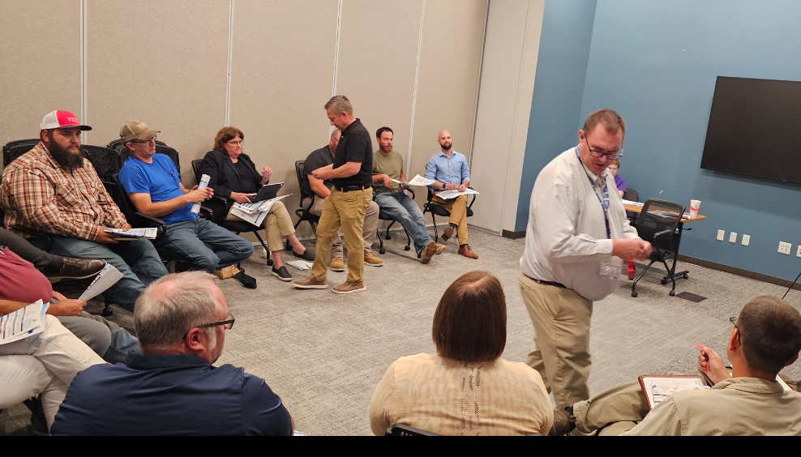
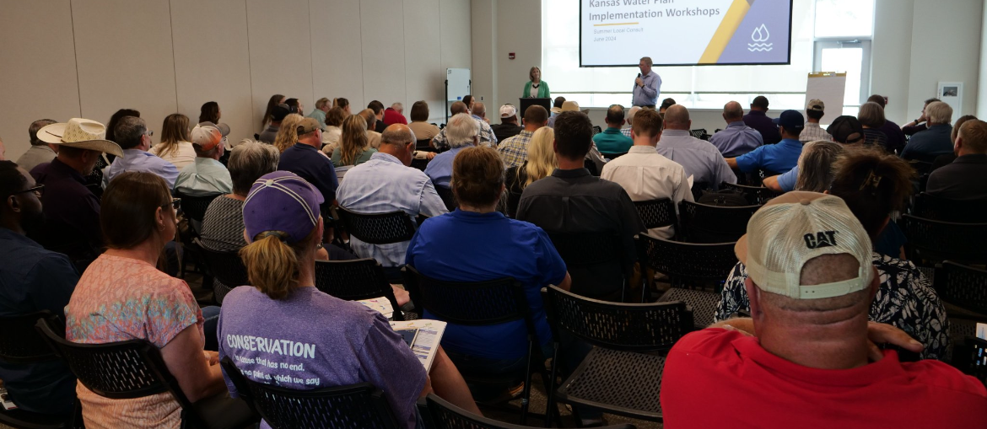
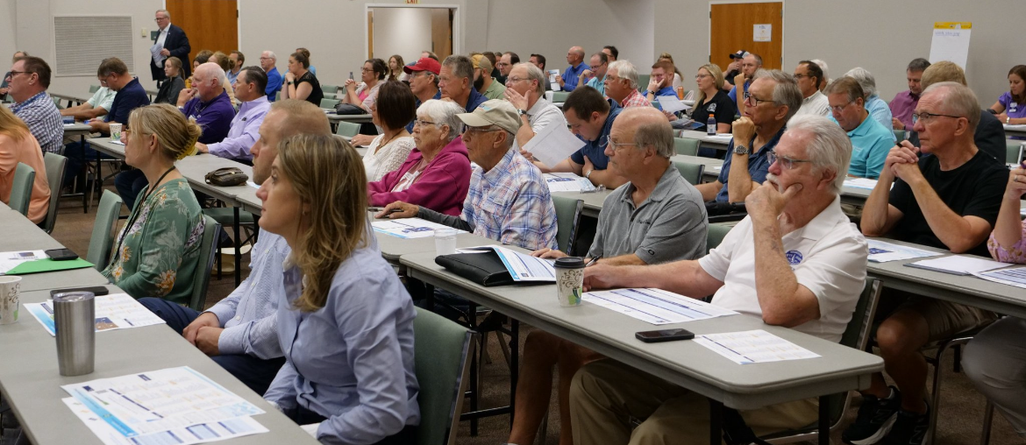
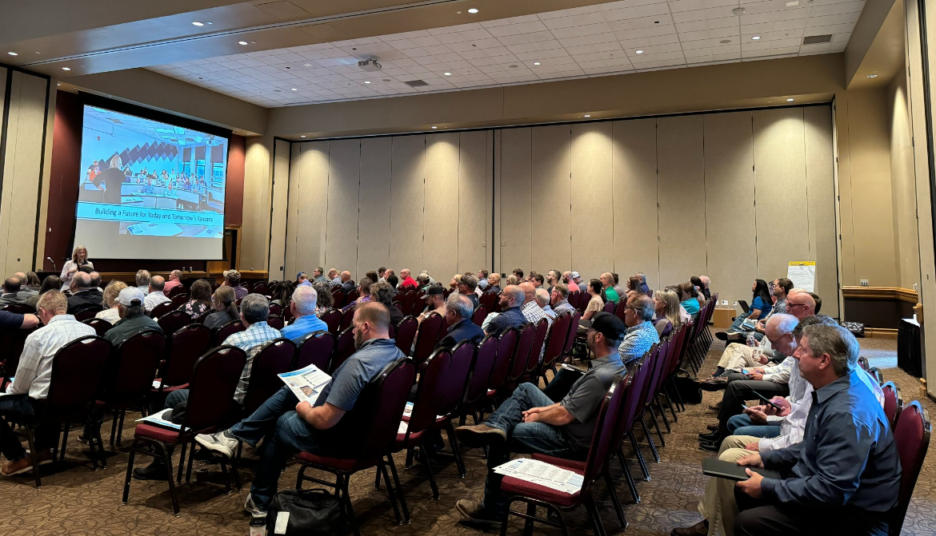
600+ Kansans Provided Input

Slide 3
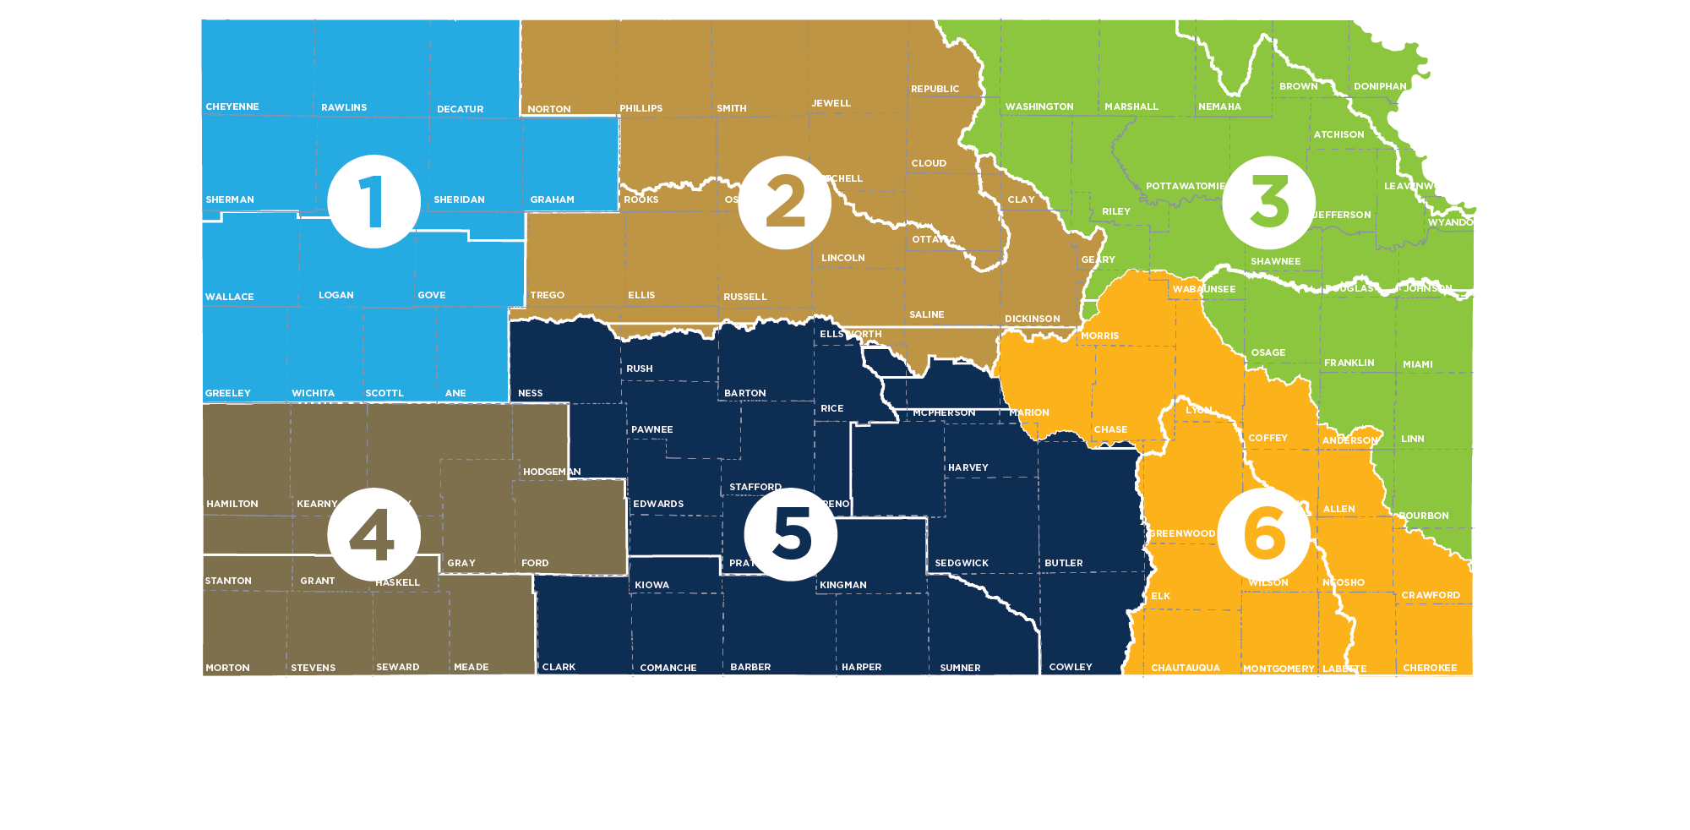
Meeting Participation by Region
55+
80+
150+
Northwest
90+
135+
90+

Slide 4
Summer Local Consult Participants Profile based on 423 RSVPs

Slide 5
Input Sought in These 3 Areas
1
2
3
Regional Goals
Where is there alignment within your region and across the state?
Investment Prioritization
Why do you value investments in one Guiding Principle over another if forced to choose?
Performance
How are we managing water in the state? Where could we improve our programs?

Slide 6
Consensus Overarching Takeaways from Kansans
We have serious water challenges and the time to act is now.
We have a vision, now is time for implementation.
We are all connected by our water issues, what happens in the western portion of the state impacts the east and vice versa.
We need to streamline state agency water programs and to make them easier to use and more efficient.
Clean, secure, accessible water is an economic necessity.

Slide 7
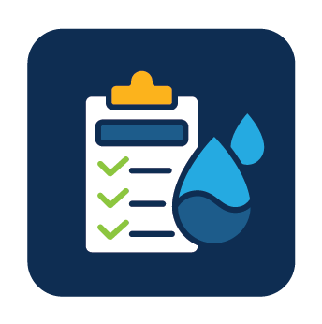
Takeaways related to the Big 3 Guiding Principles
Aquifer: Strong support for about the need to reach sustainability of High Plains Aquifer by using multiple tools like irrigation technologies, cropping practices, water reuse
Reservoir: Strong support for keeping our reservoir water supplies viable for generations through using in-lake and upstream techniques to reduce sedimentation
Water Quality: Strong support for improving water quality across Kansas by improving our water infrastructure

Slide 8
More discussion needed Round 2 on…
How to ensure water programs are reaching intended water users and stakeholders and are utilized effectively?
Prioritizing investment strategies
Braiding (local, state, federal) funding to leverage dollars further

Slide 9
Investment Scenario with Strongest Support
Aquifer
Tie
Reservoir
Water Quality

Slide 10
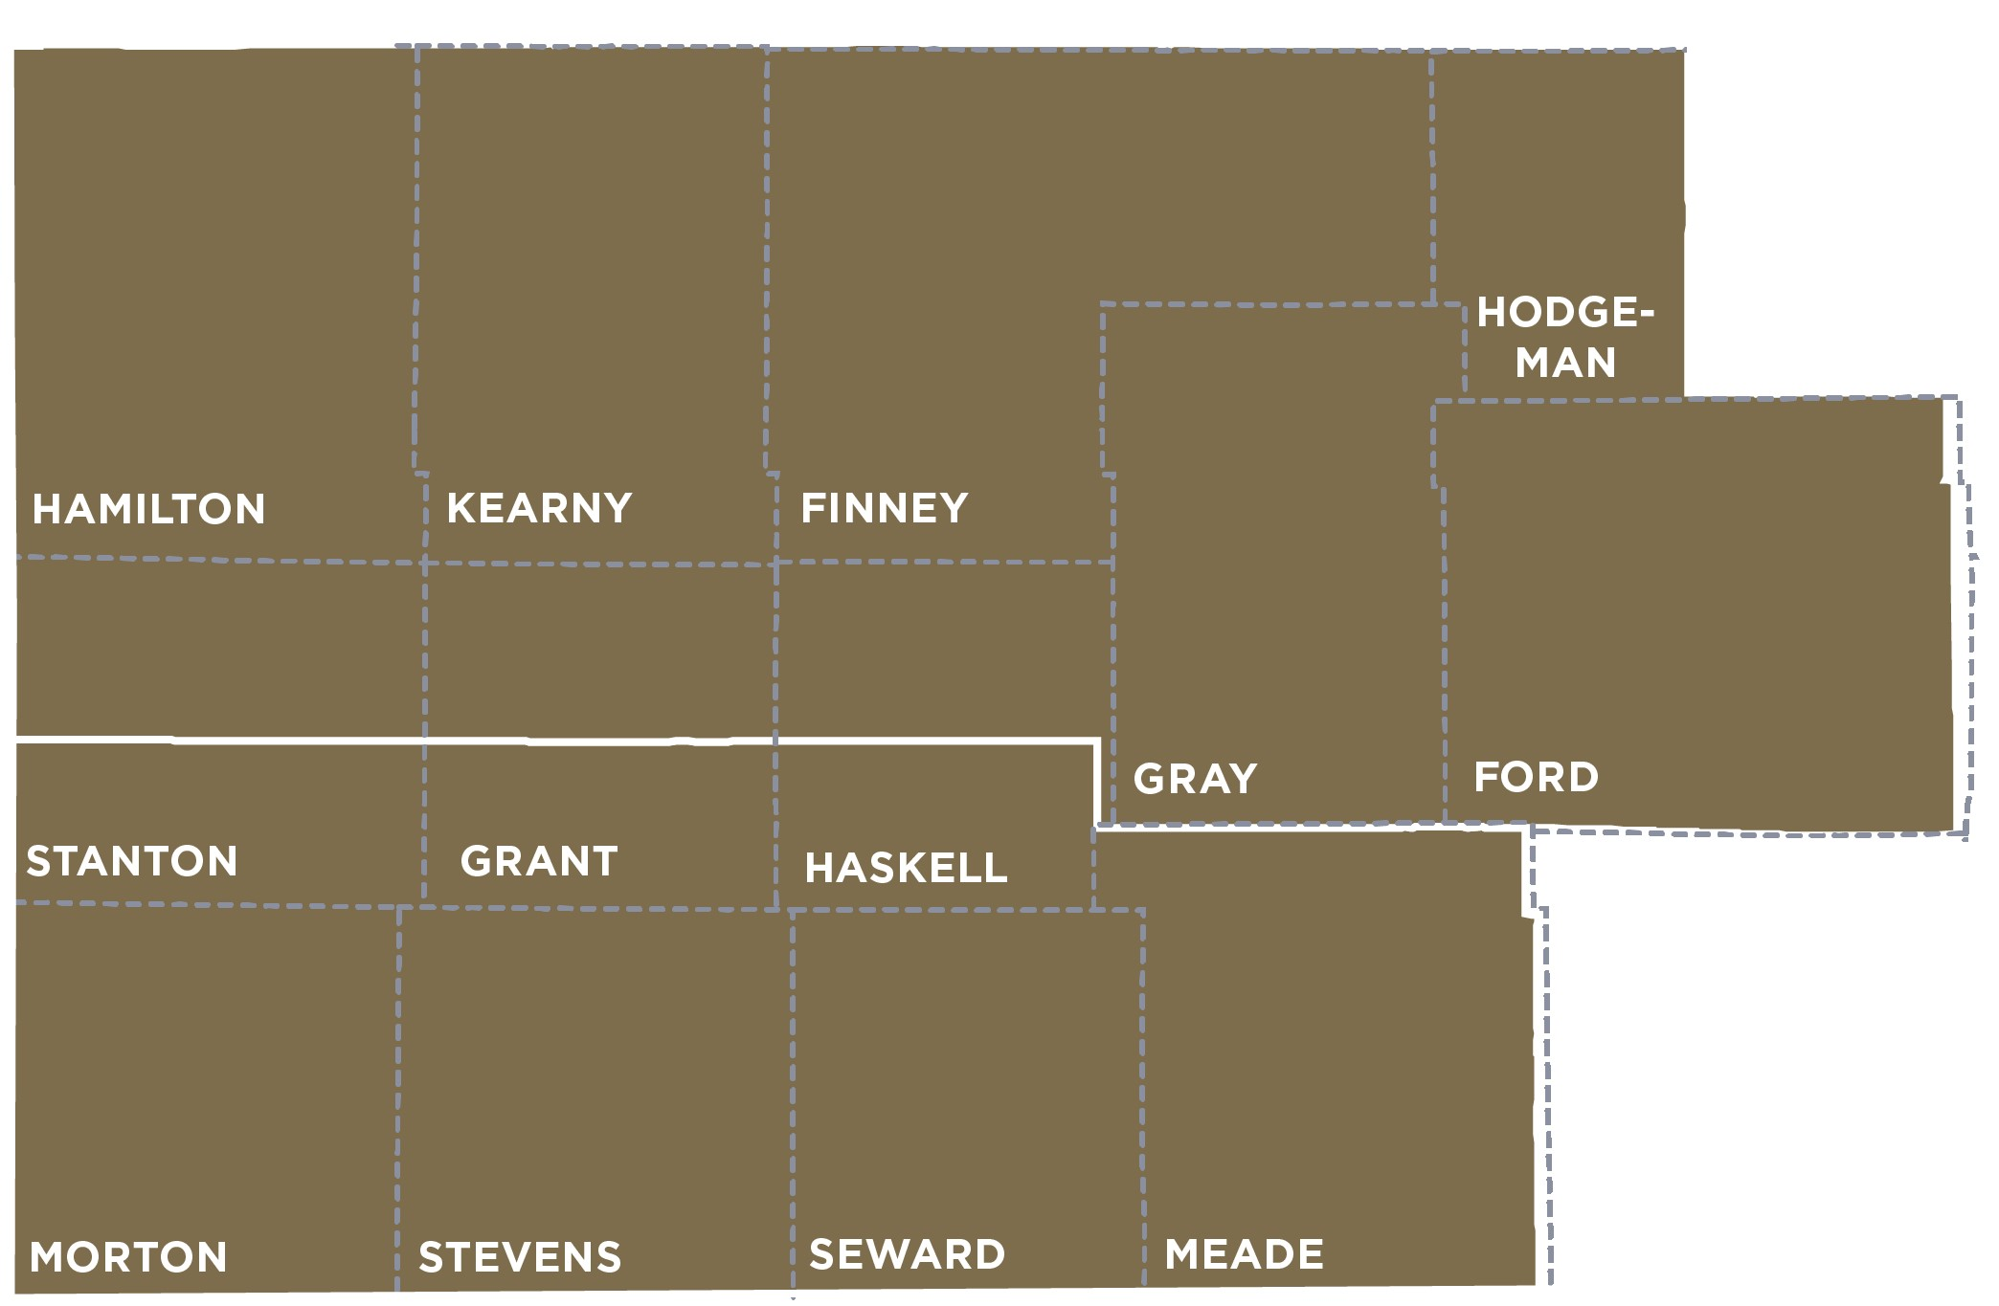
Southwest Region (Dodge City) Takeaways
Upper Arkansas RAC
Cimarron RAC

Slide 11
Regional Goal Alignment Input
Overall, RACs were in alignment with the goals.
There were some questions about what “promoting and incentivizing regionalization” means in this context.
Consider adding water quality and land management practices to reduce sedimentation in the goals. There is a need to have adequate storage to be more resilient to droughts.
This relates to the theme of wanting to show other regions they are concerned about their needs too.
RAC Similarity Score:
3 - 4

Slide 12
Reasons for Supporting Investment Scenarios
Aquifer (most support)
It’s declining and of significant importance, including household water supply.
Impact on cattle industry
Essential to way of life
Water Quality
Feels do-able
“What good is water if it isn’t usable?”
Need more money for testing and treatment, even in the groundwater regions, especially for smaller communities.
Reservoir
Investment in reservoirs shows other regions we’re committed to working together

Slide 13
Programs/Overall Performance
What is working well:
LEMAs
Playa Restoration
Multi-Year Flex Accounts
Soil Health Initiative
Water Conservation Areas
Programs that are working to coordinate water quality issues with other neighboring states.
Areas for improvement:
Improve collaboration between the State, regional agencies, and producers
Incentivize water conservation
Expand watershed districts
Fund innovative technology for producers to measure water usage

Slide 14
Other Notable Input
More awareness is needed among irrigators and water users on what the situation is currently and where it is headed.
Create stackable programs that achieve multiple goals.
Coordinate to avoid duplication of efforts, money spent, and avoid stepping on toes.
There’s a need for a prioritization rubric for smaller water systems/municipalities

Slide 15
Notable Quotes
“The aquifer is our lifeline. It’s what we rely on the most.”
“We need to change the mindset about LEMAs. We need to talk about the important economic impact of water.”
“We need model to compare depletion of the aquifer to depletion of reservoirs – how much time to deplete and the economic impact [of depletion].”
“Restructure insurance payments so we don’t have to water hailed on crops.”
“Don’t penalize early adopters of conservation.”
“Water data for each user might help drive change.”
-
- Dodge City Participants

Slide 16
Discussion Questions for All Meetings
For those that attended a local consult meeting, what stood out to you?
Did anything surprise you?
What advice or suggestions does your RAC (as one voice) have for the implementation team going forward?
What do you see as the best ways to get the word out in your communities so we can make sure everyone who wants to participate in September local consult is aware of those meetings?

Slide 17
Discussion Questions for the Southwest Region
How aware do you think the average person is in your community about the decline of the aquifer and what it could mean for future generations?
What conservation incentives do you think are most attractive for irrigators? Why?
Do you have any examples of where you think programs could be merged to be more “stackable”?

Slide 18
Next Steps
Summer Local Consult feedback will inform Fall Local Consult
Fall Local Consult meetings will seek input on
Possible investment strategies
Investment levels/cost estimates
Program/policy changes
RAC review & input
Summer & Fall input will inform the recommendations for the Governor and Legislature

