Slide 1
Summer Local Consult Key Takeaways
Kansas Water Plan Implementation
Notes:
Make sure to introduce yourself and why you are presenting today (if this is not covered in the agency welcome).

Slide 2
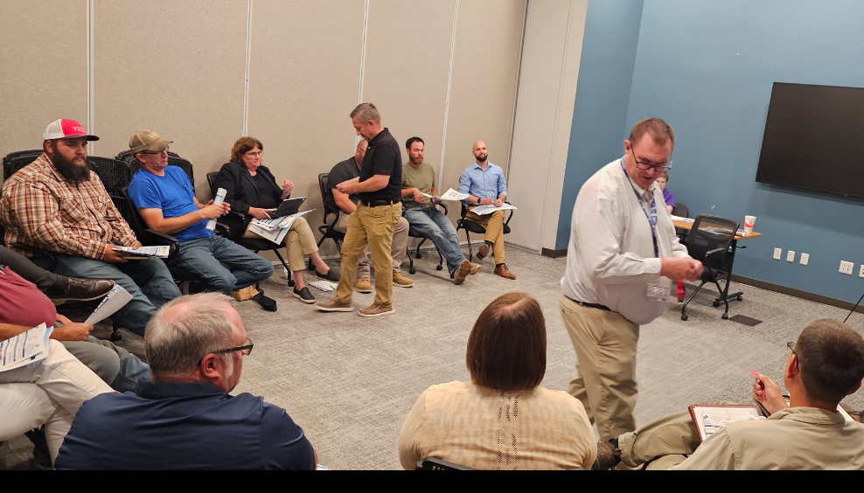
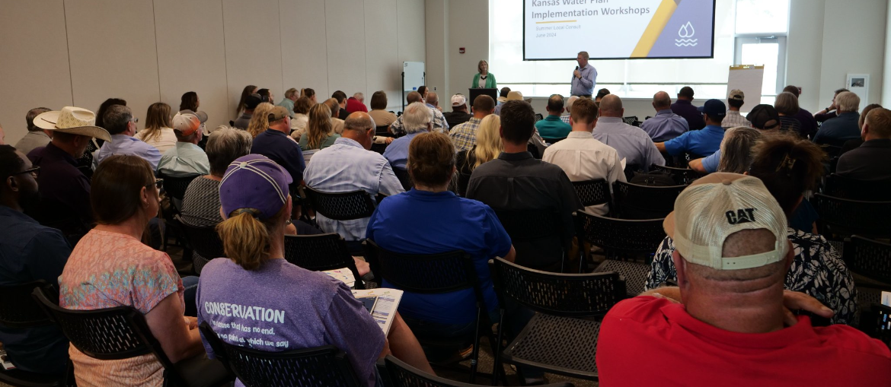
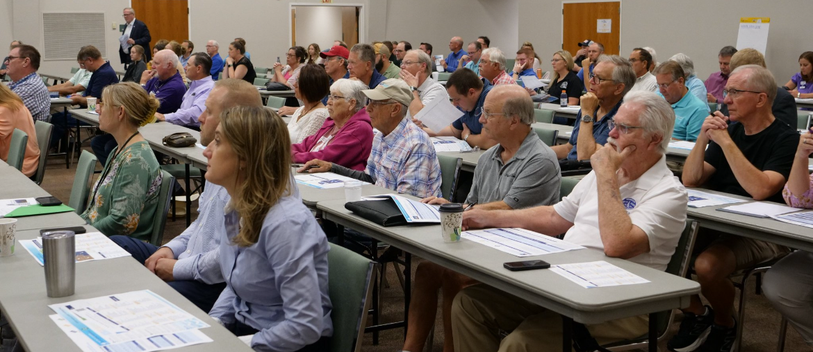
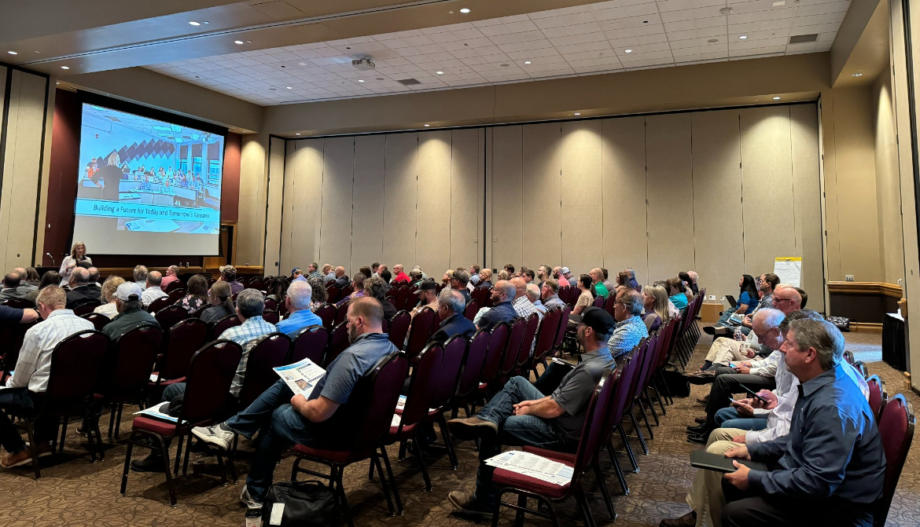
600+ Kansans Provided Input

Slide 3
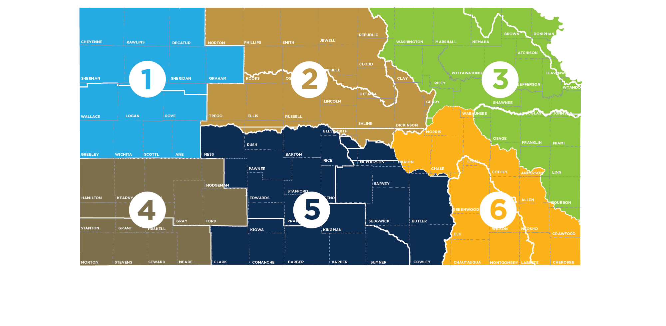
Meeting Participation by Region
55+
80+
150+
Northwest
90+
135+
90+

Slide 4
Summer Local Consult Participants Profile based on 423 RSVPs

Slide 5
Input Sought in These 3 Areas
1
2
3
Regional Goals
Where is there alignment within your region and across the state?
Investment Prioritization
Why do you value investments in one Guiding Principle over another if forced to choose?
Performance
How are we managing water in the state? Where could we improve our programs?

Slide 6
Consensus Overarching Takeaways from Kansans
We have serious water challenges and the time to act is now.
We have a vision, now is time for implementation.
We are all connected by our water issues, what happens in the western portion of the state impacts the east and vice versa.
We need to streamline state agency water programs and to make them easier to use and more efficient.
Clean, secure, accessible water is an economic necessity.

Slide 7
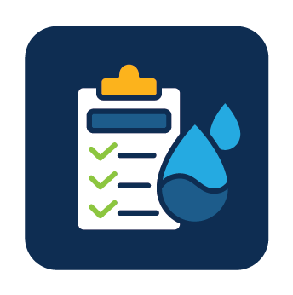
Takeaways related to the Big 3 Guiding Principles
Aquifer: Strong support for about the need to reach sustainability of High Plains Aquifer by using multiple tools like irrigation technologies, cropping practices, water reuse
Reservoir: Strong support for keeping our reservoir water supplies viable for generations through using in-lake and upstream techniques to reduce sedimentation
Water Quality: Strong support for improving water quality across Kansas by improving our water infrastructure

Slide 8
More discussion needed Round 2 on…
How to ensure water programs are reaching intended water users and stakeholders and are utilized effectively?
Prioritizing investment strategies
Braiding (local, state, federal) funding to leverage dollars further

Slide 9
Investment Scenario with Strongest Support
Aquifer
Tie
Reservoir
Water Quality

Slide 10
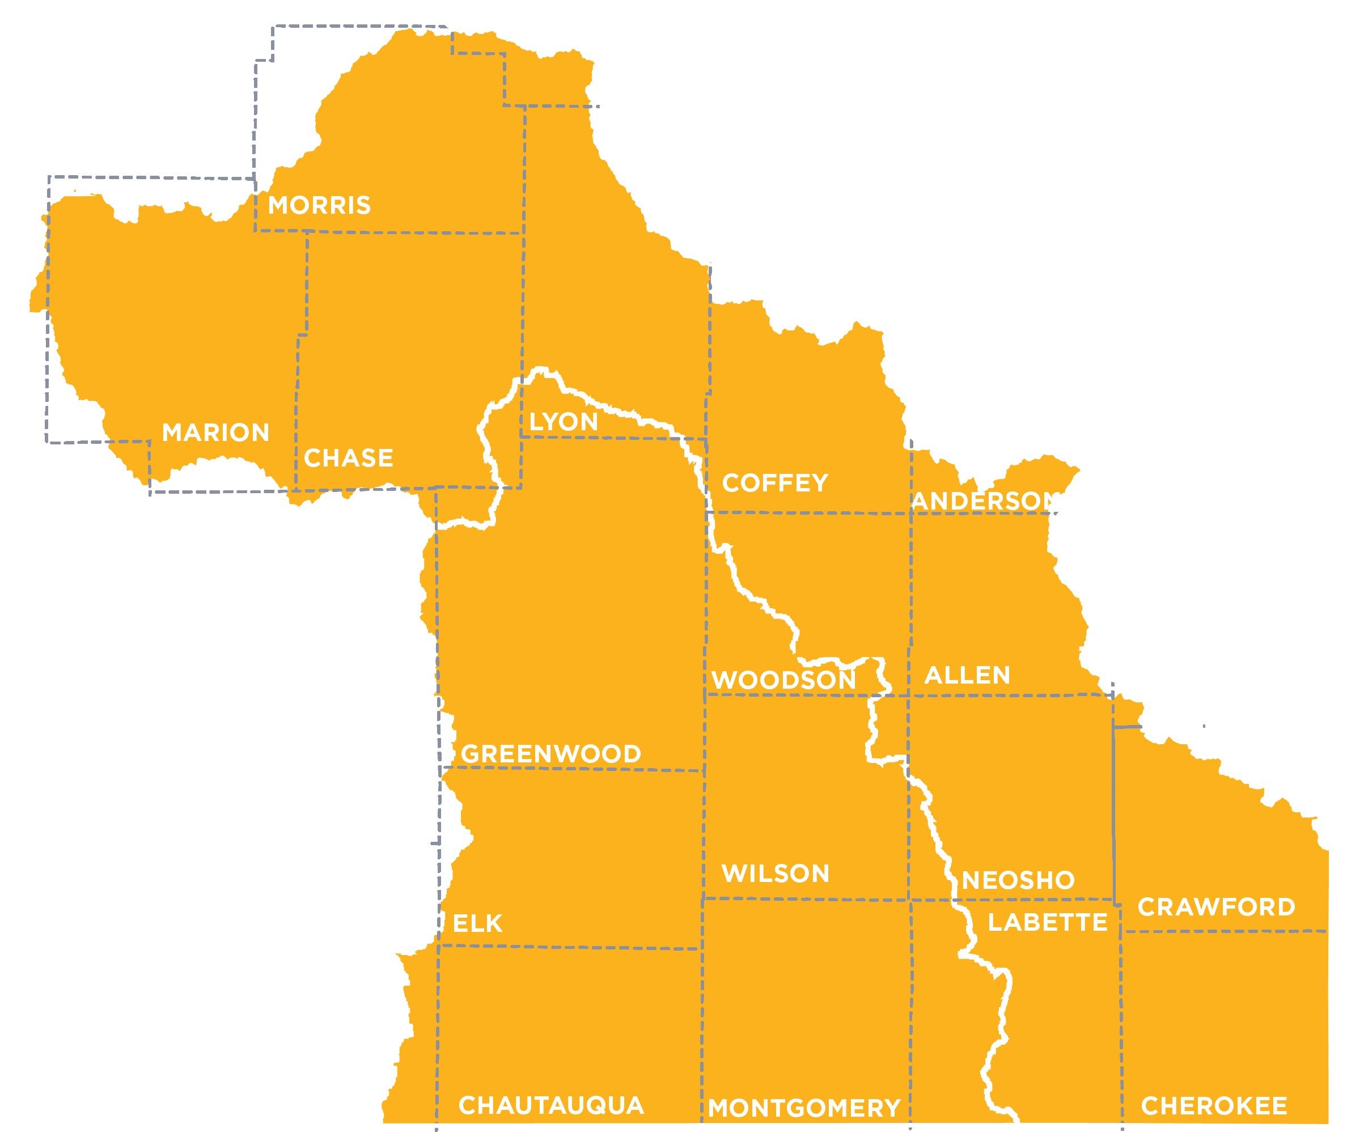
Southeast Region (Chanute) Takeaways
Neosho RAC
Verdigris RAC

Slide 11
Regional Goal Alignment Input
Alignment on prolonging water storage, improving water quality, and improving reservoir health
Participants noted that the RAC goals in this region do not reference pollution or contaminants like RACs in other regions do.
Consider adding restoring stream flow statewide to KWA goals
RAC Similarity Score:
3 - 5

Slide 12
Reasons for Supporting Investment Scenario
Reservoir (most support)
One reservoir improvement can benefit 30+ communities
Benefits water quality too
Recreational use
Water Quality
Aged infrastructure needs a considerable investment. There are water pipes 60+ years old
Rural water districts need increased access to funding
Cheapest buy
Aquifer
Most dire issue without a solution
This is a statewide economic issue
Can’t let western Kansas dry up

Slide 13
Reasons for shifting choices (red tickets)
Hearing about the importance of water quality from other participants
Understanding the economic impact of the aquifer
Felt selfish for not thinking about other portions of the state

Slide 14
Programs/Overall Performance
What’s working well:
Tile drainage
Cover crop program
Peer-to-Peer communication between farmers (e.g., Contrarian Agrarian Group)
Areas for improvement:
Dredging farm ponds
Old water well capping
Expand education and marketing efforts
Incentive programs
Use of innovative water recycling technology
One website for all water programs

Slide 15
Other Notable Input
Some participants did not like the Aquifer investment scenario because in their opinion it benefits the people who depleted the aquifer, they would prefer regulation over purchasing water rights
Need to rethink “research and extension” for a younger generation using already-established virtual communities on social media.
Modernize land designs to restore streamflow statewide.

Slide 16
Other Notable Input Continued
Need to connect infrastructure to support economic development in this part of the state.
What’s the role of the state? Reservoirs are bigger dollar problems while water quality can be cheaper and delivered locally.
Water quality onus is on producers. Government money should only be used for education.

Slide 17
Notable Quotes
“Everyone is doing the best they can to improve soil health and educate.”
“If I had to vote again with my green ticket, I’d select aquifer now that I know the statewide economic impact of it.”
“I’ve read there is a huge percentage of the population that refuses to acknowledge the aquifer is a problem.”
“All of my family is there – if the aquifer goes out, my family is gone.”
- Chanute Participants

Slide 18
Discussion Questions for All Meetings
For those that attended a local consult meeting, what stood out to you?
Did anything surprise you?
What advice or suggestions does your RAC (as one voice) have for the implementation team going forward?
What do you see as the best ways to get the word out in your communities so we can make sure everyone who wants to participate in September local consult is aware of those meetings?

Slide 19
Discussion Questions Specific Southeast Region
Recognizing there is substantial need to help communities restore their water infrastructure, what suggestions do you have for how to prioritize which systems should receive funds?
What do you think are the common characteristics of the programs or initiatives that people praised?
What suggestions do you have for how to modernize research and extension? What other programs need to be modernized?

Slide 20
Next Steps
Summer Local Consult feedback will inform Fall Local Consult
Fall Local Consult meetings will seek input on
Possible investment strategies
Investment levels/cost estimates
Program/policy changes
RAC review & input
Summer & Fall input will inform the recommendations for the Governor and Legislature

