Slide 1
Summer Local Consult Key Takeaways
Kansas Water Plan Implementation
Notes:
Make sure to introduce yourself and why you are presenting today (if this is not covered in the agency welcome).

Slide 2
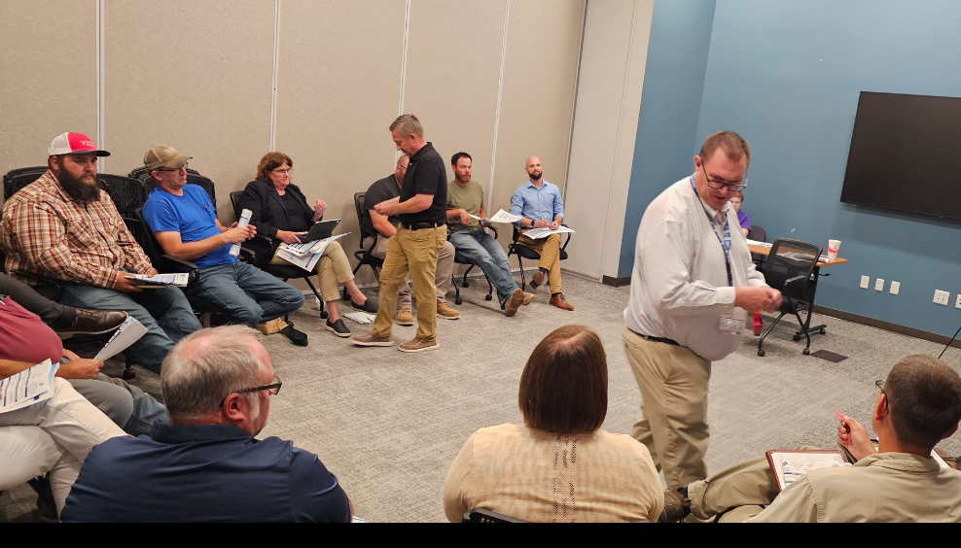
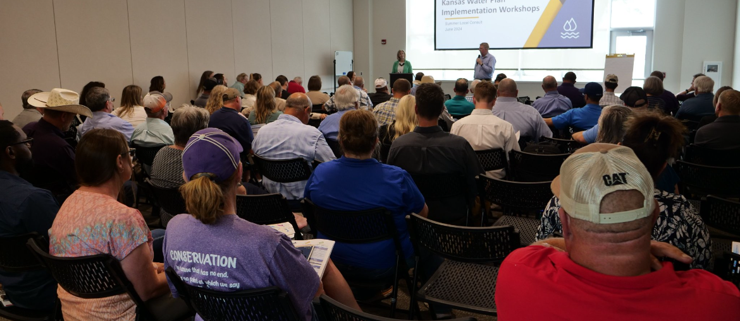
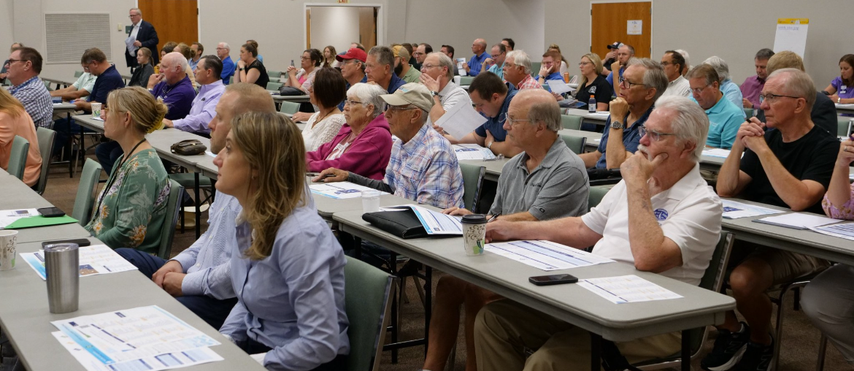
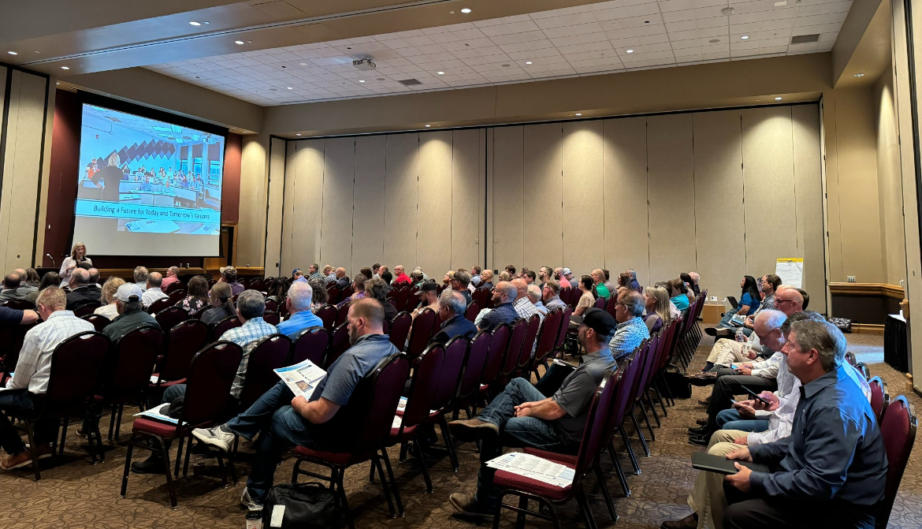
600+ Kansans Provided Input

Slide 3
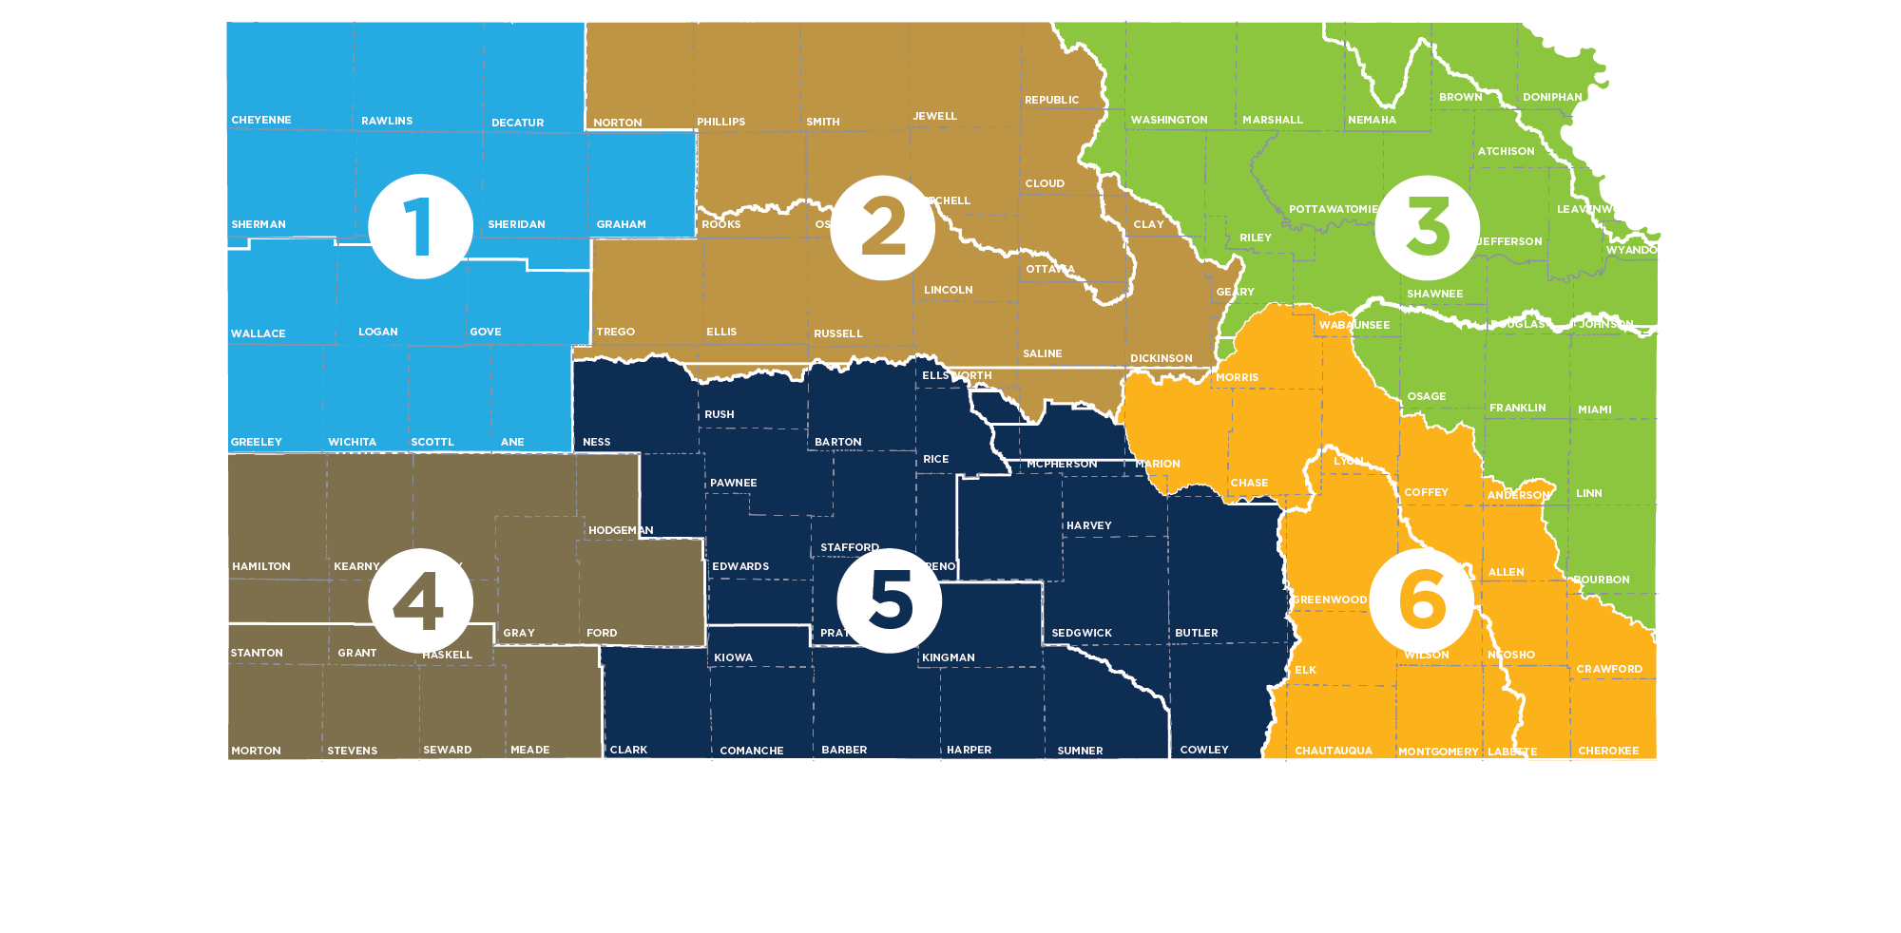
Meeting Participation by Region
55+
80+
150+
Northwest
90+
135+
90+

Slide 4
Summer Local Consult Participants Profile based on 423 RSVPs

Slide 5
Input Sought in These 3 Areas
1
2
3
Regional Goals
Where is there alignment within your region and across the state?
Investment Prioritization
Why do you value investments in one Guiding Principle over another if forced to choose?
Performance
How are we managing water in the state? Where could we improve our programs?

Slide 6
Consensus Overarching Takeaways from Kansans
We have serious water challenges and the time to act is now.
We have a vision, now is time for implementation.
We are all connected by our water issues, what happens in the western portion of the state impacts the east and vice versa.
We need to streamline state agency water programs and to make them easier to use and more efficient.
Clean, secure, accessible water is an economic necessity.

Slide 7
Takeaways related to the Big 3 Guiding Principles
Aquifer: Strong support for about the need to reach sustainability of High Plains Aquifer by using multiple tools like irrigation technologies, cropping practices, water reuse
Reservoir: Strong support for keeping our reservoir water supplies viable for generations through using in-lake and upstream techniques to reduce sedimentation
Water Quality: Strong support for improving water quality across Kansas by improving our water infrastructure

Slide 8
More discussion needed Round 2 on…
How to ensure water programs are reaching intended water users and stakeholders and are utilized effectively?
Prioritizing investment strategies
Braiding (local, state, federal) funding to leverage dollars further

Slide 9
Investment Scenario with Strongest Support
Aquifer
Tie
Reservoir
Water Quality

Slide 10
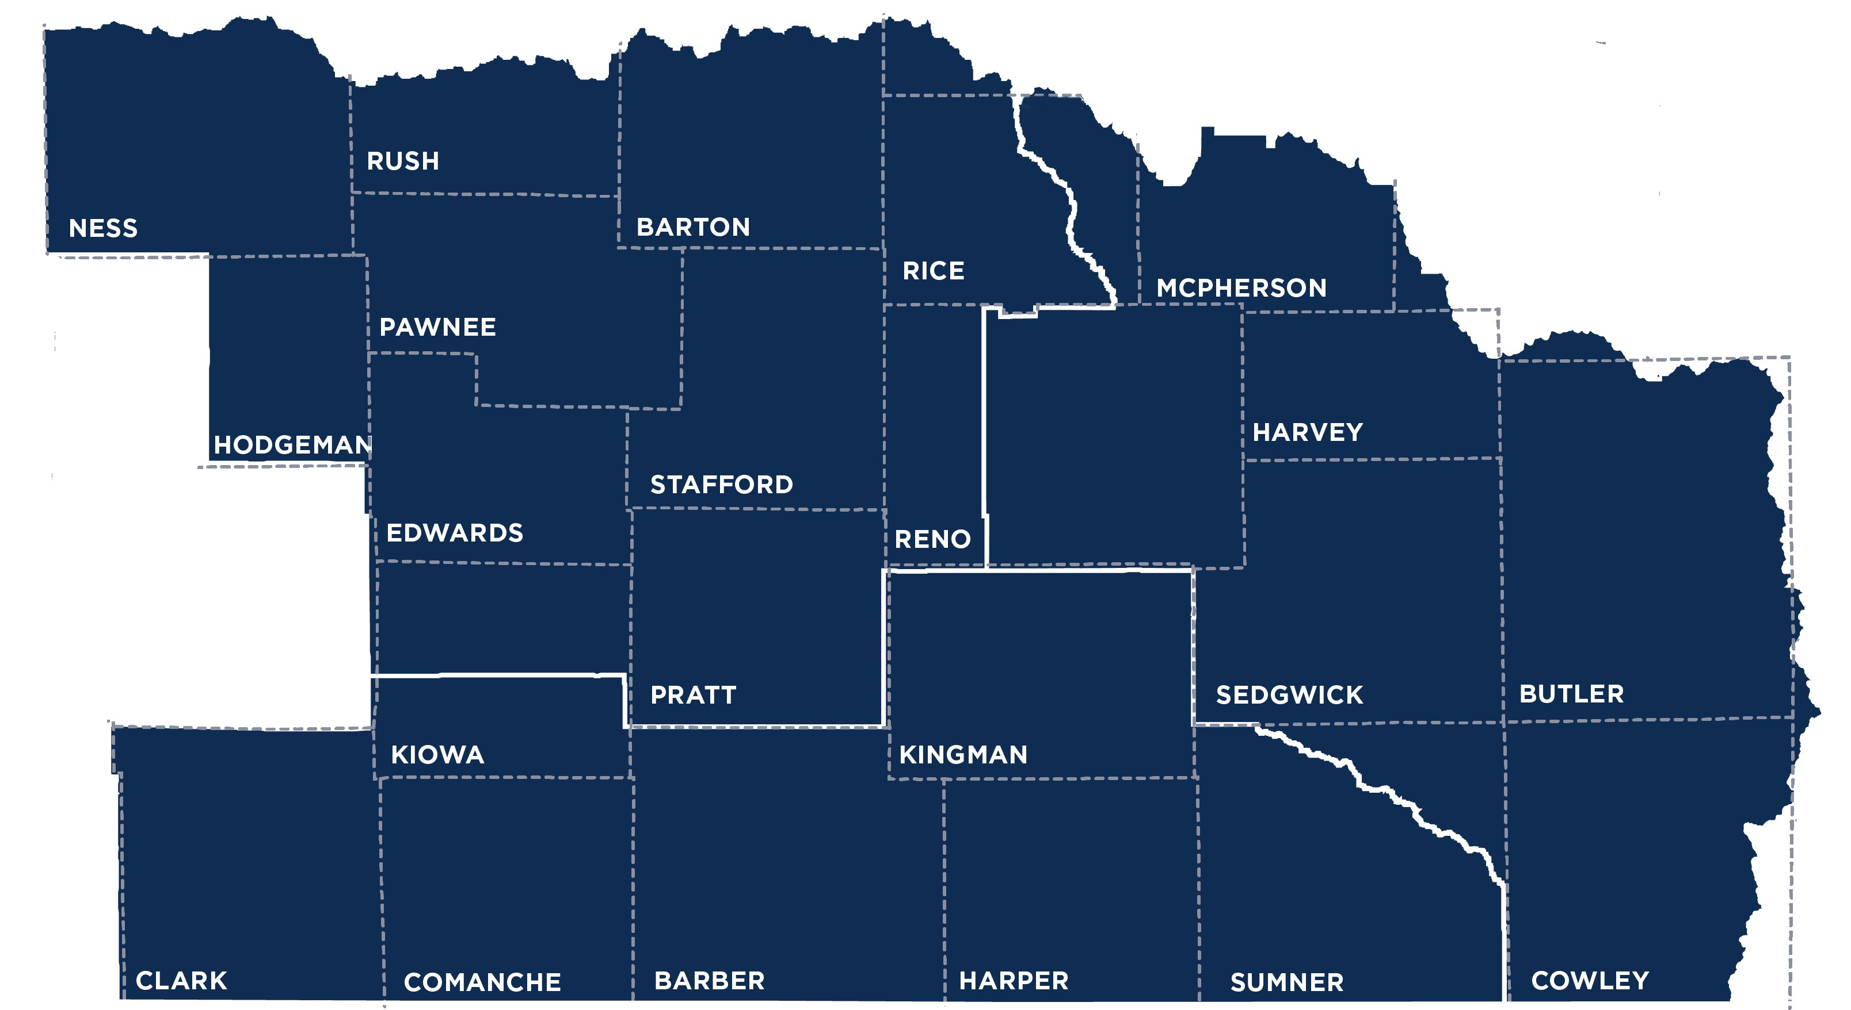
South Central Region (Wichita) Takeaways
Equus-Walnut RAC
Great Bend Prairie RAC
Red Hills RAC

Slide 11
Regional Goal Alignment Input
Majority of participants viewed RACs as a three (3) or greater in terms of similarity, although participants did raise discrepancies that could cause issues in defining regional goals, such as:
Red Hills RAC is more industrial in nature and located outside of aquifer beds
Two (2) RACs not having land management goals
Suggested additions to KWA Goals:
Providing assistance for infrastructure updates
Focusing on conservation and reuse in urban areas
Accounting for differences between rural and urban water needs
RAC Similarity Score:
3-4

Slide 12
Investment Scenario Input
Strongest support for Game Changer Investments varied between Water Quality and Aquifer Improvements
Participants did note that Reservoir improvements may provide an easier/quicker result, but they were concerned about the lack of federal funding available to assist efforts

Slide 13
Investment Scenario Input (continued)
When given the opportunity to use a red ticket (bonus game changer investment), participants gave the following reasons for their choices:
Reservoirs would provide quicker results
The Aquifer impacts more people

Slide 14
Notable Quotes
“I would rather eat food than lawns.”
“We have all the issues here (quality, aquifers and reservoirs), we can set the tone for (comprehensive) statewide perspective.”
“Why preserve water for the future? Use it now for the economy.”
“Too many agencies, too many hands, too many programs – we need a one-stop shop.”
“When I see “all” water clear of “all” contaminants, I think that’s a walking trap for violations.”
- Wichita Participants

Slide 15
Programs/Overall Performance
Participants praised:
Focus on disadvantaged communities
Peer-to-peer network building
HB 2302 Grants
Participants recommend improvements in:
Highlighting local success stories
Providing more specific contact information for program assistance
"Who should I contact when I...?“
More technical service opportunities, such as a "one-stop shop" for grant writing support

Slide 16
Discussion Questions for All Meetings
For those that attended a local consult meeting, what stood out to you?
Did anything surprise you?
What advice or suggestions does your RAC (as one voice) have for the implementation team going forward?
What do you see as the best ways to get the word out in your communities so we can make sure everyone who wants to participate in September local consult is aware of those meetings?

Slide 17
Discussion Questions Specific to South Central
When discussing the most effective ways to save water, it’s helpful to share how water is being used in the state. How do we balance informing Kansans about how water is being used without it feeling like we’re singling out irrigation farms (or others who use large quantities of water)?
How would you prioritize where technical assistance would be most impactful? (Ex. for programs, technology, grants etc).
Do you think more people would have supported the Reservoir Investment Scenario if they knew that federal funds would be utilized too? Why or why not?

Slide 18
Next Steps
Summer Local Consult feedback will inform Fall Local Consult
Fall Local Consult meetings will seek input on
Possible investment strategies
Investment levels/cost estimates
Program/policy changes
RAC review & input
Summer & Fall input will inform the recommendations for the Governor and Legislature

