Slide 1
Summer Local Consult Key Takeaways
Kansas Water Plan Implementation
Notes:
Make sure to introduce yourself and why you are presenting today (if this is not covered in the agency welcome).

Slide 2
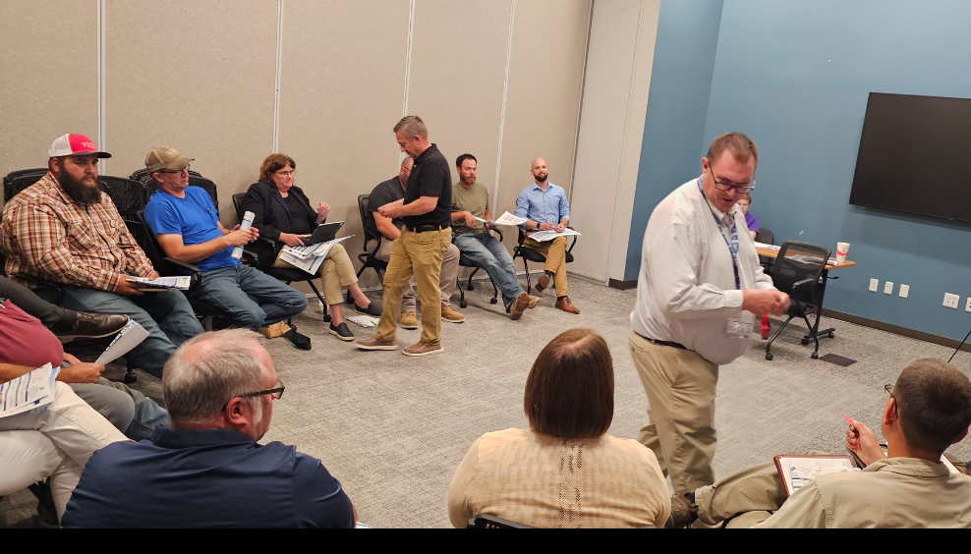
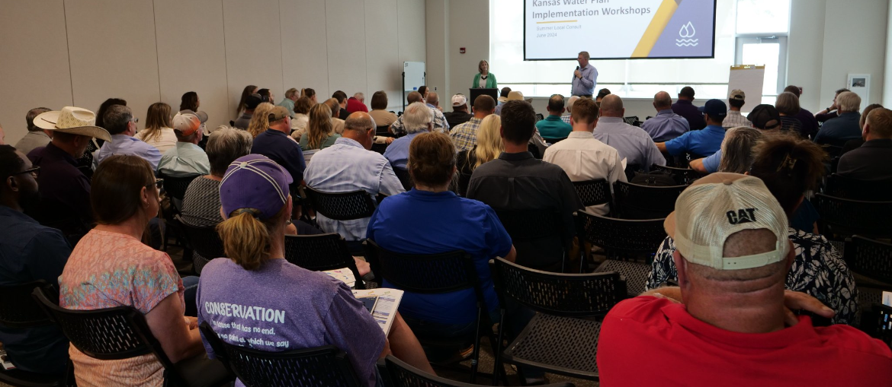
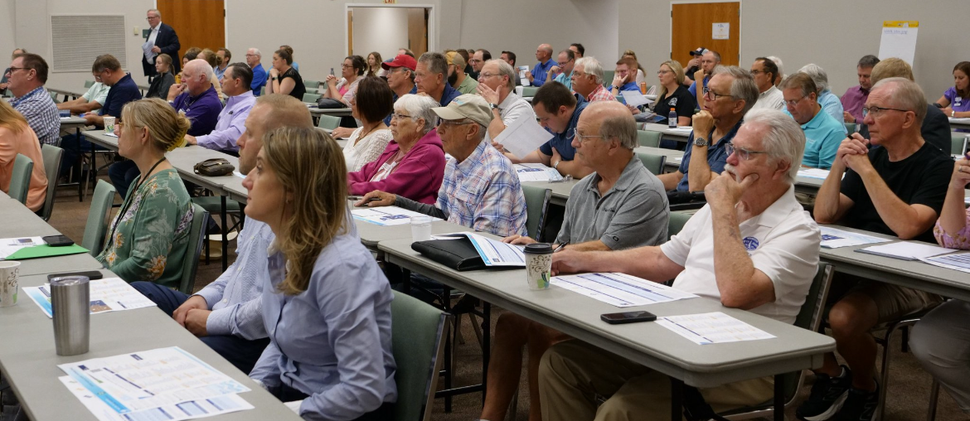
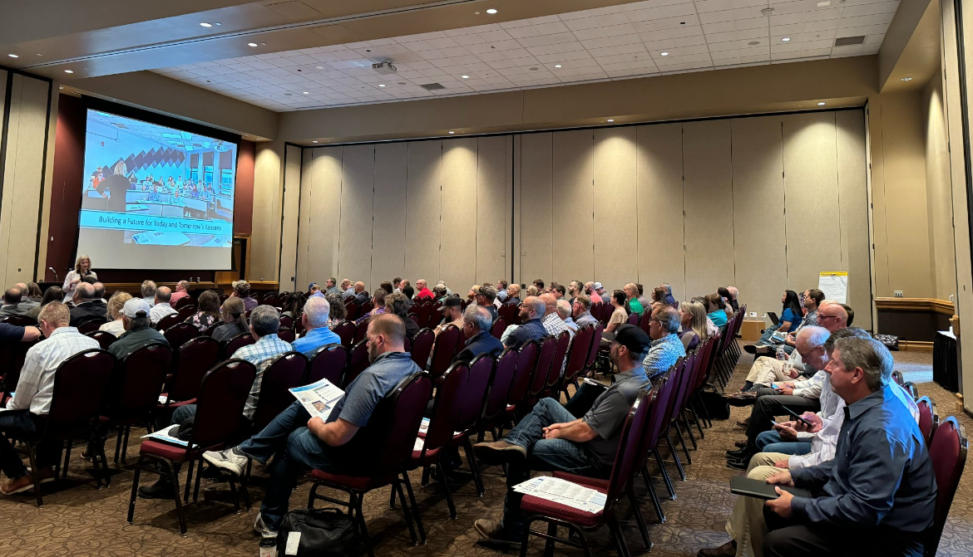
600+ Kansans Provided Input

Slide 3
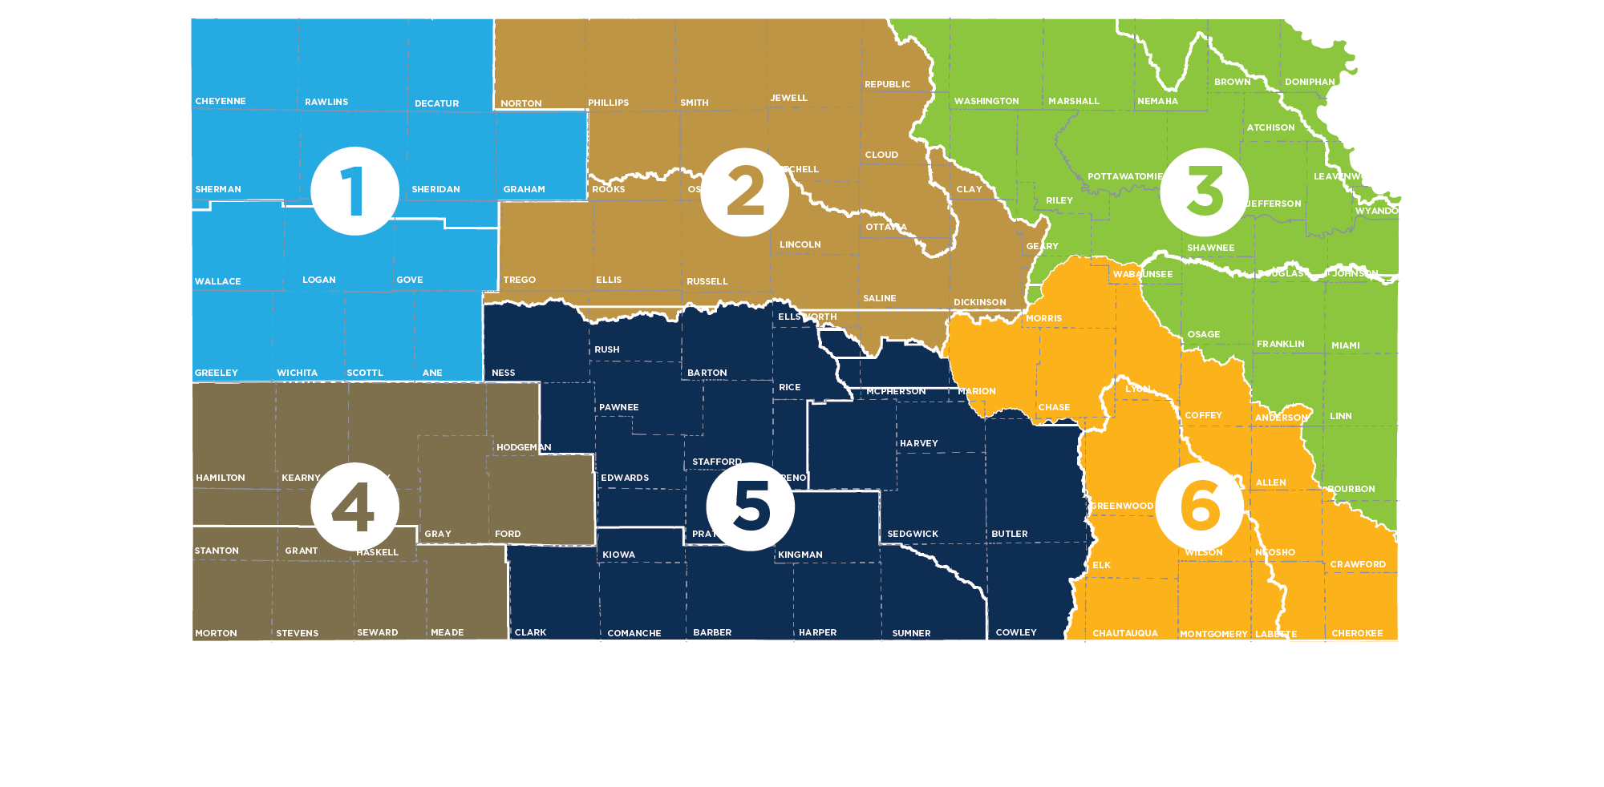
Meeting Participation by Region
55+
80+
150+
Northwest
90+
135+
90+

Slide 4
Summer Local Consult Participants Profile based on 423 RSVPs

Slide 5
Input Sought in These 3 Areas
1
2
3
Regional Goals
Where is there alignment within your region and across the state?
Investment Prioritization
Why do you value investments in one Guiding Principle over another if forced to choose?
Performance
How are we managing water in the state? Where could we improve our programs?

Slide 6
Consensus Overarching Takeaways from Kansans
We have serious water challenges and the time to act is now.
We have a vision, now is time for implementation.
We are all connected by our water issues, what happens in the western portion of the state impacts the east and vice versa.
We need to streamline state agency water programs and to make them easier to use and more efficient.
Clean, secure, accessible water is an economic necessity.

Slide 7
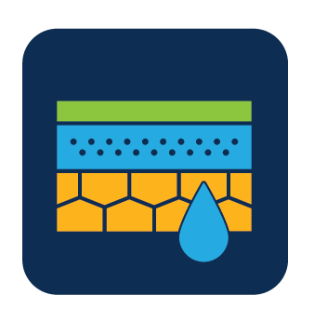
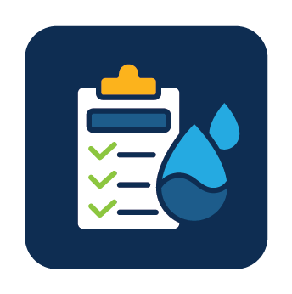
Takeaways related to the Big 3 Guiding Principles
Aquifer: Strong support for about the need to reach sustainability of High Plains Aquifer by using multiple tools like irrigation technologies, cropping practices, water reuse
Reservoir: Strong support for keeping our reservoir water supplies viable for generations through using in-lake and upstream techniques to reduce sedimentation
Water Quality: Strong support for improving water quality across Kansas by improving our water infrastructure

Slide 8
More discussion needed Round 2 on…
How to ensure water programs are reaching intended water users and stakeholders and are utilized effectively?
Prioritizing investment strategies
Braiding (local, state, federal) funding to leverage dollars further

Slide 9
Investment Scenario with Strongest Support
Aquifer
Tie
Reservoir
Water Quality

Slide 10
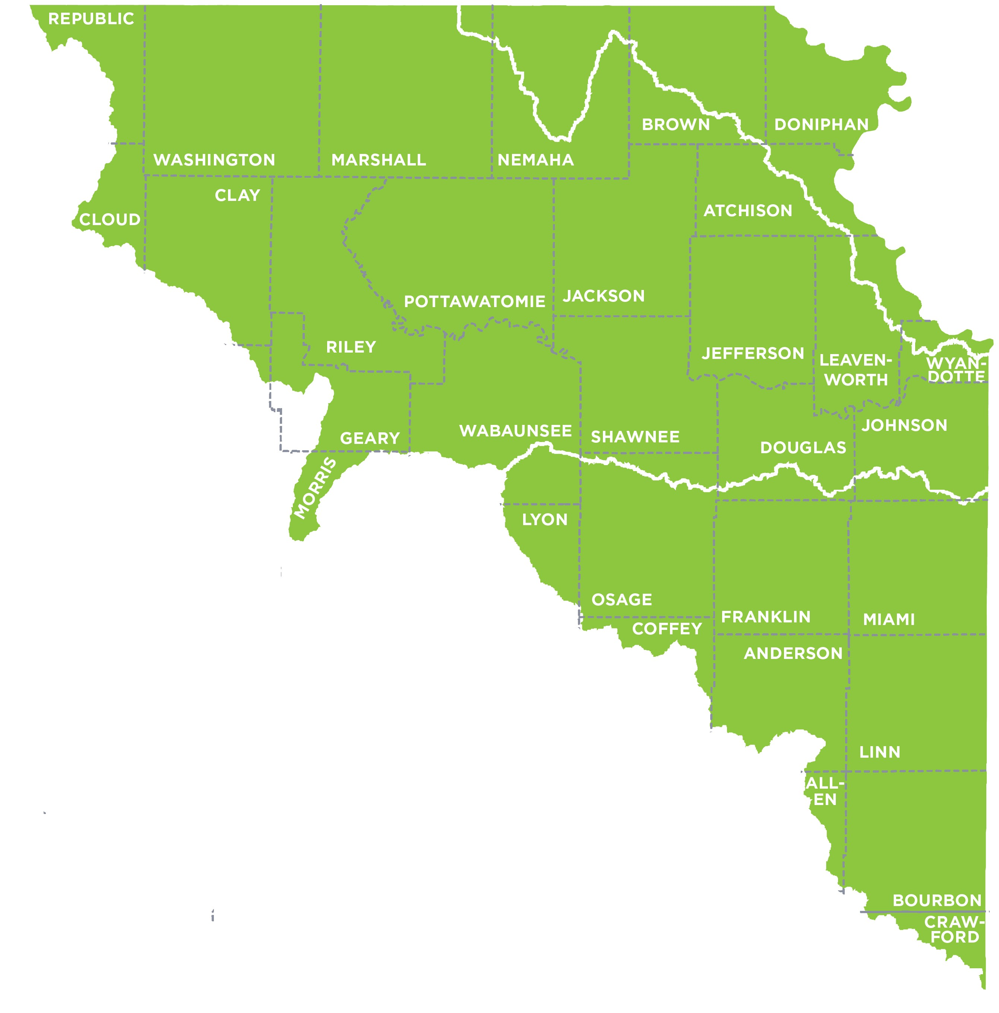
Northeast Region (Lawrence) Takeaways
Missouri RAC
Kansas RAC
Marais des Cygnes RAC

Slide 11
Regional Goal Alignment Input
Goals alignment on:
Reducing sedimentation, including through land management
Water Quality
Water Supply
Reducing harmful algal blooms
Differences:
Marais Des Cygnes addresses groundwater. (Other RACs focused on surface water)
Missouri RAC includes providing financial strategies and flood strategies (others did not).
RAC Similarity Score:
2 - 4

Slide 12
Suggestions for Kansas Water Authority Goals
Consider adding to the KWA Goals:
Water Reuse
Reduce contamination of streams/surface water
Other considerations:
Incorporate more long-term goals into planning; emphasis on goals that will have a positive impact on a few generations

Slide 13
Justification for Game Changer Investments
Water Quality
Overarching approach with large impact across all 3 areas
Water must be safe to use. (Doesn’t matter if you have a lot if you can’t use it.)
Failing infrastructure statewide
Public desire for improved water quality and equity
Improved treatment efficiency
Reservoir
Protecting what drains into the reservoirs has an impact on all 3 areas
Priority investment benefits multiple areas by impacting quality through better management
Storage/sedimentation issues
Money will go farthest
Most visible water resource
Recreational activities
Climate change – need to be prepared for floods/droughts.
Aquifer
Implementing water protection measures could maximize benefits in all 3 areas
Economic impact
Critical for agriculture
Future-focused
Easiest area to convince the public and producers to implement water reuse measures

Slide 14
What persuaded people to change (red ticket)
Shift from Aquifer to Reservoir:
Storage is a huge issue. All reservoirs have sedimentation issues, and this impacts the whole state.
Shift from Water Quality to Reservoir:
Water quality benefits can be captured through reservoir improvements
*Note, all scenarios received red tickets. Above are reasons for those who made a big shift from Stand Pat to Game Changer using their red ticket.

Slide 15
Suggested additions to the Investment Scenarios
Conservation and land management practices that can positively impact water resources
More emphasis on public health needs related to water quality investments.

Slide 16
Programs/Overall Performance
What is working well:
KS Rural Water Assoc.
KS Water Institute (K-State Research and Extension)
KWO HB2302 grant program
KDA Cost share conservation district
KWO Drought monitoring
KDA Nonpoint source pollution
KDHE WRAPS program
KDA Soil health initiative
Areas for improvement:
Increase funding for public water supply loans. KDHE programs do not have enough money to meet needs/demands.
Hiring and staffing (low pay, short staffed, inconsistent training etc.)
Improve the website
Being proactive, rather than reactive
We need stackable programs
Need peer to peer education
One stop shop for programs

Slide 17
Other Notable Input
Participants stressed the importance of tailoring education programs for specific regions/audiences (e.g., KS legislature, general public, young farmers, etc.)
Potential challenges in merging small rural water districts could be addressed by placing an emphasis on smaller water systems by:
Increasing grant funding to meet demands
Developing a more proactive approach for addressing infrastructure problems

Slide 18
Notable Quotes
“KS needs a sustainable investment strategy that will last several generations.”
“We can’t buy our way and won’t volunteer our way out of this.” (re: need for regulation)
“We need future-casting. How much water will we need?”
“We need to incentivize regionalism and collaboration.”
“You get a big bang for your buck when you invest in water quality and reservoirs” (re: overlapping benefits)
“Ogalla is a national treasure. Act now to save it.”
-Lawrence Participants

Slide 19
Discussion Questions for All Meetings
For those that attended a local consult meeting, what stood out to you?
Did anything surprise you?
What advice or suggestions does your RAC (as one voice) have for the implementation team going forward?
What do you see as the best ways to get the word out in your communities so we can make sure everyone who wants to participate in September local consult is aware of those meetings?

Slide 20
Discussion Questions for Northeast Region
What long-term benefits of these investments do you think are most persuasive to Kansans for why we need to act now?
Where do you think the state could be more proactive?
Based on your experience, are there are any common characteristics of the programs that people praised? Why do you think those programs received high marks?

Slide 21
Next Steps
Summer Local Consult feedback will inform Fall Local Consult
Fall Local Consult meetings will seek input on
Possible investment strategies
Investment levels/cost estimates
Program/policy changes
RAC review & input
Summer & Fall input will inform the recommendations for the Governor and Legislature

