Slide 1

Summer Local Consult
Key Takeaways
Kansas Water Plan Implementation
Notes:
Make sure to introduce yourself and why you are presenting today (if this is not covered in the agency welcome).

Slide 2
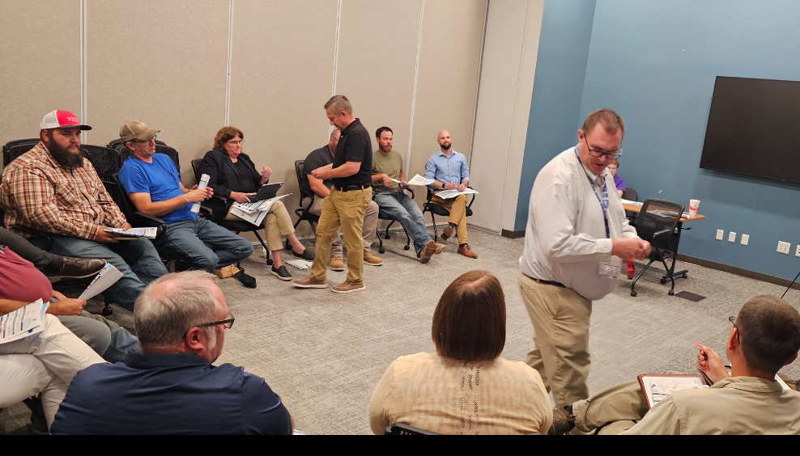
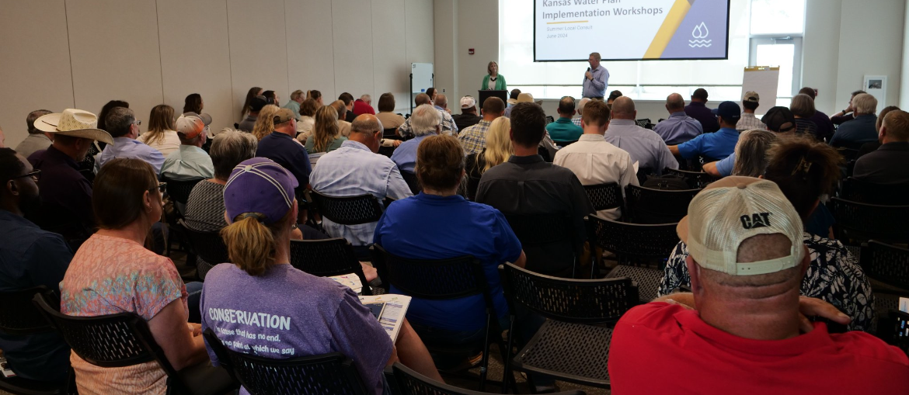
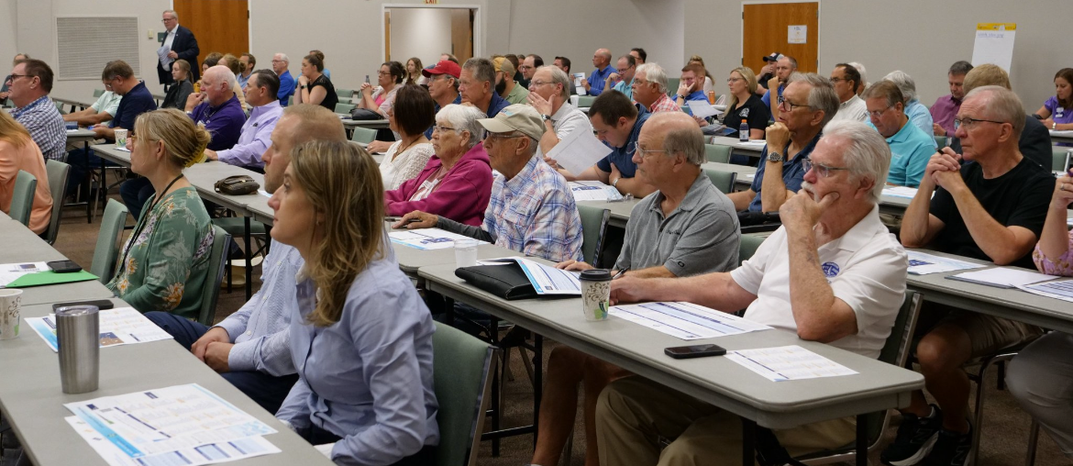
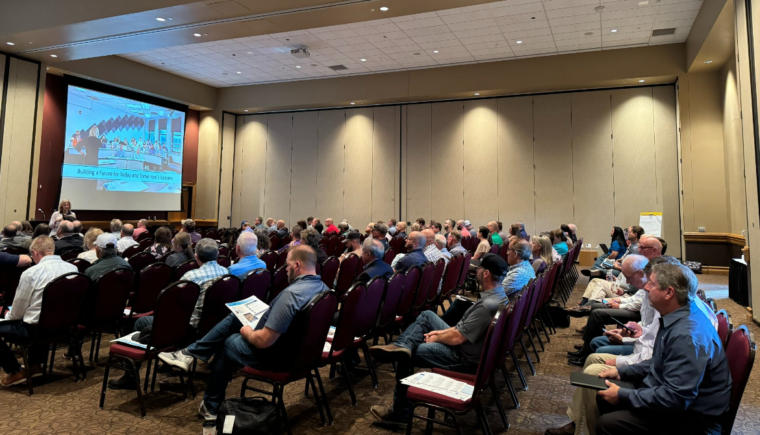
600+ Kansans Provided Input

Slide 3
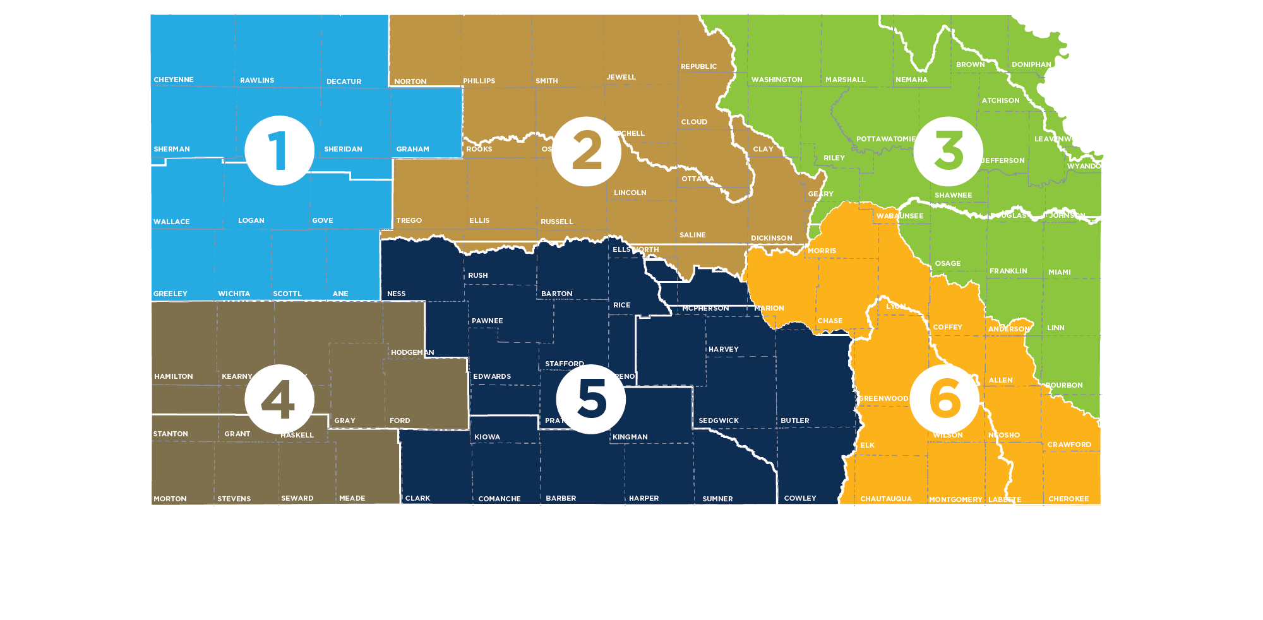
Meeting Participation by Region
55+
80+
150+
Northwest
90+
135+
90+

Slide 4
Summer Local Consult Participants Profile based on 423 RSVPs

Slide 5
Input Sought in These 3 Areas
1
2
3
Regional Goals
Where is there alignment within your region and across the state?
Investment Prioritization
Why do you value investments in one Guiding Principle over another if forced to choose?
Performance
How are we managing water in the state? Where could we improve our programs?

Slide 6
Consensus Overarching Takeaways from Kansans
We have serious water challenges and the time to act is now.
  We have a vision, now is time for implementation.
We are all connected by our water issues, what happens in the western portion of the state impacts the east and vice versa.
We need to streamline state agency water programs and to make them easier to use and more efficient.
Clean, secure, accessible water is an economic necessity.

Slide 7



Takeaways related to the Big 3 Guiding Principles
Aquifer: Strong support for about the need to reach sustainability of High Plains Aquifer by using multiple tools like irrigation technologies, cropping practices, water reuse
Reservoir: Strong support for keeping our reservoir water supplies viable for generations through using in-lake and upstream techniques to reduce sedimentation
Water Quality: Strong support for improving water quality across Kansas by improving our water infrastructure

Slide 8
More discussion needed Round 2 on…
How to ensure water programs are reaching intended water users and stakeholders and are utilized effectively?
Prioritizing investment strategies
Braiding (local, state, federal) funding to leverage dollars further

Slide 9
Investment Scenario with Strongest Support
Aquifer
Tie
Reservoir
Water Quality

Slide 10
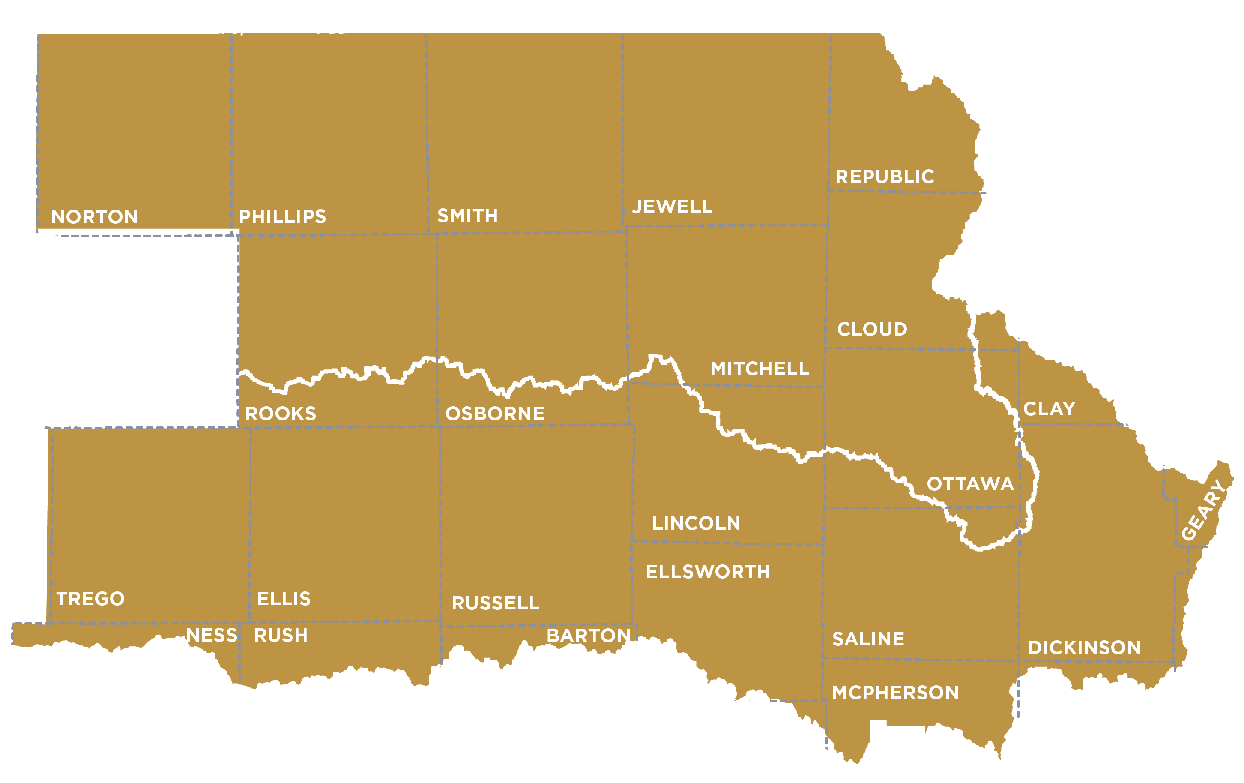
North Central Region (Salina) Takeaways
Solomon-Republican RAC
Smoky Hill- Saline RAC

Slide 11
Regional Goal Alignment Input
Majority viewed RACs as a two (2) or less in terms of similarity
  Geographic differences were attributed to portions of the region having more arid climate than others, resulting in different water needs
They recommend adding more educational outreach to the KWA Goals and provided the following suggestions:
  Urging more emphasis on all aquifers and not focusing too much on the Ogallala
  Stressing "conservation as a pillar"
  Discussing woody encroachment into native grasslands, which decreases livestock production and increases wildfire potential
RAC Similarity Score:
1-2

Slide 12
Investment Scenario Input
Strongest support for Game Changer Investments in Water Quality, followed by investments in Reservoirs
Participants pointed towards immediate impacts on preventing pollution (nitrates, copper, PFAS, etc.) upstream and in local drinking sources as reasons for their support.
  They noted that these actions would protect pollutants from impacting aquifers and reservoirs too - so there was more bang for their buck

Slide 13
Investment Scenario Input (continued)
The bonus investment red tickets were fairly evenly split between Aquifer and Reservoirs
Participants gave the following reasons for their choices:
  "Good conversation" among their peers
  Being educated on data they didn't know prior

Slide 14
Programs/Overall Performance
Participants praised:
  Water Quality Data, although some thought it was too hard to find
  LEMAs
Participants recommend improvements in:
  Making water quality data more accessible
  Utilizing producers in education efforts
  Providing more technical service opportunities, such as a "one-stop-shop" for grant writing support

Slide 15
Notable Quotes
“Conservation is vital to our continuation.”
“Water quality is the tie that binds”
“Fixing agencies’ workforce needs is imperative”
- Salina Participants

Slide 16
Discussion Questions for All Meetings
For those that attended a local consult meeting, what stood out to you?
  Did anything surprise you?
What advice or suggestions does your RAC (as one voice) have for the implementation team going forward?
What do you see as the best ways to get the word out in your communities so we can make sure everyone who wants to participate in September local consult is aware of those meetings?

Slide 17
Discussion Questions for North Central
What ideas or suggestions do you have for how to utilize producers in education efforts?
Where would investments to provide more technical assistance be most impactful?
Participants indicated that their views shifted some because they were made aware of new information during the local consult meetings. For those that attended, did you learn anything new? Or do you know what information might have been particularly persuasive to participants?

Slide 18
Next Steps
Summer Local Consult feedback will inform Fall Local Consult
Fall Local Consult meetings will seek input on
  Possible investment strategies
  Investment levels/cost estimates
  Program/policy changes
RAC review & input
Summer & Fall input will inform the recommendations for the Governor and Legislature

