Slide 1

Summer Local Consult
Key Takeaways
Kansas Water Plan Implementation
Notes:
Make sure to introduce yourself and why you are presenting today (if this is not covered in the agency welcome).

Slide 2
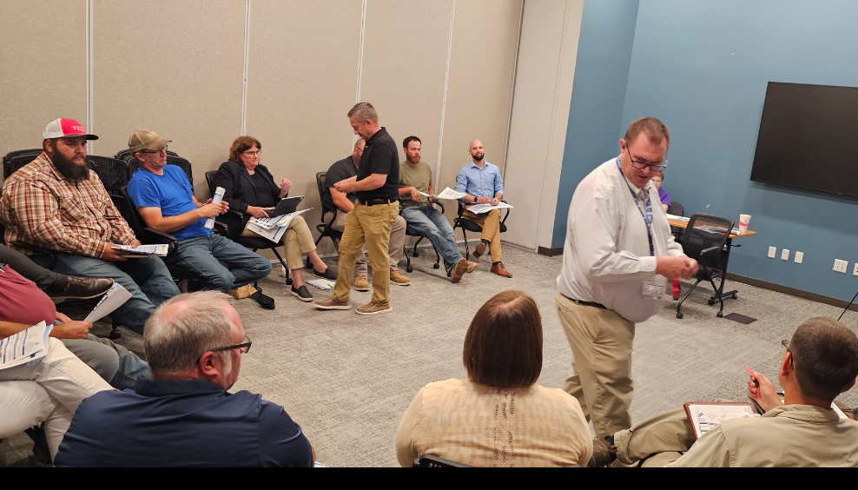
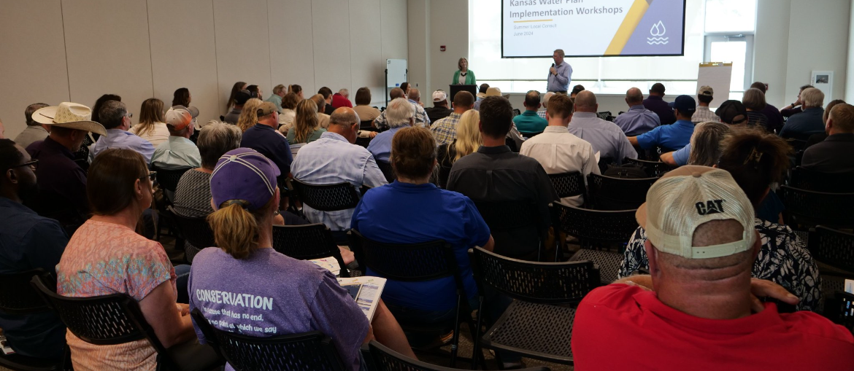
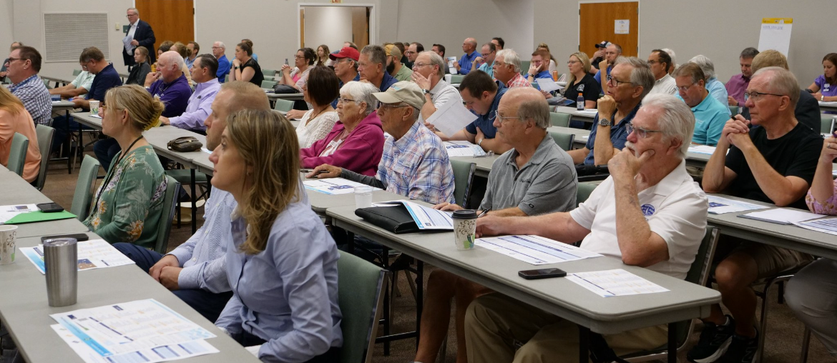
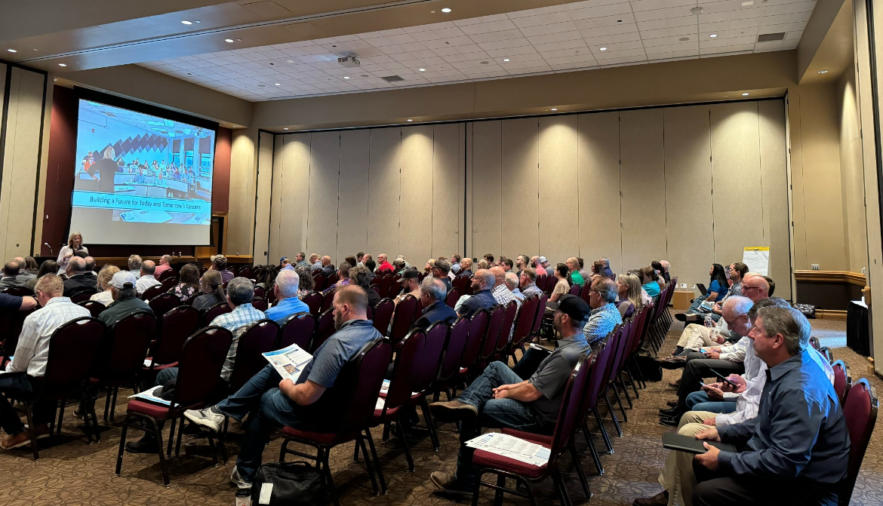
600+ Kansans Provided Input

Slide 3
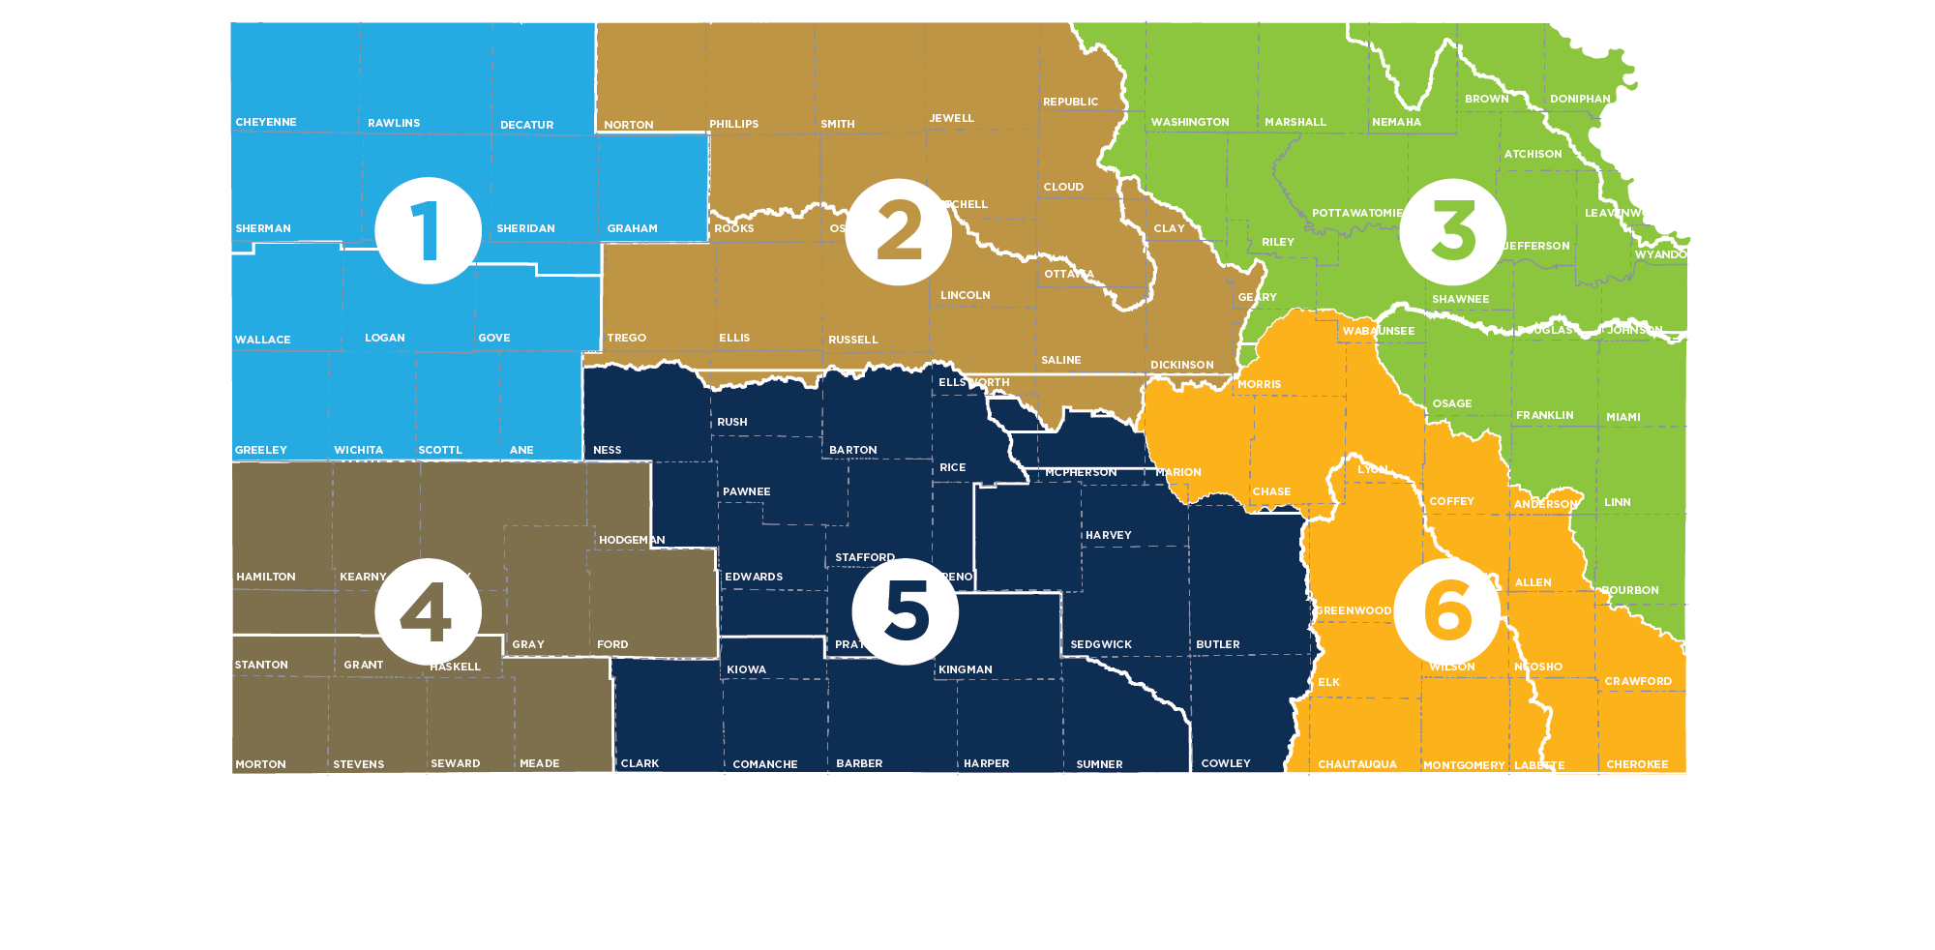
Meeting Participation by Region
55+
80+
150+
Northwest
90+
135+
90+

Slide 4
Summer Local Consult Participants Profile based on 423 RSVPs

Slide 5
Input Sought in These 3 Areas
1
2
3
Regional Goals
Where is there alignment within your region and across the state?
Investment Prioritization
Why do you value investments in one Guiding Principle over another if forced to choose?
Performance
How are we managing water in the state? Where could we improve our programs?

Slide 6
Consensus Overarching Takeaways from Kansans
We have serious water challenges and the time to act is now.
  We have a vision, now is time for implementation.
We are all connected by our water issues, what happens in the western portion of the state impacts the east and vice versa.
We need to streamline state agency water programs and to make them easier to use and more efficient.
Clean, secure, accessible water is an economic necessity.

Slide 7



Takeaways related to the Big 3 Guiding Principles
Aquifer: Strong support for about the need to reach sustainability of High Plains Aquifer by using multiple tools like irrigation technologies, cropping practices, water reuse
Reservoir: Strong support for keeping our reservoir water supplies viable for generations through using in-lake and upstream techniques to reduce sedimentation
Water Quality: Strong support for improving water quality across Kansas by improving our water infrastructure

Slide 8
More discussion needed Round 2 on…
How to ensure water programs are reaching intended water users and stakeholders and are utilized effectively?
Prioritizing investment strategies
Braiding (local, state, federal) funding to leverage dollars further

Slide 9
Investment Scenario with Strongest Support
Aquifer
Tie
Reservoir
Water Quality

Slide 10
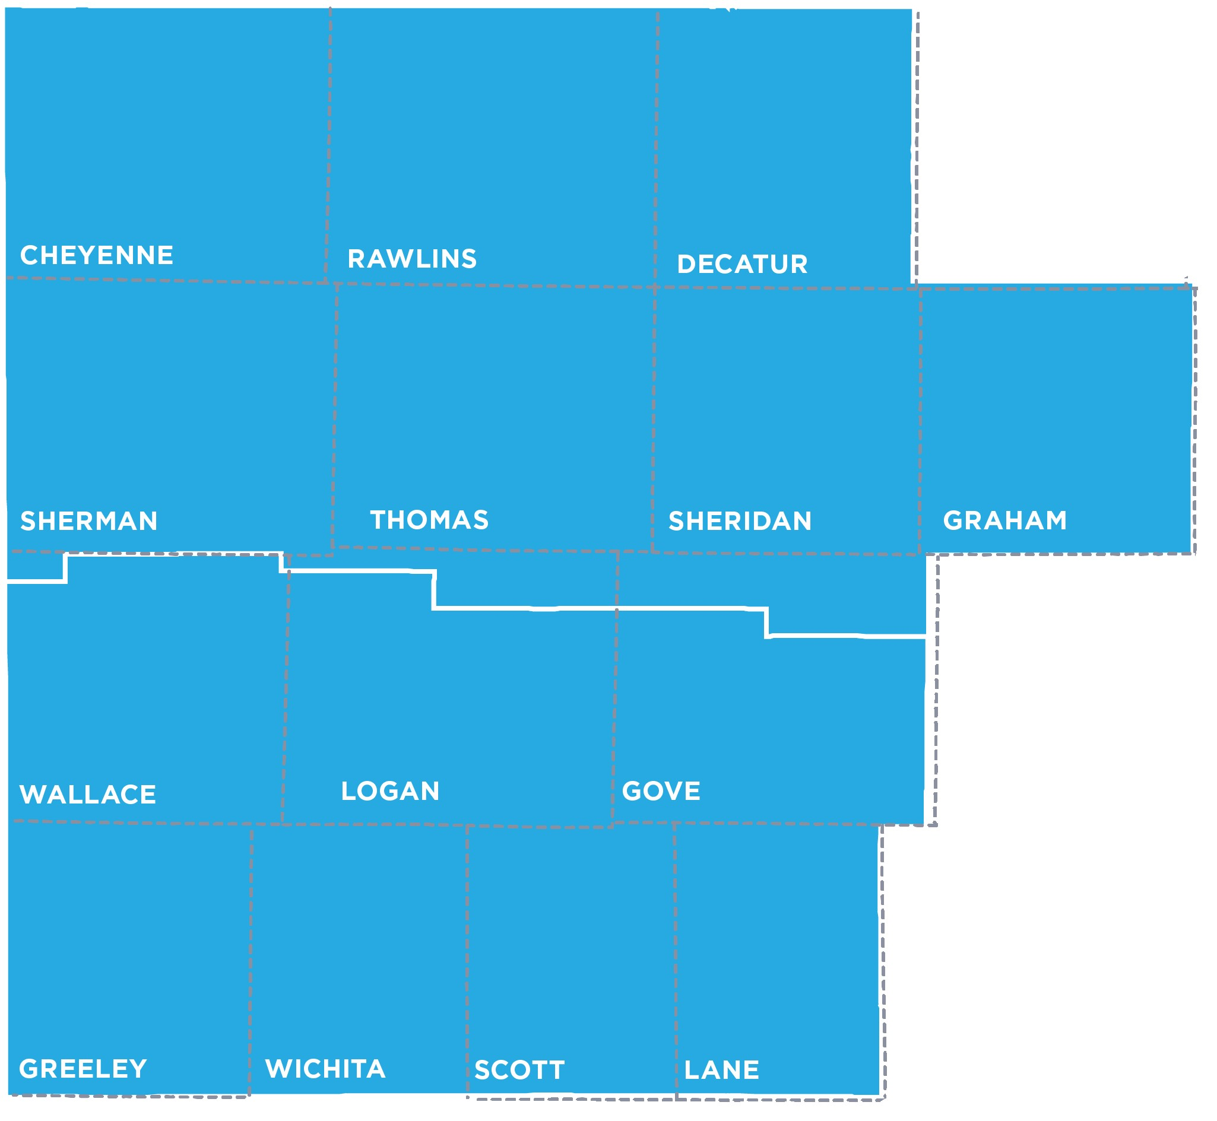
Northwest Region (Colby) Takeaways
Upper Republican RAC
Upper Smokey Hill RAC

Slide 11
Regional Goal Alignment Input
RAC Similarity Score:
3-4
Majority of participants viewed RACs alignments as a three (3) or higher in terms of similarity
All groups suggested adding improving streamflow to the KWA goals with some suggesting more education and outreach

Slide 12
Investment Scenario Input
Majority made game changing investments in Aquifer
  Water Quality received the most red tickets (bonus investment) following discussion
Maintaining local control when developing programs is important
Must increase awareness of the immediate need for reducing usage
Important to emphasize that water conservation is an “everybody problem” and not a “you” problem (i.e., don’t single out farmers).

Slide 13
Investment Scenario Input (continued)
When given the opportunity to use a red ticket, participants gave the following reasons for their choices:
  Belief that using funds on Water Quality and Aquifers would provide the most benefit per dollar spent
  Belief that using funds towards reservoirs would be wasteful in the long-term due to constant sedimentation issues

Slide 14
Programs/Overall Performance
Participants praised:
  Education (modeling and data sharing)
  LEMAs
  Conservation Districts
  HB 2302 Grant Program is good but needs to be smoother
Participants recommend improvements in:
  Maintaining local control on programs
  Educating across all levels (producers and school curriculums)
  Providing more technical assistance opportunities

Slide 15
Other Notable Input
Participants noted a distrust of government as a reason that efforts may not be as effective
Opinions were mixed on whether the State purchasing water rights is a good approach for conserving the aquifer, and some said straight out that purchasing/leasing water rights won’t work.
Concerns were expressed that purchasing water rights will reduce GDP.

Slide 16
Notable Quote
"Leave us alone and let us do it."
- Colby Participant

Slide 17
Discussion Questions for All Meetings
For those that attended a local consult meeting, what stood out to you?
  Did anything surprise you?
What advice or suggestions does your RAC (as one voice) have for the implementation team going forward?
What do you see as the best ways to get the word out in your communities so we can make sure everyone who wants to participate in September local consult is aware of those meetings?

Slide 18
Discussion Questions Specific to Northwest
How do can we persuade people to see conservation as “everyone’s problem?”
What do you see as the tradeoffs of offering an incentive- based approach to water conservation efforts versus regulation?
Why do you think Northwest participants were most likely to want the game-changing investment scenario in the aquifer that relies on the state purchasing water rights if they also want more local control?

Slide 19
Next Steps
Summer Local Consult feedback will inform Fall Local Consult
Fall Local Consult meetings will seek input on
  Possible investment strategies
  Investment levels/cost estimates
  Program/policy changes
RAC review & input
Summer & Fall input will inform the recommendations for the Governor and Legislature

