Slide 1
Marais des Cygnes RAC meeting
May 2, 2023

Slide 3
KWA meetings
January-
Legislative visits
April-
Upper Arkansas RAC message
KCC well plugging

Slide 4
Legislative Update
House Bill 2302
Adjustments to the State Water Plan Fund
Additional $35 million from SGF to SWPF
Transfers $5 million from SWPF to new Water Technical Assistance Fund
Transfers $12 million from SWPF to new Water Projects Grant Fund
Guidelines to KWA when making SWPF budget recommendations

Slide 5
Legislative Update cont.
House Bill 2279
Annual reports to legislature from GMDs
Mostly financial documents…. Income, expenses, audits, assets
Activity descriptions and explanation of how GMD boards are furthering conservation of the groundwater
Requires each GMD to identify priority areas of concern
Report to the Chief Engineer
Action plan for priority areas of concern by July 1, 2026

Slide 6
TMDLs in the Marais des Cygnes Basin
Dane Boring | May 2, 2023

Slide 7
TMDLs in the Marais des Cygnes
1. Define water quality through Water Quality Standards (WQS)
2. Assess available data against the WQS
3. Write TMDL to restore waters from impaired to attaining WQS
What is a TMDL?
Three pollutants and water bodies:
Bacteria in the Marais des Cygnes (near Ottawa)
Eutrophication in Hillsdale Reservoir
Another time: Atrazine in Edgerton City Lake

Slide 8
TMDLs in the Marais des Cygnes
Bacteria in the Marais des Cygnes near Ottawa
Water Quality Standards (WQS) have adopted bacteria criteria to protect recreational uses (fishable and swimmable).
Marais des Cygnes has those uses protected for primary contact (deep enough to swim in).
Originally listed as impaired for fecal coliform bacteria 20+ years ago. TMDL was approved in 2001
Since then, WQS have changed from fecal coliform to E. coli and KSA 82a-2001.

Slide 9
TMDLs in the Marais des Cygnes
Bacteria in the Marais des Cygnes near Ottawa (cont’d)
TMDL states Ottawa’s discharge needs UV disinfection to improve bacteria loadings in the stream.
From 2020 to present, Ottawa has averaged 50 cfus/100 mL for E. coli; criteria is 262 in rec season and 2,358 in non-rec season (in other words, not likely to be cause of impairment).
How about the ambient station?

Slide 10
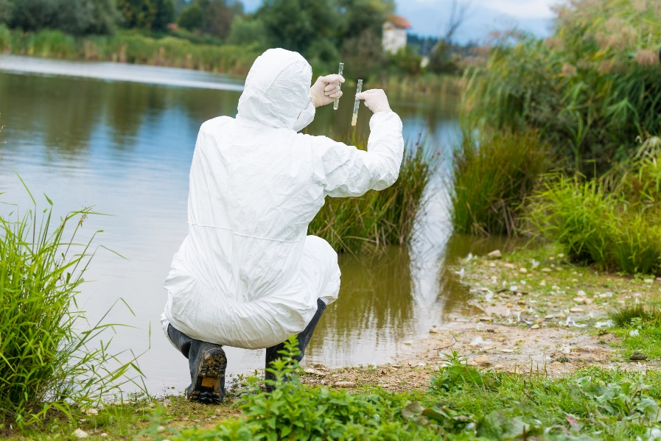
TMDLs in the Marais des Cygnes
Bacteria in the Marais des Cygnes near Ottawa (cont’d)
SC270 designated in the TMDL
Quarterly monitoring for E. coli since 2003
Average value is 879 cfus/100 mL (median is 91.5 and 75th percentile is 283)
Violations suggest still impaired
KSA 82a-2001 constrains making any impairment decisions
Also of note is WRAPS 9-element Plan for Middle Marais des Cygnes

Slide 11
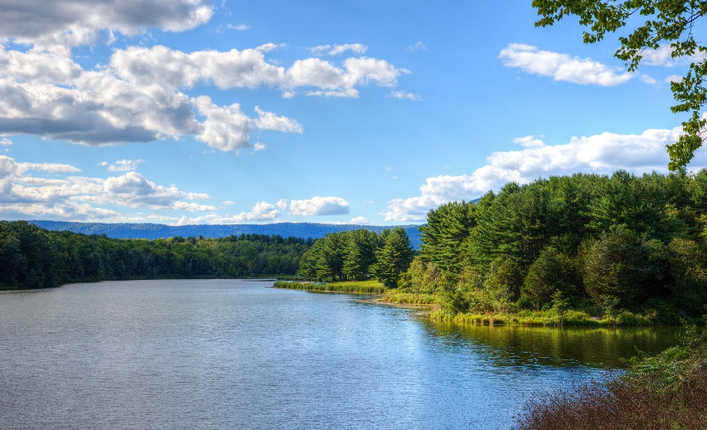
TMDLs in the Marais des Cygnes
Eutrophication in Hillsdale
Hillsdale has been listed for impairment of narrative criteria (“free from”) and a TMDL was written to address Eutrophication (excess nutrients).
The TMDL states all uses impacted to an extent by the eutrophication.

Slide 12
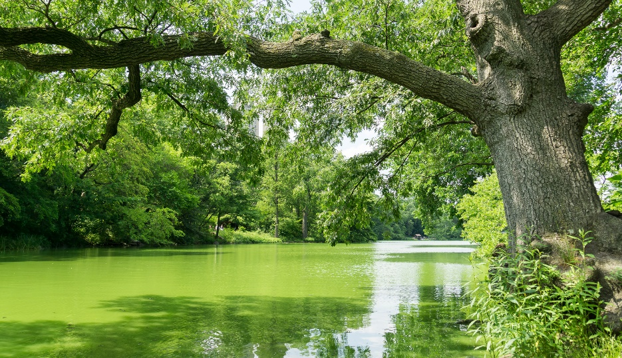
TMDLs in the Marais des Cygnes
Eutrophication in Hillsdale
First TMDL written in 2001, revision done in 2013
Chl-a endpoint of 10 µg/L was chosen for the TMDL; median since 2001 has been 19 µg/L
Sets lbs/day limits from wastewater plants
Normally a concentration like E. coli, but nutrients are about total pounds going into the reservoir
Population of Gardner 2000: 9,800
Population of Gardner 2020: 23,400

Slide 13
TMDLs in the Marais des Cygnes
Eutrophication in Hillsdale (cont’d)
Also of note: WRAPS 9-element for Hillsdale

Slide 14
TMDLs in the Marais des Cygnes
Thank you/Questions

